Slide 1
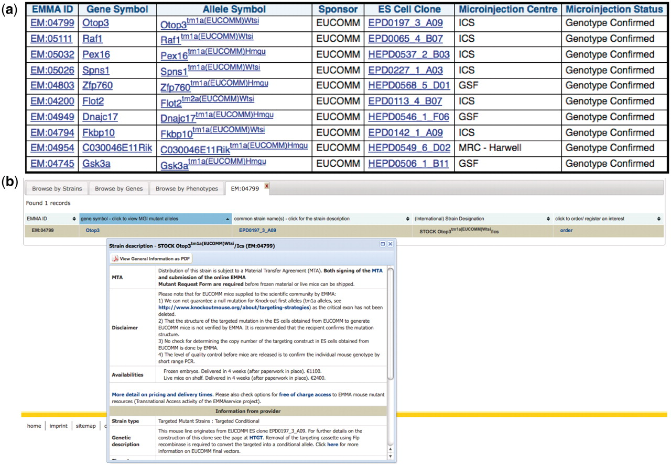
Figure 4. Distributed EMMA lines that have passed Southern blot quality control at a distribution center: (a) results ...
Notes:
Figure 4. Distributed EMMA lines that have passed Southern blot quality control at a distribution center: (a) results of a query involving the dataset from the mouse distribution dataset at the European Mouse Mutant Archive (EMMA) and the IKMC mouse production dataset, (b) further detail of one of the mouse lines at the main EMMA website after linking from one of the above results.
Unless provided in the caption above, the following copyright applies to the content of this slide: © The Author(s) 2011. Published by Oxford University Press.This is Open Access article distributed under the terms of the Creative Commons Attribution Non-Commercial License (http://creativecommons.org/licenses/by-nc/2.5), which permits unrestricted non-commercial use, distribution, and reproduction in any medium, provided the original work is properly cited.

