Slide 1
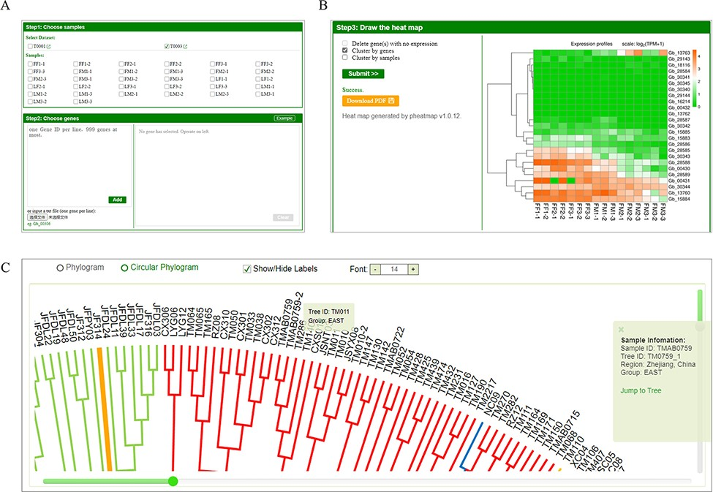
Figure 4. Expression analysis tool and phylogeny of GinkgoDB. Users can select specific sample combinations for the ...
Notes:
Figure 4. Expression analysis tool and phylogeny of GinkgoDB. Users can select specific sample combinations for the traits under study to analyze the expression differences of target genes among different experiments (A), which will be visualized by an expression heatmap, which could be downloaded as PDF(B). (C) The neighbor-joining phylogeny tree of wild individuals. Each sample ID could be clicked and links to the sample information page.
Unless provided in the caption above, the following copyright applies to the content of this slide: © The Author(s) 2022. Published by Oxford University Press.This is an Open Access article distributed under the terms of the Creative Commons Attribution-NonCommercial License (https://creativecommons.org/licenses/by-nc/4.0/), which permits non-commercial re-use, distribution, and reproduction in any medium, provided the original work is properly cited. For commercial re-use, please contact journals.permissions@oup.com

