Slide 1
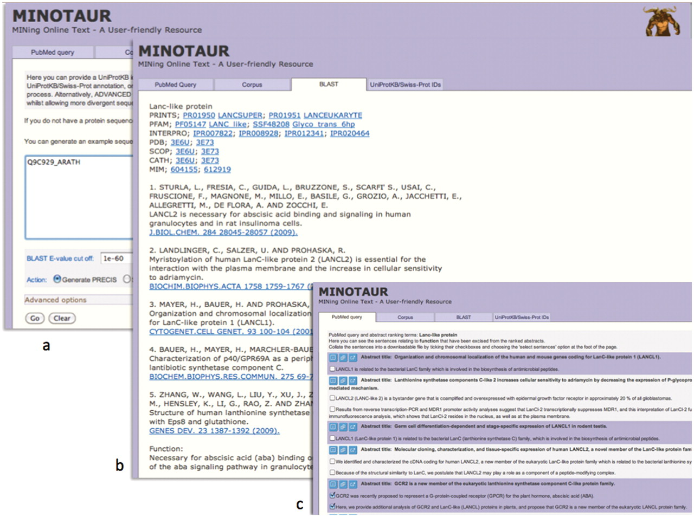
Figure 2. Using the MINOTAUR curator-assistant tool to generate a protein report and extract structure-related ...
Notes:
Figure 2. Using the MINOTAUR curator-assistant tool to generate a protein report and extract structure-related sentences from the literature: (a) shows the BLAST-PRECIS input option, with putative G-protein-coupled receptor, Q9C929_ARATH, as the query sequence; (b) shows the returned PRECIS report from the top 7 BLAST hits, which suggests the sequence really belongs to the LanC-like protein family; (c) selection of relevant sentences from the PubMed query results, confirming that the sequence is unlikely to be a GPCR.
Unless provided in the caption above, the following copyright applies to the content of this slide: © The Author(s) 2012. Published by Oxford University Press.This is an Open Access article distributed under the terms of the Creative Commons Attribution Non-Commercial License (http://creativecommons.org/licenses/by-nc/3.0), which permits unrestricted non-commercial use, distribution, and reproduction in any medium, provided the original work is properly cited.

