Slide 1
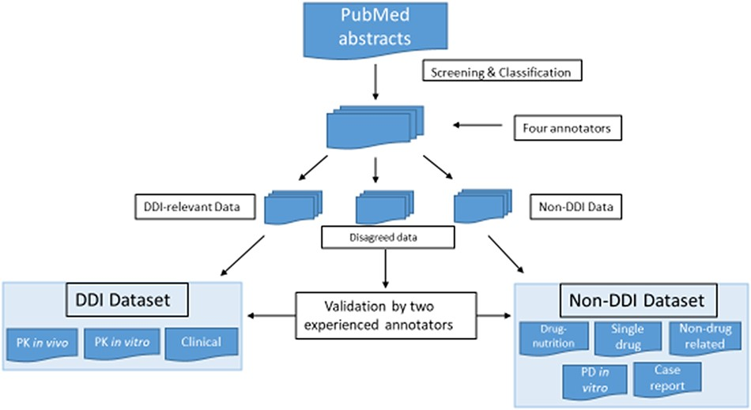
Figure 1. Screening and classification of PubMed abstracts for corpus development. PubMed abstracts were initially ...
Notes:
Figure 1. Screening and classification of PubMed abstracts for corpus development. PubMed abstracts were initially screened by four annotators into DDI-relevant, non-DDI and disagreed data. The four annotators included two experienced ones and two novice ones. The two experienced annotators had drug–interaction research experience, and two novice annotators were new bioinformatics master novices with biology and pharmacology background. All the abstracts were classified by these four annotators independently, and each abstract was labeled by two annotators. The disagreed data were further validated by two experienced annotators.
Unless provided in the caption above, the following copyright applies to the content of this slide: © The Author(s) 2022. Published by Oxford University Press.This is an Open Access article distributed under the terms of the Creative Commons Attribution-NonCommercial License (https://creativecommons.org/licenses/by-nc/4.0/), which permits non-commercial re-use, distribution, and reproduction in any medium, provided the original work is properly cited. For commercial re-use, please contact journals.permissions@oup.com

