Slide 1
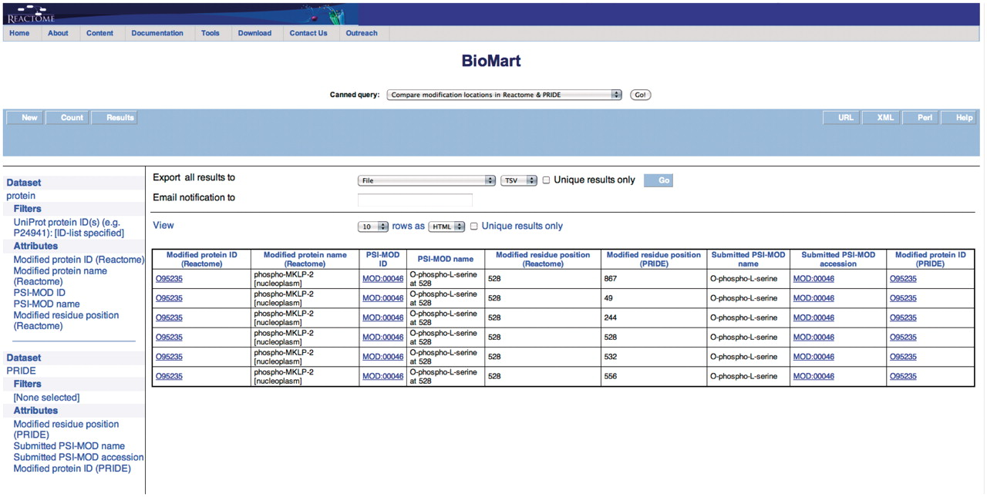
Figure 4. Results of comparing modification locations between Reactome and PRIDE. The modified protein's UniProt ID, ...
Notes:
Figure 4. Results of comparing modification locations between Reactome and PRIDE. The modified protein's UniProt ID, its name, cellular compartment, the modified residue and its residue coordinate from Reactome are reported. PRIDE also reports corresponding details of the protein present in their database i.e. location of modification on protein, PSI-MOD name, ID and the UniProt Accession.
Unless provided in the caption above, the following copyright applies to the content of this slide: © The Author(s) 2011. Published by Oxford University Press.This is Open Access article distributed under the terms of the Creative Commons Attribution Non-Commercial License (http://creativecommons.org/licenses/by-nc/2.5), which permits unrestricted non-commercial use, distribution, and reproduction in any medium, provided the original work is properly cited.

