Slide 1
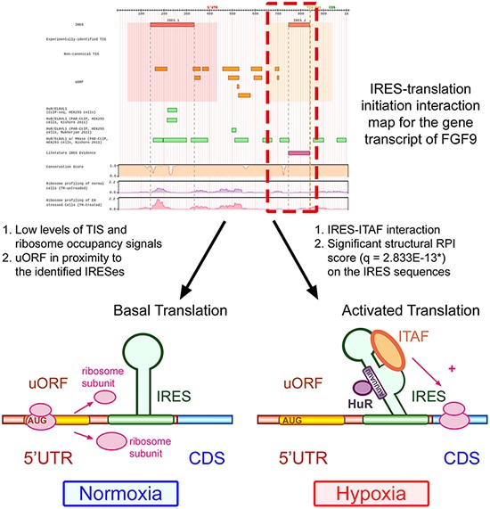
Figure 5. Human IRES Atlas helps suggest testable IRES-mediated translational regulation mechanism hypotheses.
Notes:
Figure 5. Human IRES Atlas helps suggest testable IRES-mediated translational regulation mechanism hypotheses. For the FGF9 5ʹ UTR, the IRES–translation initiation interaction map suggests that (1) the transcript is of low translation level and (2) some regulatory program between the RPI interpretable IRESs, the nearby uORFs and some ITAFs may exist. From experimental literature evidence, we know that the uORF represses FGF9 protein synthesis in normal conditions. Some ITAFs bind to the IRES to start cap-independent translation under hypoxia, verifying the testable hypotheses suggested by the constructed database.
Unless provided in the caption above, the following copyright applies to the content of this slide: © The Author(s) 2021. Published by Oxford University Press.This is an Open Access article distributed under the terms of the Creative Commons Attribution License (http://creativecommons.org/licenses/by/4.0/), which permits unrestricted reuse, distribution, and reproduction in any medium, provided the original work is properly cited.

