Slide 1
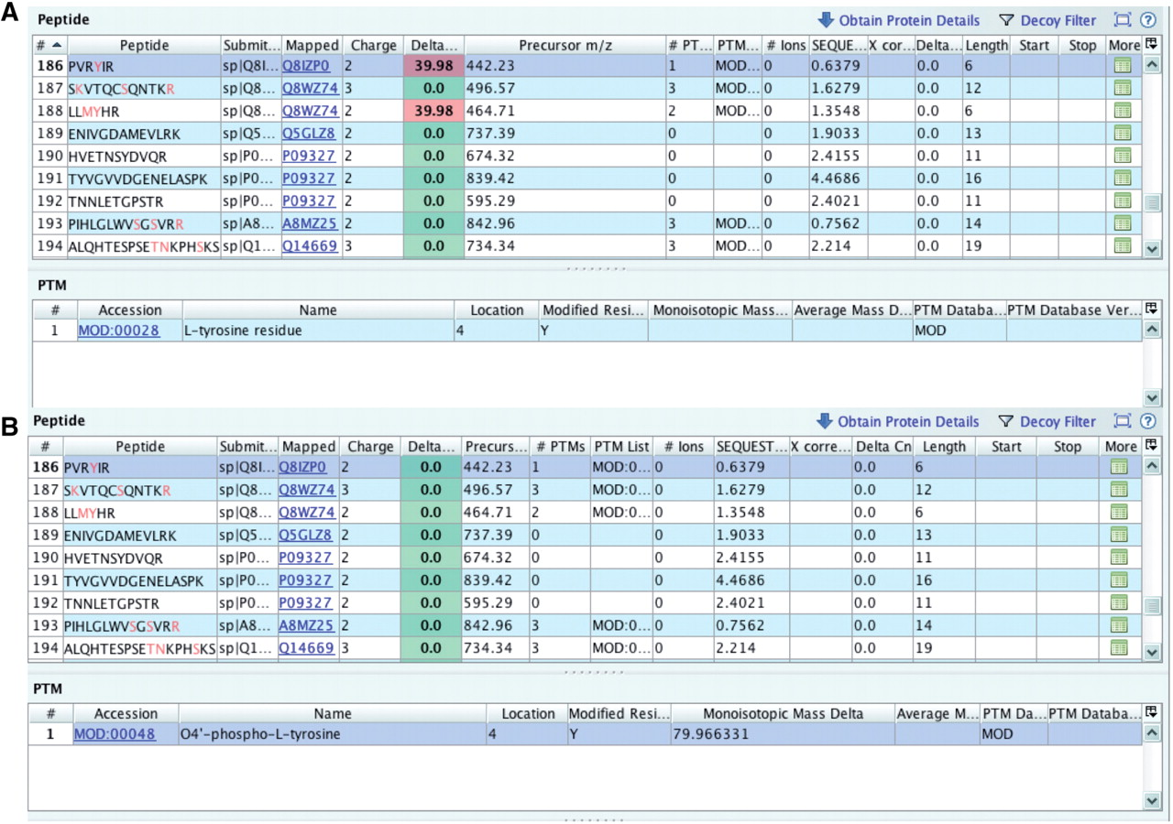
Figure 5. Checking delta m/z values with PRIDE Inspector peptide view: Example 1: misreported modification (A) outlier ...
Notes:
Figure 5. Checking delta m/z values with PRIDE Inspector peptide view: Example 1: misreported modification (A) outlier delta m/z value highlighted in red indicates a potential problem with the assigned protein modification. (B) protein modification replaced with the proper PSI-MOD term with a delta mass that gives an expected delta m/z value.
Unless provided in the caption above, the following copyright applies to the content of this slide: © The Author(s) 2012. Published by Oxford University Press.This is an Open Access article distributed under the terms of the Creative Commons Attribution Non-Commercial License (http://creativecommons.org/licenses/by-nc/3.0), which permits unrestricted non-commercial use, distribution, and reproduction in any medium, provided the original work is properly cited.

