Slide 1
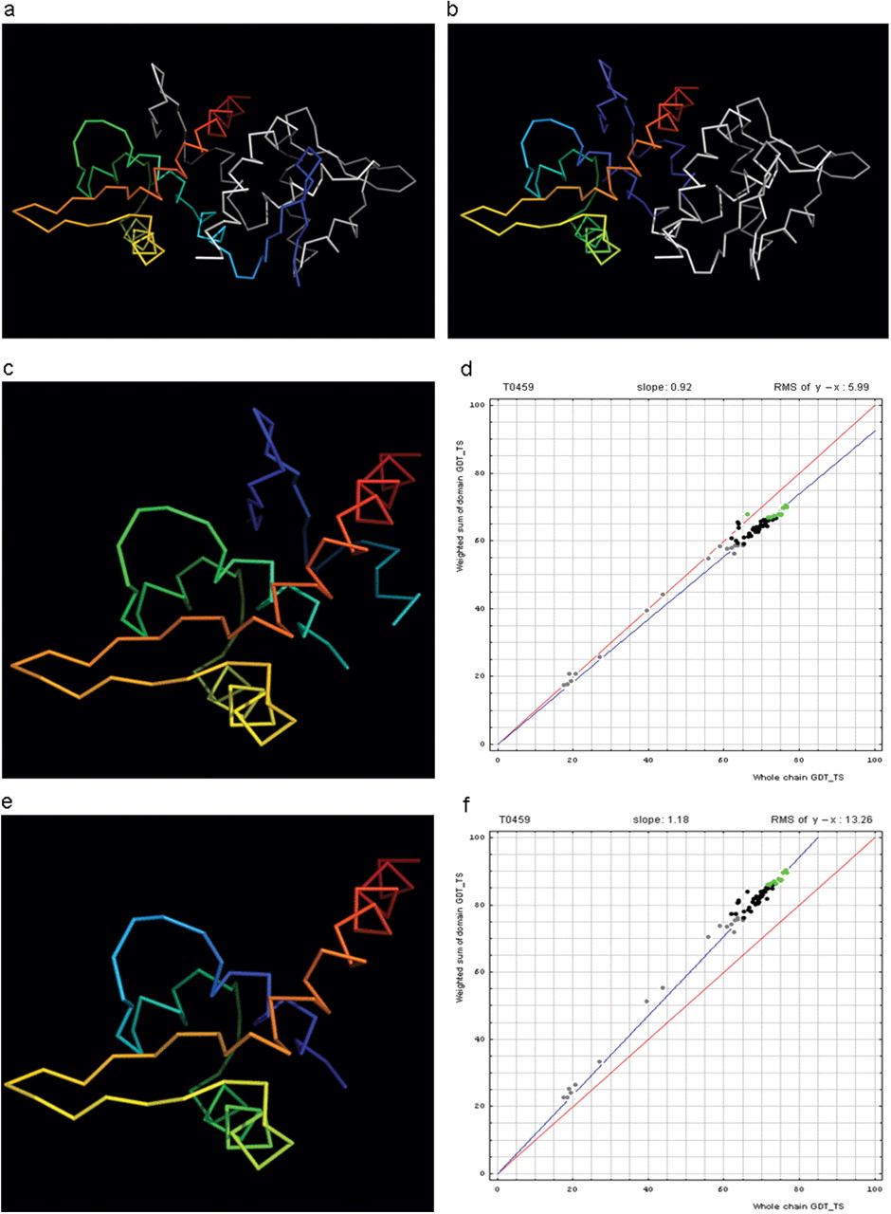
Figure 2. Domain swap example (a) T0459 chain A (rainbow) with its symmetry mate (white). (b) T0459 chain A with a ...
Notes:
Figure 2. Domain swap example (a) T0459 chain A (rainbow) with its symmetry mate (white). (b) T0459 chain A with a swapped N-terminal β-hairpin from its symmetry mate chain (rainbow) and the swapped hairpin symmetry mate chain (white). (c) Domain-swapped T0459 with chain B: 2–22 plus chain A: 23–106. (d) Correlation between GDT-TS scores for T0459 domain-based evaluation with a swapped domain (y, vertical axis) and whole-chain GDT-TS (x, horizontal axis). (e) T0459 with domain-swapped segment removed: chain A: 23–106. (f) Correlation between GDT-TS scores for T0459 domain-based evaluation with N-terminal segment removed (just A: 23–106, y, vertical axis) and whole-chain GDT-TS (x, horizontal axis).
Unless provided in the caption above, the following copyright applies to the content of this slide: © 2009 The Author(s).This is Open Access article distributed under the terms of the Creative Commons Attribution Non-Commercial License (http://creativecommons.org/licenses/by-nc/2.0/uk/) which permits unrestricted non-commercial use, distribution, and reproduction in any medium, provided the original work is properly cited.

