Slide 1
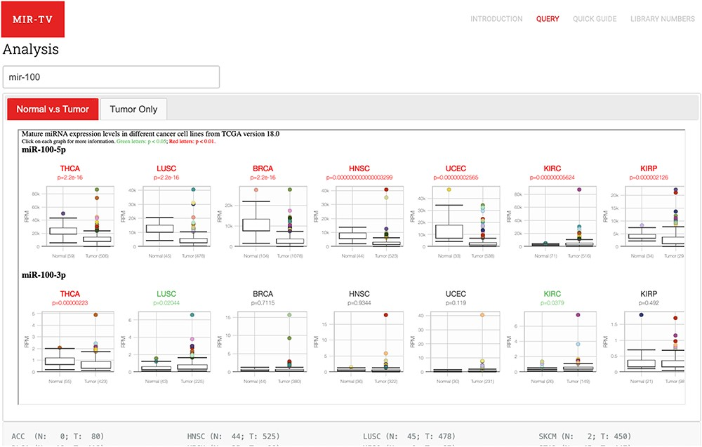
Figure 2 User query interface of miR-TV. First, users must enter the miRNA gene name in the query field. Once the ...
Notes:
Figure 2 User query interface of miR-TV. First, users must enter the miRNA gene name in the query field. Once the miRNA is selected, both 5p- and 3p-arm expression box plot graphs of the selected miRNA in different cancer types are displayed in the main working window, and users can browse through their expression patterns by scrolling to the right side. Red labels indicate cancer tissues with a P-value < 0.01, and green labels indicate those with a P-value < 0.05. Several cancer types contain only tumor tissue samples (i.e. no normal counterparts); therefore, they are listed in the Tumor Only tab page.
Unless provided in the caption above, the following copyright applies to the content of this slide: © The Author(s) 2020. Published by Oxford University Press. All rights reserved. For Permissions, please email: journals.permissions@oup.comThis is an Open Access article distributed under the terms of the Creative Commons Attribution License (http://creativecommons.org/licenses/by/4.0/), which permits unrestricted reuse, distribution, and reproduction in any medium, provided the original work is properly cited.

