Slide 1
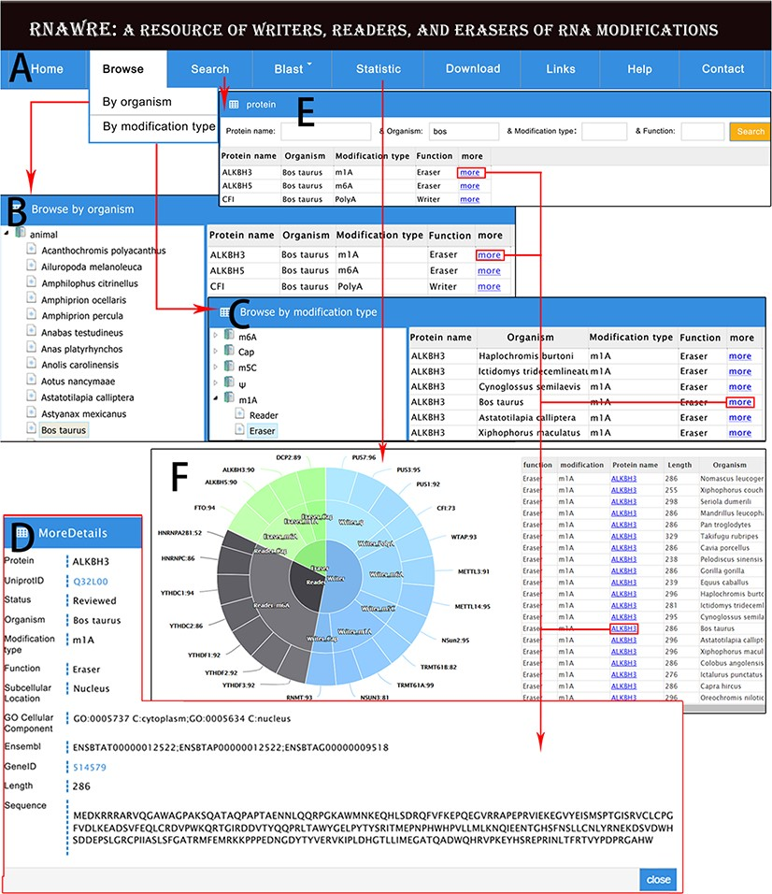
Figure 3 Web interface and usage of RNAWRE. (A) Home page. (B) Browse page by organism. (C) Browse page by ...
Notes:
Figure 3 Web interface and usage of RNAWRE. (A) Home page. (B) Browse page by organism. (C) Browse page by modification type. (D) The detail page of RNA modification protein. (E) The search page of RNAWRE. (F) The statistical page.
Unless provided in the caption above, the following copyright applies to the content of this slide: © The Author(s) 2020. Published by Oxford University Press.This is an Open Access article distributed under the terms of the Creative Commons Attribution License (http://creativecommons.org/licenses/by/4.0/), which permits unrestricted reuse, distribution, and reproduction in any medium, provided the original work is properly cited.

