Slide 1
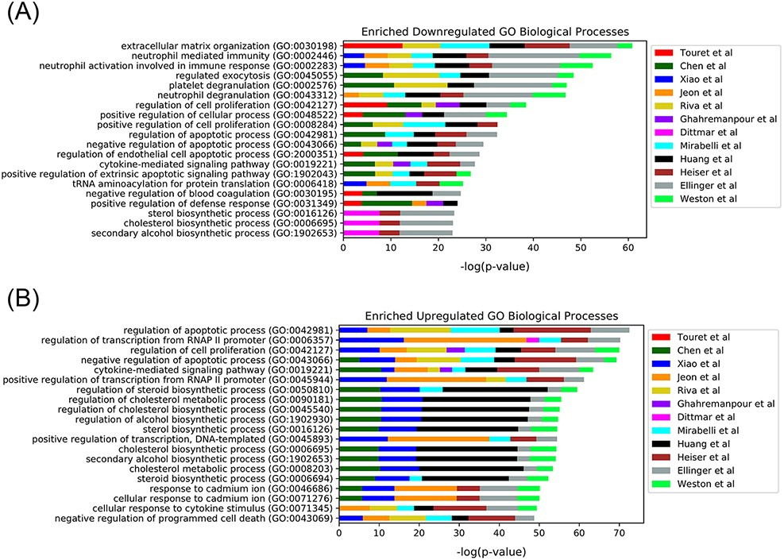
Figure 4. Top 20 enriched GO Biological Processes terms for the 12 in vitro SARS-CoV-2 drug screens. Enriched terms ...
Notes:
Figure 4. Top 20 enriched GO Biological Processes terms for the 12 in vitro SARS-CoV-2 drug screens. Enriched terms are ranked by the sum of the −log(P-value) of the term across all screens. The enriched terms are applied to the consensus downregulated (A) and upregulated (B) genes for each drug in each set based on the data provided from L1000FWD (29).
Unless provided in the caption above, the following copyright applies to the content of this slide: © The Author(s) 2021. Published by Oxford University Press.This is an Open Access article distributed under the terms of the Creative Commons Attribution License (http://creativecommons.org/licenses/by/4.0/), which permits unrestricted reuse, distribution, and reproduction in any medium, provided the original work is properly cited.

