Slide 1
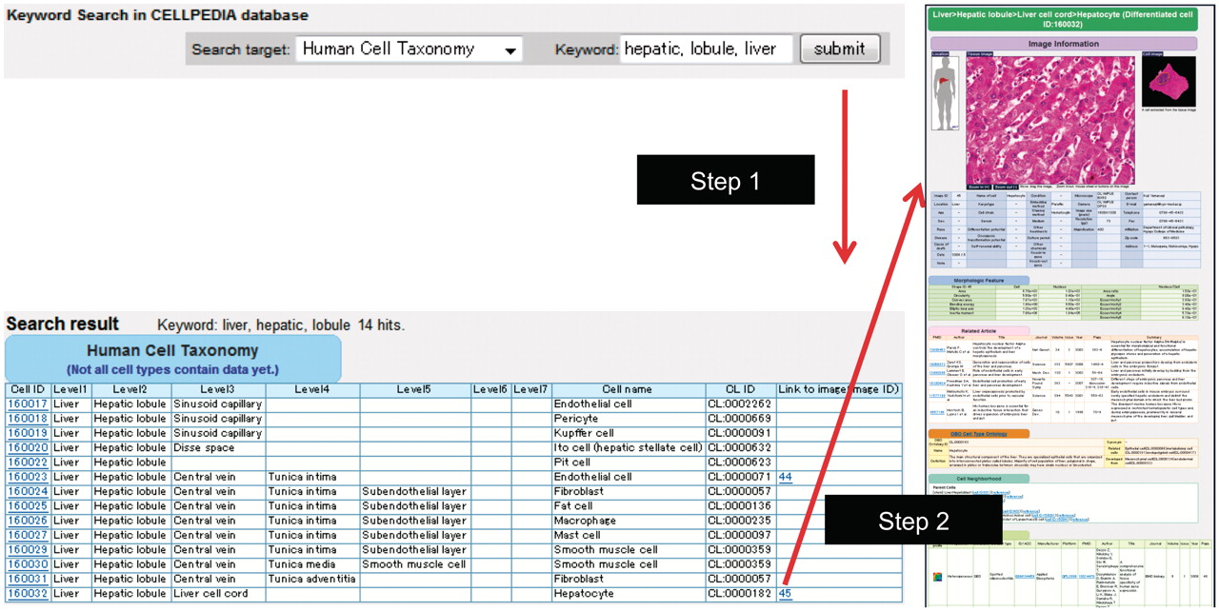
Figure 1. Example of keyword search and integrated page of hepatocyte (differentiated cell ID: 160032). (a) Retrieval ...
Notes:
Figure 1. Example of keyword search and integrated page of hepatocyte (differentiated cell ID: 160032). (a) Retrieval of cell taxonomy entries by keyword search (keywords: hepatic, lobule, liver) is shown (Step 1). Clicking on an image ID in the cell taxonomy page will lead to the integrated page (Step 2). The integrated page is composed of three types of primary data: (b) digital images of cells (and tissues); (c) gene expression data; and (d) journal articles. Additional secondary information is also provided, including (b) image parameters regarding cell shape (table of morphologic features); (e) the OBO Cell Type Ontology; and (f) cell differentiation neighborhood links.
Unless provided in the caption above, the following copyright applies to the content of this slide: © The Author(s) 2011. Published by Oxford University Press.This is Open Access article distributed under the terms of the Creative Commons Attribution Non-Commercial License (http://creativecommons.org/licenses/by-nc/2.5), which permits unrestricted non-commercial use, distribution, and reproduction in any medium, provided the original work is properly cited.

Slide 2
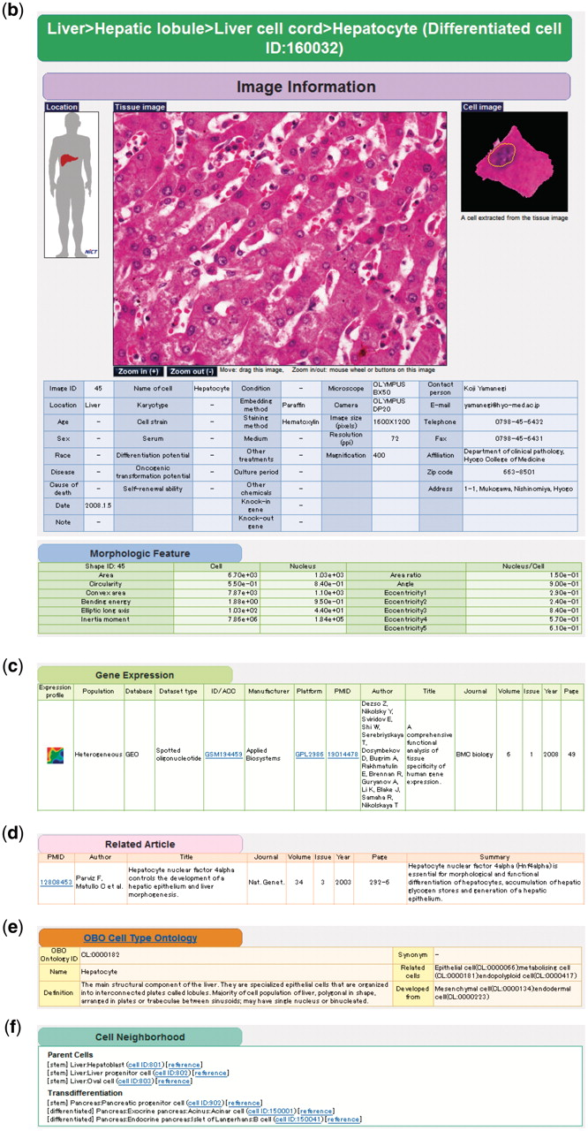
Figure 1. Example of keyword search and integrated page of hepatocyte (differentiated cell ID: 160032). (a) Retrieval ...
Notes:
Figure 1. Example of keyword search and integrated page of hepatocyte (differentiated cell ID: 160032). (a) Retrieval of cell taxonomy entries by keyword search (keywords: hepatic, lobule, liver) is shown (Step 1). Clicking on an image ID in the cell taxonomy page will lead to the integrated page (Step 2). The integrated page is composed of three types of primary data: (b) digital images of cells (and tissues); (c) gene expression data; and (d) journal articles. Additional secondary information is also provided, including (b) image parameters regarding cell shape (table of morphologic features); (e) the OBO Cell Type Ontology; and (f) cell differentiation neighborhood links.
Unless provided in the caption above, the following copyright applies to the content of this slide: © The Author(s) 2011. Published by Oxford University Press.This is Open Access article distributed under the terms of the Creative Commons Attribution Non-Commercial License (http://creativecommons.org/licenses/by-nc/2.5), which permits unrestricted non-commercial use, distribution, and reproduction in any medium, provided the original work is properly cited.

Slide 3
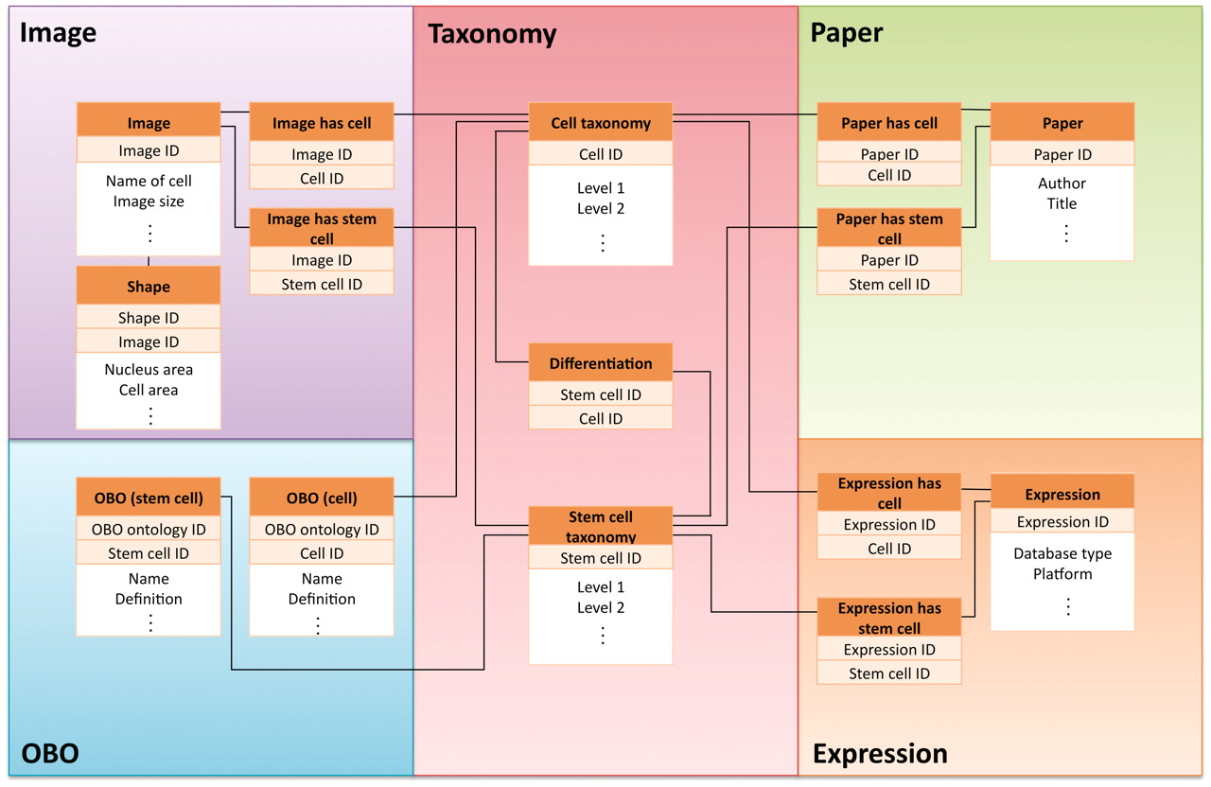
Figure 2. Simplified view of database schema used in CELLPEDIA. The database schema is designed so that as many as 15 ...
Notes:
Figure 2. Simplified view of database schema used in CELLPEDIA. The database schema is designed so that as many as 15 tables in the database can be interconnected by the backbone of the cell taxonomy keys (differentiated cell ID or stem cell ID) and other branch group keys.
Unless provided in the caption above, the following copyright applies to the content of this slide: © The Author(s) 2011. Published by Oxford University Press.This is Open Access article distributed under the terms of the Creative Commons Attribution Non-Commercial License (http://creativecommons.org/licenses/by-nc/2.5), which permits unrestricted non-commercial use, distribution, and reproduction in any medium, provided the original work is properly cited.

Slide 4
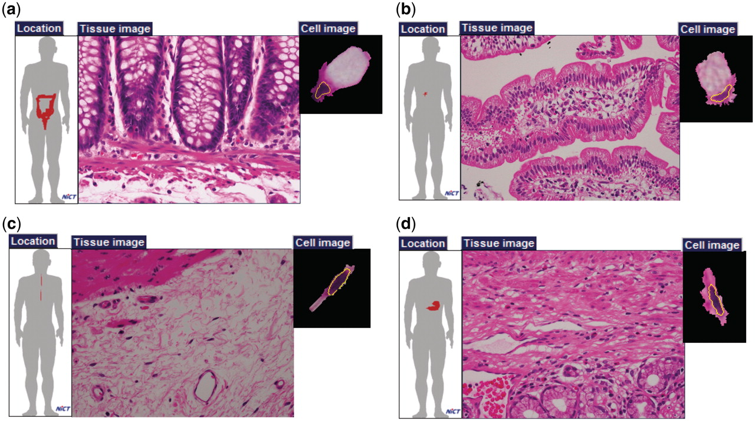
Figure 3. Examples of cells with the same names. Goblet cells of (a) large intestine and (b) small intestine; and ...
Notes:
Figure 3. Examples of cells with the same names. Goblet cells of (a) large intestine and (b) small intestine; and fibroblasts of (c) esophageal submucosa and (d) pylorus.
Unless provided in the caption above, the following copyright applies to the content of this slide: © The Author(s) 2011. Published by Oxford University Press.This is Open Access article distributed under the terms of the Creative Commons Attribution Non-Commercial License (http://creativecommons.org/licenses/by-nc/2.5), which permits unrestricted non-commercial use, distribution, and reproduction in any medium, provided the original work is properly cited.

Slide 5
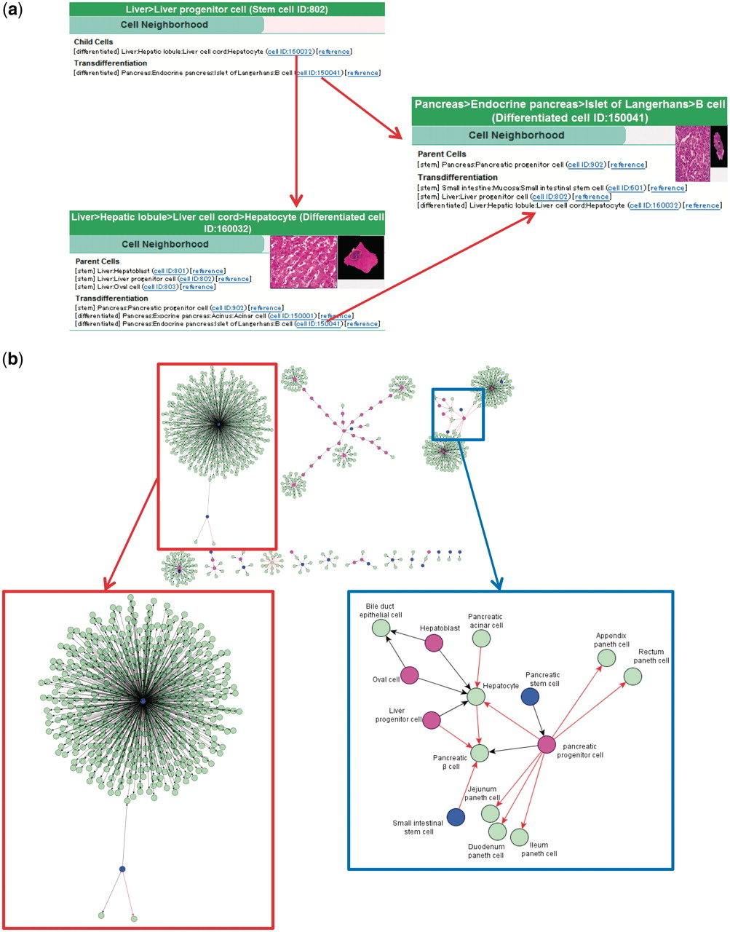
Figure 4. Cell neighborhood links. (a) Cell neighborhood links with the hepatocyte: cell differentiation or ...
Notes:
Figure 4. Cell neighborhood links. (a) Cell neighborhood links with the hepatocyte: cell differentiation or transdifferentiation pathways can be deductively traced. (b) Cell differentiation map constructed with 934 collected binary relationships. Circles filled with different colors indicate levels of differentiated cells (blue: stem cells, wine red: progenitor cells and light green: differentiated cells). Black and red arrows indicate differentiation and transdifferentiation pathways, respectively. The red box shows the mesenchymal stem cell cluster in a magnified view. The blue box shows a part of the endoderm cluster in a magnified view.
Unless provided in the caption above, the following copyright applies to the content of this slide: © The Author(s) 2011. Published by Oxford University Press.This is Open Access article distributed under the terms of the Creative Commons Attribution Non-Commercial License (http://creativecommons.org/licenses/by-nc/2.5), which permits unrestricted non-commercial use, distribution, and reproduction in any medium, provided the original work is properly cited.

