Slide 1
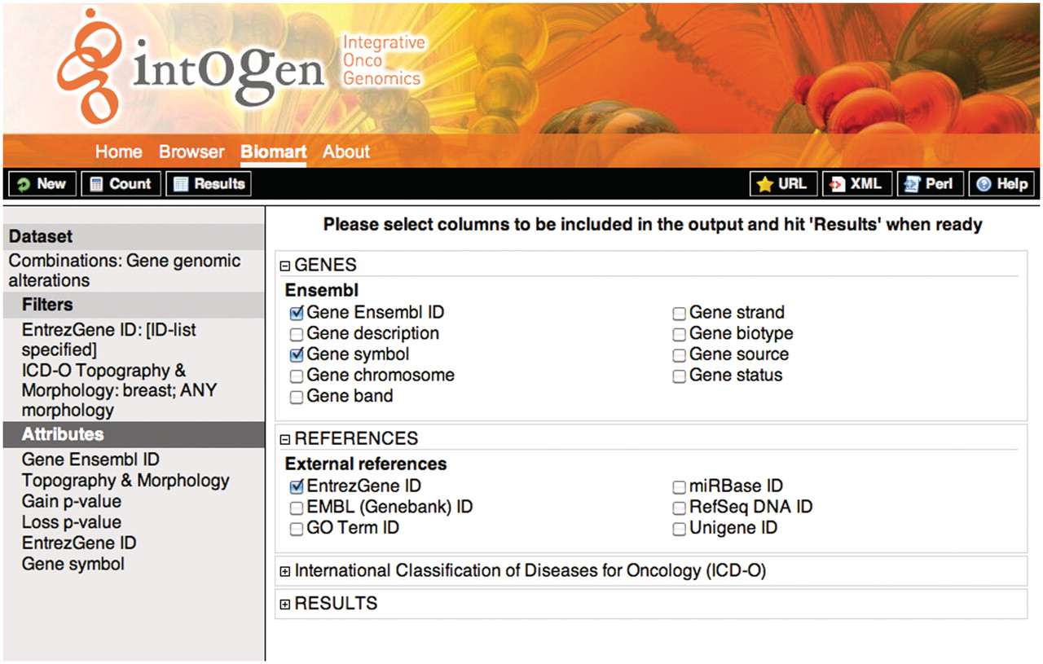
Figure 3. Screenshot showing the attribute selection for the query 1. On the left, the selected dataset, filters and ...
Notes:
Figure 3. Screenshot showing the attribute selection for the query 1. On the left, the selected dataset, filters and attributes are shown. On the right the detailed attributes selection view. To retrieve the results the user should click on the ‘Results’ button on the upper-left black bar, the ‘Count’ button gives the number of rows that match the query and the ‘New’ button allows to start a new query.
Unless provided in the caption above, the following copyright applies to the content of this slide: © The Author(s) 2011. Published by Oxford University Press.This is Open Access article distributed under the terms of the Creative Commons Attribution Non-Commercial License (http://creativecommons.org/licenses/by-nc/2.5), which permits unrestricted non-commercial use, distribution, and reproduction in any medium, provided the original work is properly cited.

