Slide 1
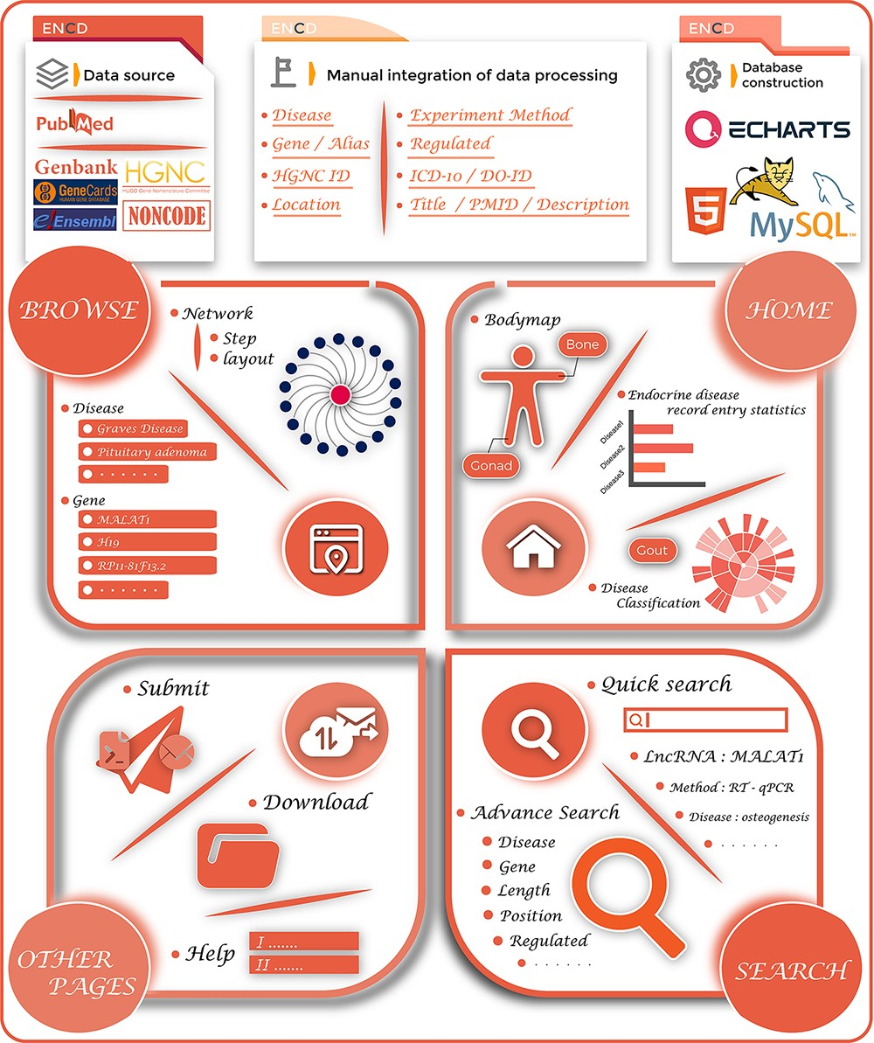
Figure 1. The overview of the ENCD database. The top panel illustrates the building process of ENCD, including the data ...
Notes:
Figure 1. The overview of the ENCD database. The top panel illustrates the building process of ENCD, including the data source, data mining pipeline and database construction. The bottom panel illustrates the functions and interfaces of ENCD. The HOME interface provides a bodymap and statistics of data. The BROWSE and SEARCH interfaces provide different functions to query data from ENCD. The Submit, Download and Help interfaces are shown as OTHER PAGES.
Unless provided in the caption above, the following copyright applies to the content of this slide: © The Author(s) 2023. Published by Oxford University Press.This is an Open Access article distributed under the terms of the Creative Commons Attribution License (https://creativecommons.org/licenses/by/4.0/), which permits unrestricted reuse, distribution, and reproduction in any medium, provided the original work is properly cited.

Slide 2
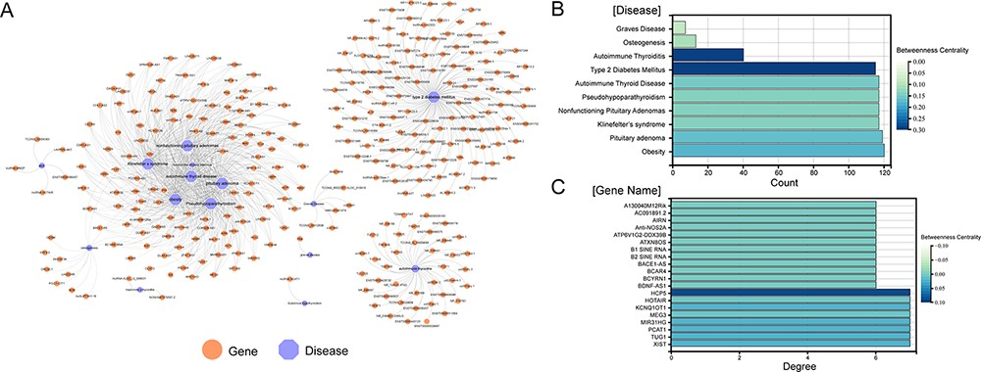
Figure 2. Visualization of all gene-disease associations in ENCD. (A) A network diagram constructed for all ...
Notes:
Figure 2. Visualization of all gene-disease associations in ENCD. (A) A network diagram constructed for all gene-diseases in ENCD, showing all disease and gene names in ENCD. (B) The betweenness centrality of endocrine diseases in the network. (C) The betweenness centrality of lncRNAs in the network.
Unless provided in the caption above, the following copyright applies to the content of this slide: © The Author(s) 2023. Published by Oxford University Press.This is an Open Access article distributed under the terms of the Creative Commons Attribution License (https://creativecommons.org/licenses/by/4.0/), which permits unrestricted reuse, distribution, and reproduction in any medium, provided the original work is properly cited.

Slide 3
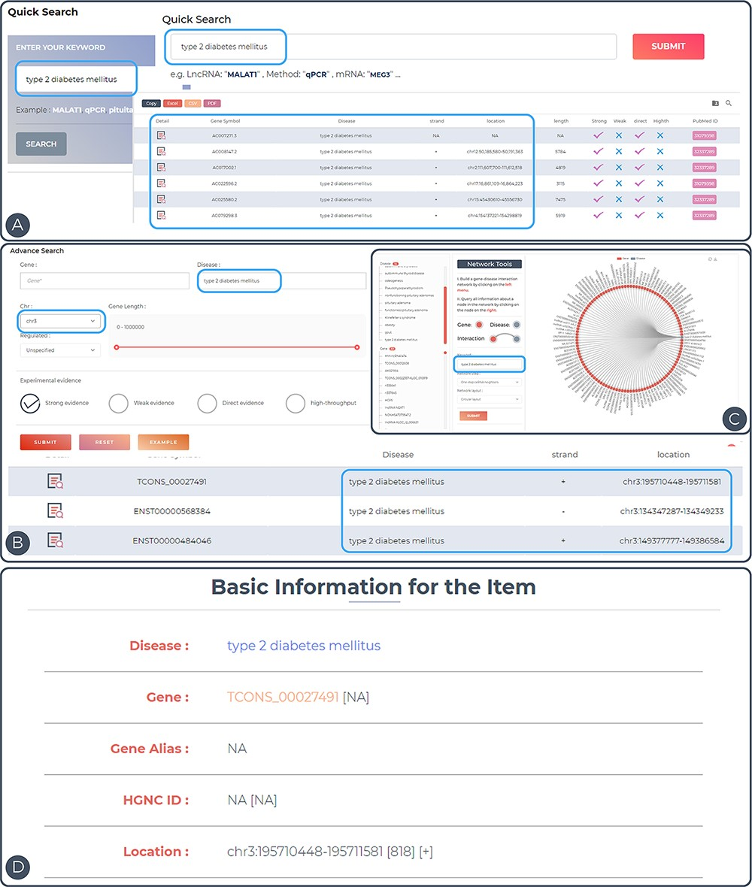
Figure 3. Features and utilities of ENCD. (A) A single keyword search and the corresponding results presentation using ...
Notes:
Figure 3. Features and utilities of ENCD. (A) A single keyword search and the corresponding results presentation using a quick query. (B) A multi-criteria search and display of results using an advanced query. (C) Browsing the web based on keywords in the interface. (D) Detailed display of query entries.
Unless provided in the caption above, the following copyright applies to the content of this slide: © The Author(s) 2023. Published by Oxford University Press.This is an Open Access article distributed under the terms of the Creative Commons Attribution License (https://creativecommons.org/licenses/by/4.0/), which permits unrestricted reuse, distribution, and reproduction in any medium, provided the original work is properly cited.

