Slide 1
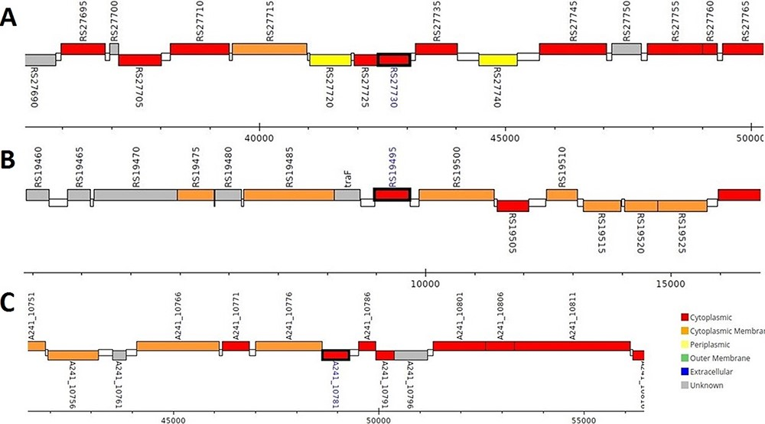
Figure 2. Genomic analysis of β-CA sequences from putative contaminants associated with Pseudomonas spp. The analysis ...
Notes:
Figure 2. Genomic analysis of β-CA sequences from putative contaminants associated with Pseudomonas spp. The analysis shows the presence of coding genes for β-CA from (A) Pseudomonas sp. (UniProt ID: A0A0Q8Y2C1), (B) Pseudomonas sp. LP_8_YM (UniProt ID: A0A4R3W4C9) and (C) Pseudomonas syringae pv. actinidiae ICMP 19096 (UniProt ID: A0A656JXK1).
Unless provided in the caption above, the following copyright applies to the content of this slide: © The Author(s) 2021. Published by Oxford University Press.This is an Open Access article distributed under the terms of the Creative Commons Attribution License (http://creativecommons.org/licenses/by/4.0/), which permits unrestricted reuse, distribution, and reproduction in any medium, provided the original work is properly cited.

