Slide 1
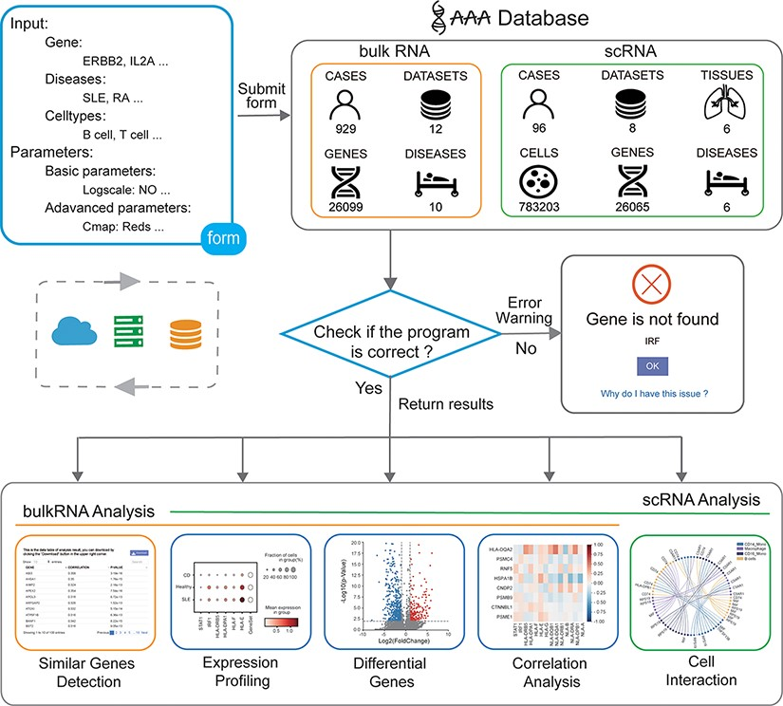
Figure 1. Overview of the IAAA database. The user can submit a custom form; the background obtains data from the ...
Notes:
Figure 1. Overview of the IAAA database. The user can submit a custom form; the background obtains data from the database according to the form and finally checks whether the program performs the analysis function correctly. Returns the result of the analysis upon success and returns an error warning in the event of failure.
Unless provided in the caption above, the following copyright applies to the content of this slide: © The Author(s) 2022. Published by Oxford University Press.This is an Open Access article distributed under the terms of the Creative Commons Attribution-NonCommercial License (https://creativecommons.org/licenses/by-nc/4.0/), which permits non-commercial re-use, distribution, and reproduction in any medium, provided the original work is properly cited. For commercial re-use, please contact journals.permissions@oup.com

