Slide 1
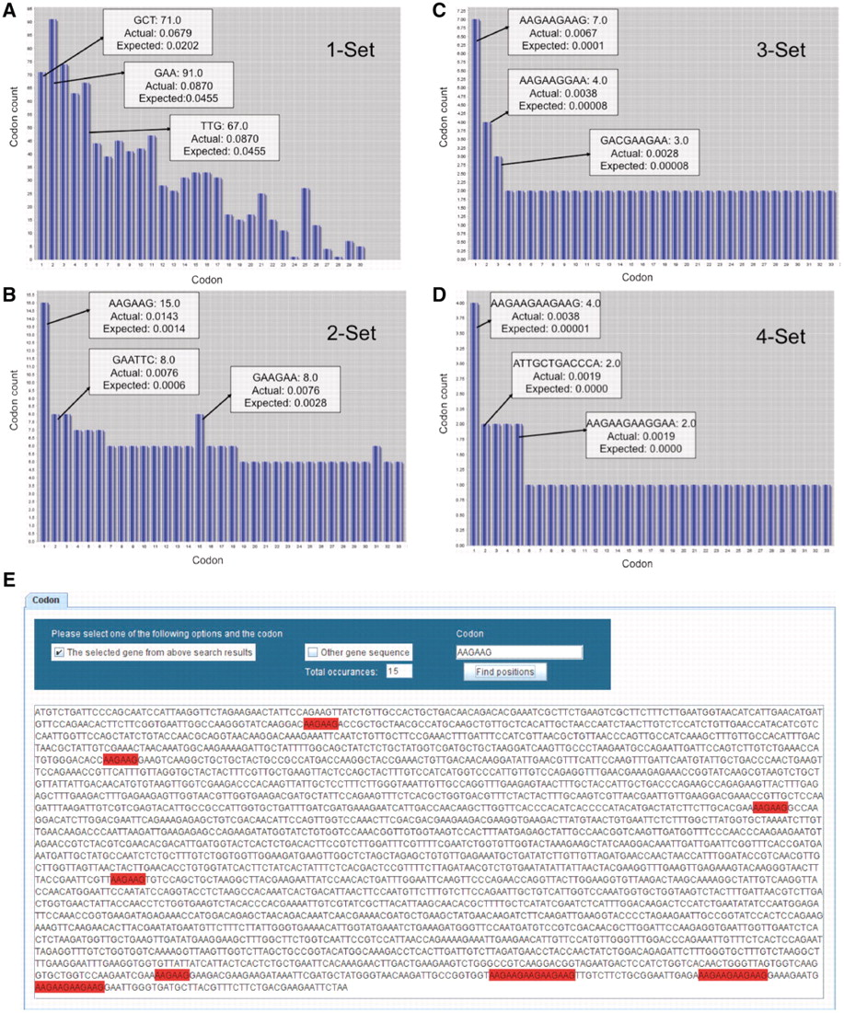
Figure 2 GSCC visual output demonstrating codon combinations in YEF3. Bar graphs (A–D) of single, double, triple, and ...
Notes:
Figure 2 GSCC visual output demonstrating codon combinations in YEF3. Bar graphs (A–D) of single, double, triple, and quadruple codon combinations in the YEF3 gene, respectively. Each bar represents a codon. When the user places the mouse pointer over the each bar (codon) in GSCC, it shows the quantitated values of the codon. In all the graphs, the bars are sorted in the descending order of (actual–expected frequency). Codon painting (E) takes user input information, consisting of individual codons or codon runs, and highlights these occurrences in the gene sequence.
Unless provided in the caption above, the following copyright applies to the content of this slide: © The Author(s) 2012. Published by Oxford University Press.This is an Open Access article distributed under the terms of the Creative Commons Attribution Non-Commercial License (http://creativecommons.org/licenses/by-nc/3.0), which permits unrestricted non-commercial use, distribution, and reproduction in any medium, provided the original work is properly cited.

