Slide 1
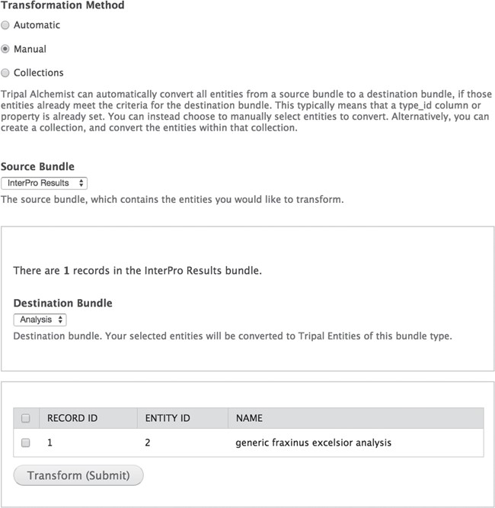
Figure 1 The Tripal Alchemist administrator tool. The Tripal Alchemist administrator interface. To convert entities, ...
Notes:
Figure 1 The Tripal Alchemist administrator tool. The Tripal Alchemist administrator interface. To convert entities, the administrator must first select a transformation method (top). In this example, choosing the manual method allows conversion of selected entities from a source type to a destination type (middle). The available source entities are then presented in a table (bottom), which the user can select from and submit.
Unless provided in the caption above, the following copyright applies to the content of this slide: © The Author(s) 2018. Published by Oxford University Press.This is an Open Access article distributed under the terms of the Creative Commons Attribution License (http://creativecommons.org/licenses/by/4.0/), which permits unrestricted reuse, distribution, and reproduction in any medium, provided the original work is properly cited.

