Slide 1
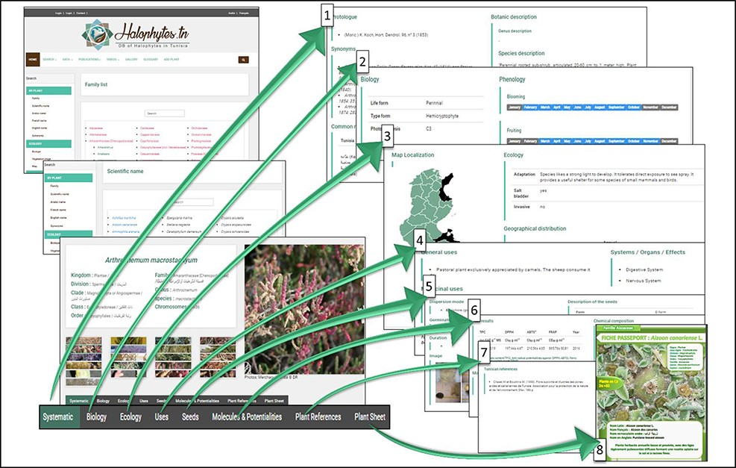
Figure 9. Organization of the different webpages related to each species: 1: systematic information and botanic ...
Notes:
Figure 9. Organization of the different webpages related to each species: 1: systematic information and botanic description; 2: biological data and phenology; 3: ecological data and geographical distribution; 4: general and medicinal uses; 5: seeds data; 6: molecules and potentialities; 7: references; 8: plant sheet.
Unless provided in the caption above, the following copyright applies to the content of this slide: © The Author(s) 2022. Published by Oxford University Press.This is an Open Access article distributed under the terms of the Creative Commons Attribution License (https://creativecommons.org/licenses/by/4.0/), which permits unrestricted reuse, distribution, and reproduction in any medium, provided the original work is properly cited.

