Slide 1
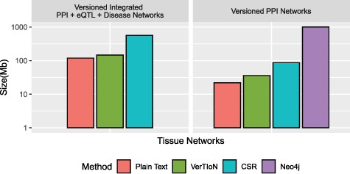
Fig. 6 Compression performance. Comparison of different methods in terms of the storage space they require for the ...
Notes:
Fig. 6 Compression performance. Comparison of different methods in terms of the storage space they require for the tissue-specific PPI versions alone and the full set of PPI+eQTL+disease networks outlined in Figure 1. Here CSR refers to the total space required for storing each version separately with a standard CSR representation, whereas VerTIoN refers to the total space required by VerTIoN to store all versions, by exploiting the edge overlap.
Unless provided in the caption above, the following copyright applies to the content of this slide: © The Author(s) 2020. Published by Oxford University Press.This is an Open Access article distributed under the terms of the Creative Commons Attribution License (http://creativecommons.org/licenses/by/4.0/), which permits unrestricted reuse, distribution, and reproduction in any medium, provided the original work is properly cited.

