Slide 1
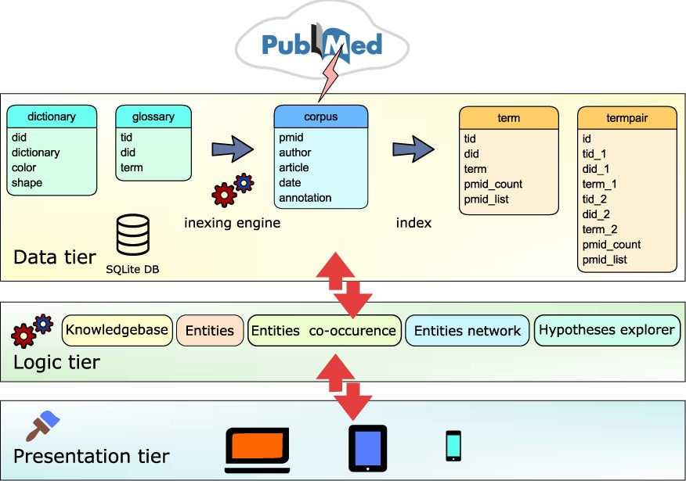
Figure 1. Text-mining module is based on 3-tier architecture. (i) Data tier database: dictionary table containing the ...
Notes:
Figure 1. Text-mining module is based on 3-tier architecture. (i) Data tier database: dictionary table containing the list of dictionary names and the glossary table containing list of biomedical terms is applied by the indexing engine to the corpus table containing PubMed abstracts. Indexing module updates the corpus table and produces two new tables: term table, containing indices of terms and termpair table containing indices of co-occurring terms in the PubMed corpus. (ii) Logic tier is driven by ajax calls that access tables and combine data. (iii) Presentation layer is based on the jQuery/Bootstrap framework producing responsive web pages that can be viewed on a variety of devices.
Unless provided in the caption above, the following copyright applies to the content of this slide: © The Author(s) 2021. Published by Oxford University Press.This is an Open Access article distributed under the terms of the Creative Commons Attribution License (http://creativecommons.org/licenses/by/4.0/), which permits unrestricted reuse, distribution, and reproduction in any medium, provided the original work is properly cited.

Slide 2
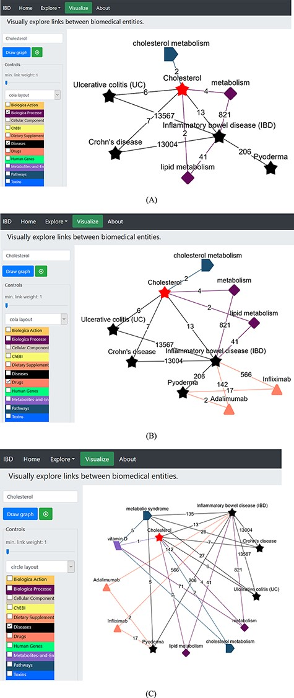
Figure 4. (A) Network construction to identify the direct relationship between pyoderma and IBD through PubMed ...
Notes:
Figure 4. (A) Network construction to identify the direct relationship between pyoderma and IBD through PubMed abstracts. (B) Illustrates the construction of network to identify the link between pyoderma and IBD though common drugs used for treatment of both diseases. The orange triangles represent the ‘Drugs’ dictionary used to find drugs commonly used for treatment of both PG and IBD. (C) Illustrates the link between pyoderma and cholesterol through metabolic pathways. The red star represents the initial searched term ‘cholesterol’. The black stars represent the ‘Diseases’ dictionary. The purple-coloured diamond represents the ‘Biological Processes’ dictionary. The rectangular light purple colour represents the ‘Metabolites and Enzymes’ dictionary. The coloured edges represent the colours of their respective dictionaries. The number shown on each edge showcases the number of publications that link the associated nodes.
Unless provided in the caption above, the following copyright applies to the content of this slide: © The Author(s) 2021. Published by Oxford University Press.This is an Open Access article distributed under the terms of the Creative Commons Attribution License (http://creativecommons.org/licenses/by/4.0/), which permits unrestricted reuse, distribution, and reproduction in any medium, provided the original work is properly cited.

Slide 3
Figure 3. The hypothesis generated by the hypothesis explorer showing that PG may be linked to lipid metabolism.
Notes:
Figure 3. The hypothesis generated by the hypothesis explorer showing that PG may be linked to lipid metabolism.
Unless provided in the caption above, the following copyright applies to the content of this slide: © The Author(s) 2021. Published by Oxford University Press.This is an Open Access article distributed under the terms of the Creative Commons Attribution License (http://creativecommons.org/licenses/by/4.0/), which permits unrestricted reuse, distribution, and reproduction in any medium, provided the original work is properly cited.

Slide 4
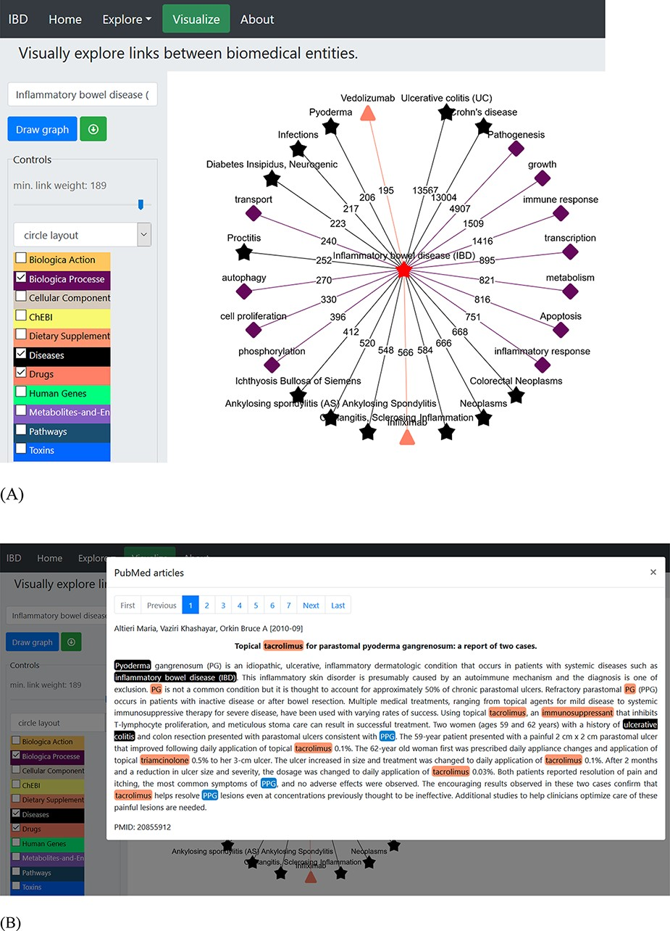
Figure 2. An example of a term-specific network. The network was generated using ‘inflammatory bowel disease’ as the ...
Notes:
Figure 2. An example of a term-specific network. The network was generated using ‘inflammatory bowel disease’ as the search term, and the network represents the connections with terms from three different dictionaries (biological process, diseases and drugs). (A) The layout of the displayed network is circle with colour-coded nodes representing the colour of the dictionary they belong to. The digits on the edges represent the number of PubMed records, where co-occurrence of the two terms was found. (B) The PubMed literature appearing as the edge linking ‘pyoderma and inflammatory bowel disease’ was clicked. The terms are colour-coded based on the colour of the dictionary they belong to (shown in the left panel).
Unless provided in the caption above, the following copyright applies to the content of this slide: © The Author(s) 2021. Published by Oxford University Press.This is an Open Access article distributed under the terms of the Creative Commons Attribution License (http://creativecommons.org/licenses/by/4.0/), which permits unrestricted reuse, distribution, and reproduction in any medium, provided the original work is properly cited.

Slide 5
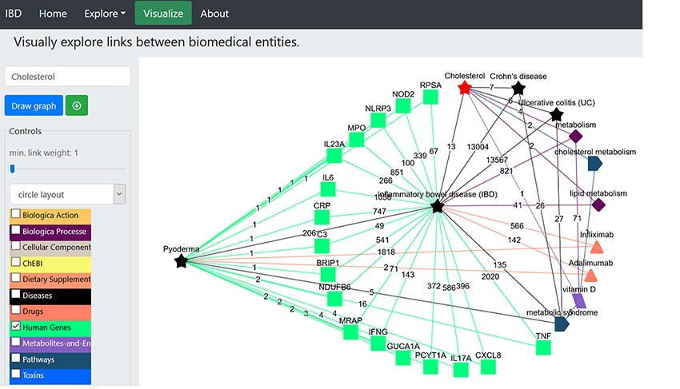
Figure 5. Illustration of the construction of network to identify the potential genes linked to pyoderma and IBD. The ...
Notes:
Figure 5. Illustration of the construction of network to identify the potential genes linked to pyoderma and IBD. The red star represents the searched term ‘cholesterol’. The green squares represent the ‘Human genes’ dictionary. The black stars represent the ‘Diseases’ dictionary, and the orange triangles represent ‘Drugs’ dictionary. The burgundy-coloured diamonds represent the ‘Biological Processes’ dictionary. The coral blue colour pentagon shape represents the ‘Pathways’ dictionary. The coloured edges represent the colours of their respective dictionaries. The number allocated on each edge showcase the number of publications that link to the associated nodes.
Unless provided in the caption above, the following copyright applies to the content of this slide: © The Author(s) 2021. Published by Oxford University Press.This is an Open Access article distributed under the terms of the Creative Commons Attribution License (http://creativecommons.org/licenses/by/4.0/), which permits unrestricted reuse, distribution, and reproduction in any medium, provided the original work is properly cited.

