Slide 1
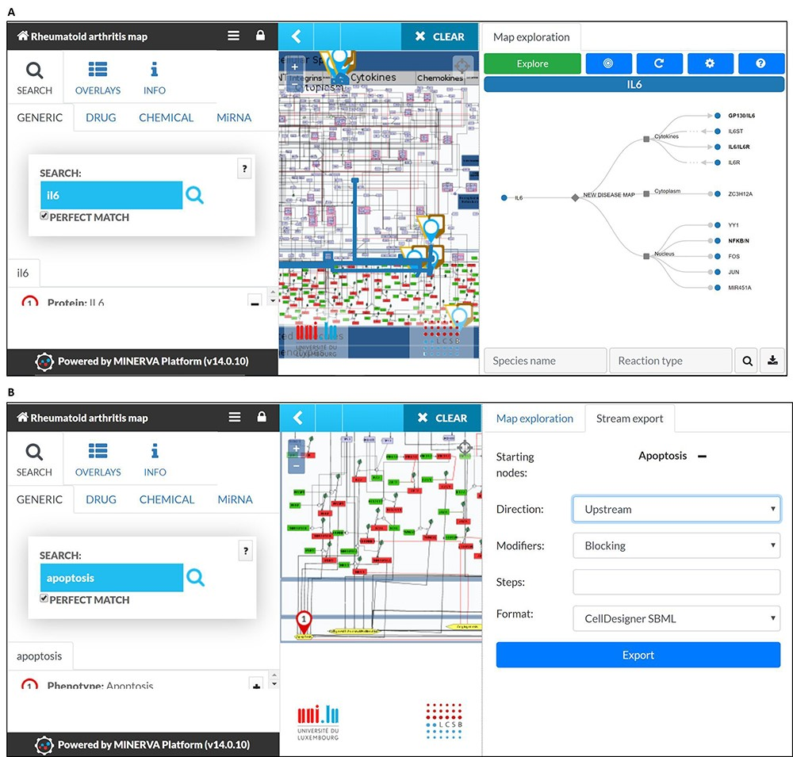
Figure 4 MINERVA plugins. (A) The tree plugin allows to navigate in dense networks by following interactions in a ...
Notes:
Figure 4 MINERVA plugins. (A) The tree plugin allows to navigate in dense networks by following interactions in a tree-like manner. (B) The stream plugin allows for downstream or upstream expansion when selecting a node of interest.
Unless provided in the caption above, the following copyright applies to the content of this slide: © The Author(s) 2020. Published by Oxford University Press.This is an Open Access article distributed under the terms of the Creative Commons Attribution License (http://creativecommons.org/licenses/by/4.0/), which permits unrestricted reuse, distribution, and reproduction in any medium, provided the original work is properly cited.

