Slide 1
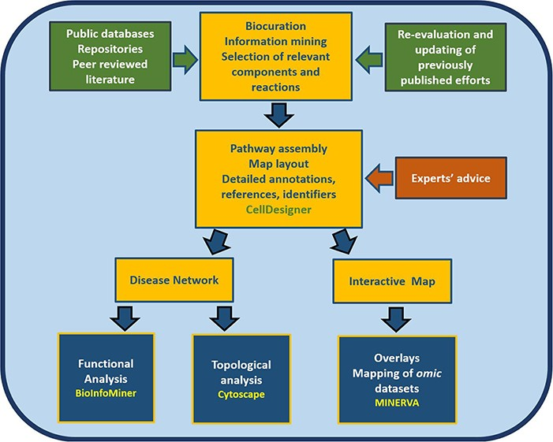
Figure 1 Workflow for the construction and use of the RA map. The assembly of the signalling and molecular pathways ...
Notes:
Figure 1 Workflow for the construction and use of the RA map. The assembly of the signalling and molecular pathways implicated in RA involves exhaustive manual curation and information mining from literature, public databases and repositories and the use of the software CellDesigner (18). The RA map contains mechanisms reported in the most recently published studies, after validation from RA experts. The map can be transformed into an online interactive knowledge base using the platform MINERVA (19). Functional enrichment and topological analysis is possible using the software BioInfoMiner (16) (https://bioinfominer.com) and Cytoscape (17), respectively.
Unless provided in the caption above, the following copyright applies to the content of this slide: © The Author(s) 2020. Published by Oxford University Press.This is an Open Access article distributed under the terms of the Creative Commons Attribution License (http://creativecommons.org/licenses/by/4.0/), which permits unrestricted reuse, distribution, and reproduction in any medium, provided the original work is properly cited.

Slide 2
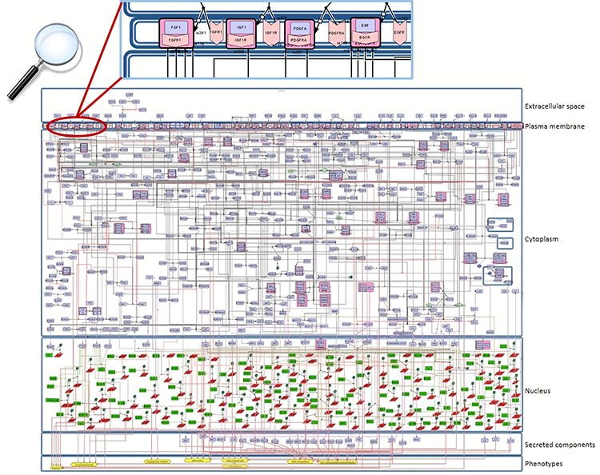
Figure 2 Snapshot of the SBGN-compliant RA map. The map is colour-coded with proteins in purple, genes in green, RNAs ...
Notes:
Figure 2 Snapshot of the SBGN-compliant RA map. The map is colour-coded with proteins in purple, genes in green, RNAs in red and phenotypes in yellow. State transitions and catalysis reactions are displayed in black, and the inhibitions are in red. Compartments are distinguished as bounding boxes. The map was built using CellDesigner, version 4.4 (18). Modifications to the SBGN format: translation arcs are used to keep the representation compact, as well as the gene and RNA shapes.
Unless provided in the caption above, the following copyright applies to the content of this slide: © The Author(s) 2020. Published by Oxford University Press.This is an Open Access article distributed under the terms of the Creative Commons Attribution License (http://creativecommons.org/licenses/by/4.0/), which permits unrestricted reuse, distribution, and reproduction in any medium, provided the original work is properly cited.

Slide 3
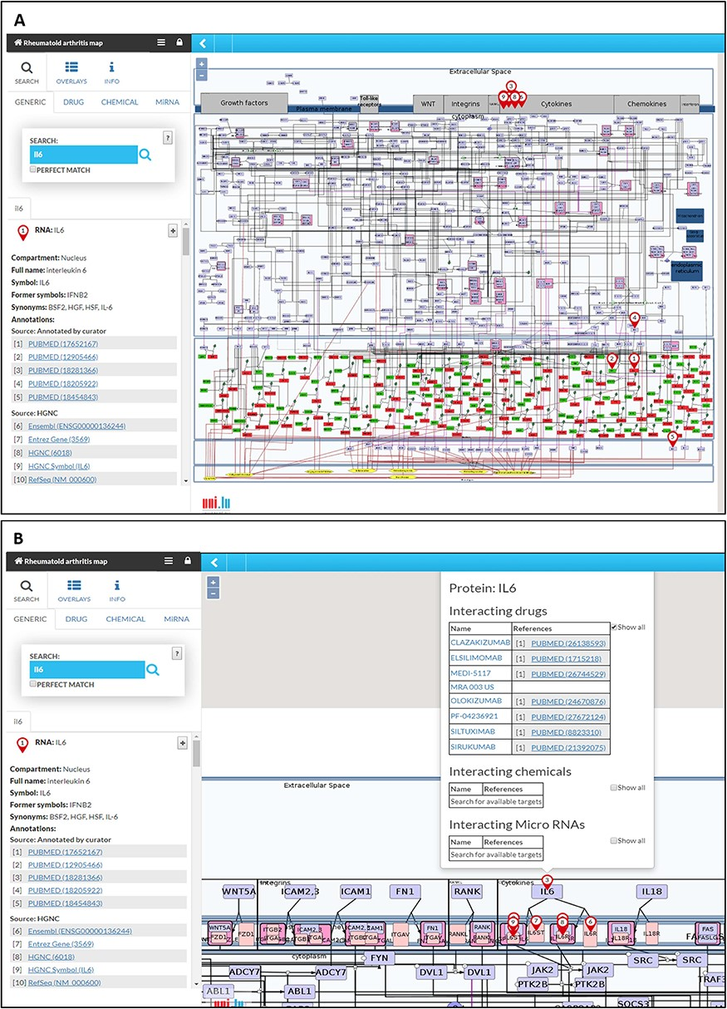
Figure 3 The RA map in MINERVA platform. (A) Users can use the search box to type in the element of interest. The ...
Notes:
Figure 3 The RA map in MINERVA platform. (A) Users can use the search box to type in the element of interest. The resulting element shows up as pins on the map. Corresponding annotations of the searched element, like HGNC, Entrez Gene, RefSeq and Ensembl identifiers are displayed on the left panel along with the PubMed identifiers of the manually curated annotations. (B) Further clicking on the pin will display additional information about interacting drugs, chemicals and microRNAs for the element.
Unless provided in the caption above, the following copyright applies to the content of this slide: © The Author(s) 2020. Published by Oxford University Press.This is an Open Access article distributed under the terms of the Creative Commons Attribution License (http://creativecommons.org/licenses/by/4.0/), which permits unrestricted reuse, distribution, and reproduction in any medium, provided the original work is properly cited.

Slide 4
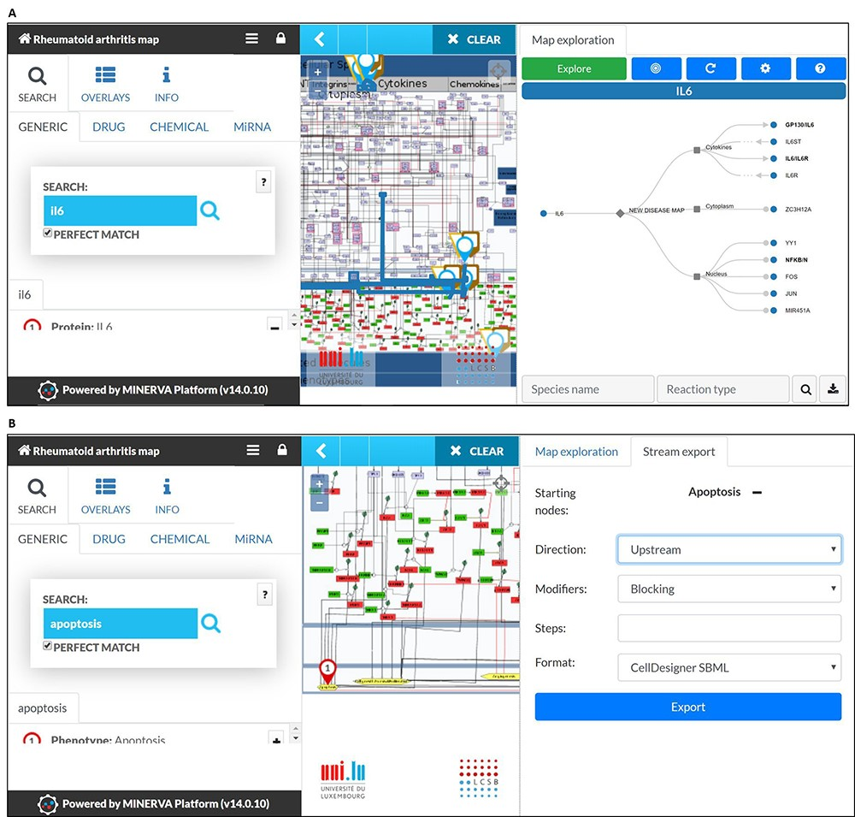
Figure 4 MINERVA plugins. (A) The tree plugin allows to navigate in dense networks by following interactions in a ...
Notes:
Figure 4 MINERVA plugins. (A) The tree plugin allows to navigate in dense networks by following interactions in a tree-like manner. (B) The stream plugin allows for downstream or upstream expansion when selecting a node of interest.
Unless provided in the caption above, the following copyright applies to the content of this slide: © The Author(s) 2020. Published by Oxford University Press.This is an Open Access article distributed under the terms of the Creative Commons Attribution License (http://creativecommons.org/licenses/by/4.0/), which permits unrestricted reuse, distribution, and reproduction in any medium, provided the original work is properly cited.

Slide 5
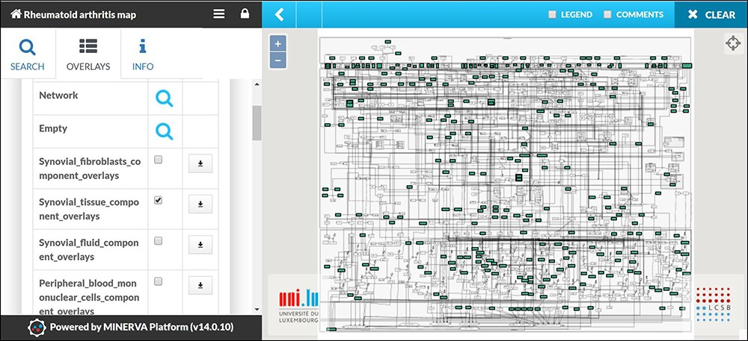
Figure 5 Visualizing cell/tissue/fluid-specific parts of the RA map using dedicated overlays. Snapshot of the ...
Notes:
Figure 5 Visualizing cell/tissue/fluid-specific parts of the RA map using dedicated overlays. Snapshot of the visualization of the Synovial Tissue overlay.
Unless provided in the caption above, the following copyright applies to the content of this slide: © The Author(s) 2020. Published by Oxford University Press.This is an Open Access article distributed under the terms of the Creative Commons Attribution License (http://creativecommons.org/licenses/by/4.0/), which permits unrestricted reuse, distribution, and reproduction in any medium, provided the original work is properly cited.

Slide 6
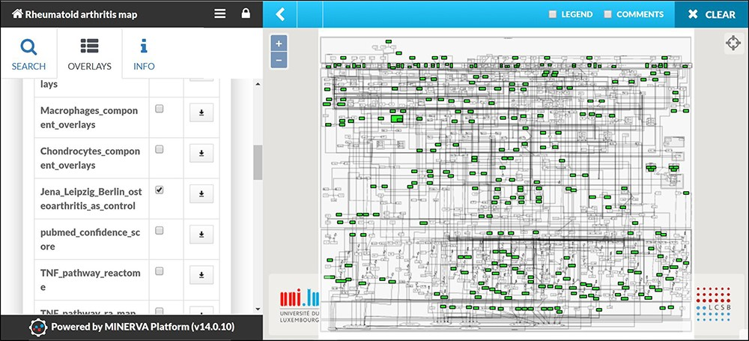
Figure 6 Mapping of Omic datasets from RA synovial tissue. The apoptosis and angiogenesis phenotypes appear to be ...
Notes:
Figure 6 Mapping of Omic datasets from RA synovial tissue. The apoptosis and angiogenesis phenotypes appear to be inactive as no molecule leading to these cellular phenotypes is mapped.
Unless provided in the caption above, the following copyright applies to the content of this slide: © The Author(s) 2020. Published by Oxford University Press.This is an Open Access article distributed under the terms of the Creative Commons Attribution License (http://creativecommons.org/licenses/by/4.0/), which permits unrestricted reuse, distribution, and reproduction in any medium, provided the original work is properly cited.

Slide 7
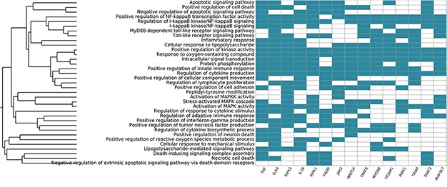
Figure 7 Systemic functional analysis of the RA map using GO terms. Heat map of the top 15 priority genes and their ...
Notes:
Figure 7 Systemic functional analysis of the RA map using GO terms. Heat map of the top 15 priority genes and their systemic interpretation using BioInfoMiner and GO terms.
Unless provided in the caption above, the following copyright applies to the content of this slide: © The Author(s) 2020. Published by Oxford University Press.This is an Open Access article distributed under the terms of the Creative Commons Attribution License (http://creativecommons.org/licenses/by/4.0/), which permits unrestricted reuse, distribution, and reproduction in any medium, provided the original work is properly cited.

Slide 8
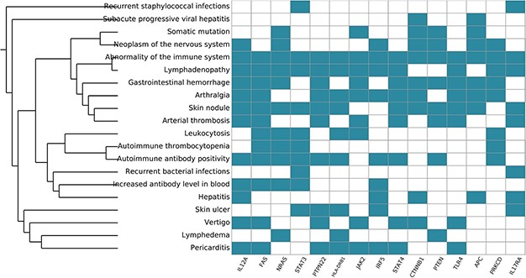
Figure 8 Systemic functional analysis of the RA map using HPO terms. Heat map of the top 15 priority genes and their ...
Notes:
Figure 8 Systemic functional analysis of the RA map using HPO terms. Heat map of the top 15 priority genes and their systemic interpretation using BioInfoMiner and HPO terms.
Unless provided in the caption above, the following copyright applies to the content of this slide: © The Author(s) 2020. Published by Oxford University Press.This is an Open Access article distributed under the terms of the Creative Commons Attribution License (http://creativecommons.org/licenses/by/4.0/), which permits unrestricted reuse, distribution, and reproduction in any medium, provided the original work is properly cited.

Slide 9
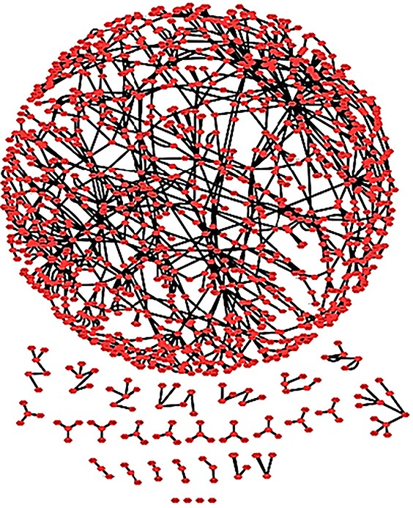
Figure 9 The RA map as a complex network. The RA network with spring embedded layout. One connected core and several ...
Notes:
Figure 9 The RA map as a complex network. The RA network with spring embedded layout. One connected core and several smaller unconnected parts are shown.
Unless provided in the caption above, the following copyright applies to the content of this slide: © The Author(s) 2020. Published by Oxford University Press.This is an Open Access article distributed under the terms of the Creative Commons Attribution License (http://creativecommons.org/licenses/by/4.0/), which permits unrestricted reuse, distribution, and reproduction in any medium, provided the original work is properly cited.

Slide 10
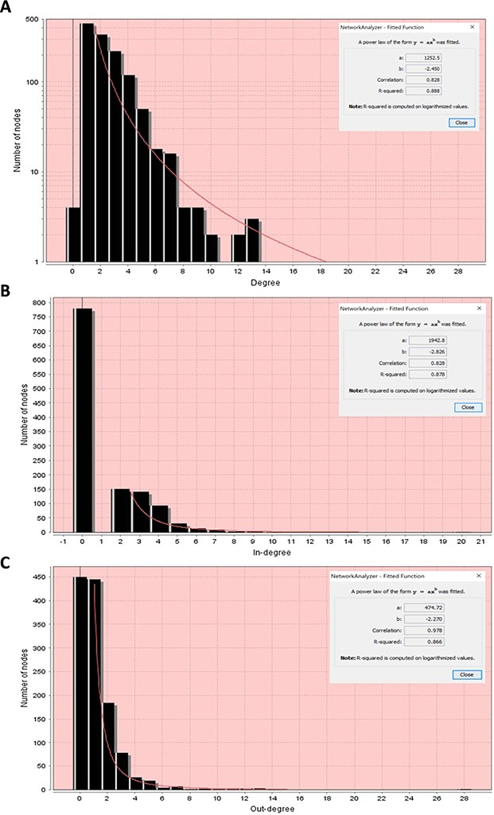
Figure 10 Node degree distributions of the RA map with a fitted power law. (A) Overall degree distribution. (B) ...
Notes:
Figure 10 Node degree distributions of the RA map with a fitted power law. (A) Overall degree distribution. (B) In-degree distribution. (C) Out-degree distribution.
Unless provided in the caption above, the following copyright applies to the content of this slide: © The Author(s) 2020. Published by Oxford University Press.This is an Open Access article distributed under the terms of the Creative Commons Attribution License (http://creativecommons.org/licenses/by/4.0/), which permits unrestricted reuse, distribution, and reproduction in any medium, provided the original work is properly cited.

