Slide 1
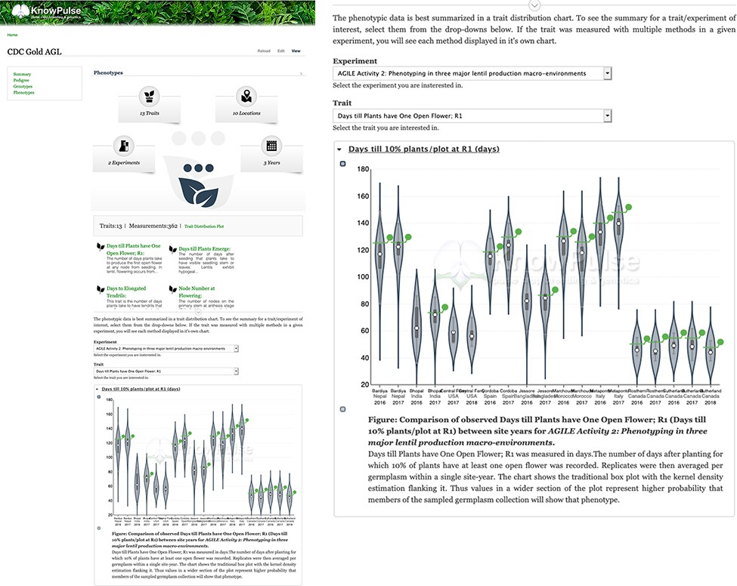
Figure 8. Phenotypic data visualization for CDC Gold AGL provided by Analyzed Phenotypes. The screenshot on the left ...
Notes:
Figure 8. Phenotypic data visualization for CDC Gold AGL provided by Analyzed Phenotypes. The screenshot on the left shows the phenotypic data pane open on the KnowPulse germplasm page for CDC Gold AGL. The top section summarizes the phenotypic data available for CDC Gold AGL, the middle section provides quick links to all traits with data for CDC Gold AGL and the bottom section embeds the ‘Days till 10% of Flowers have one open flower’ Trait Distribution plot for this germplasm. The user selects the trait and experiment combination, and the plot is dynamically drawn for them. The screenshot on the right magnifies the trait distribution plot. This page can be accessed at https://knowpulse.usask.ca/germGoldAgl or by searching for CDC Gold AGL using the Germplasm search tool.
Unless provided in the caption above, the following copyright applies to the content of this slide: © The Author(s) 2021. Published by Oxford University Press.This is an Open Access article distributed under the terms of the Creative Commons Attribution License (http://creativecommons.org/licenses/by/4.0/), which permits unrestricted reuse, distribution, and reproduction in any medium, provided the original work is properly cited.

