Slide 1
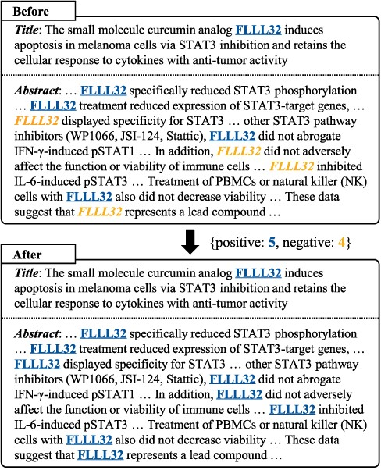
Figure 1. The tagging inconsistency problem and our majority voting method. We underline positive predictions and ...
Notes:
Figure 1. The tagging inconsistency problem and our majority voting method. We underline positive predictions and italicize negative predictions for the entity “FLLL32”. Our method improves tagging consistency by changing the minority to the majority.
Unless provided in the caption above, the following copyright applies to the content of this slide: © The Author(s) 2022. Published by Oxford University Press.This is an Open Access article distributed under the terms of the Creative Commons Attribution-NonCommercial License (https://creativecommons.org/licenses/by-nc/4.0/), which permits non-commercial re-use, distribution, and reproduction in any medium, provided the original work is properly cited. For commercial re-use, please contact journals.permissions@oup.com

Slide 2
Figure 2. Overview of our final system for the BioCreative VII NLM-Chem track challenge.
Notes:
Figure 2. Overview of our final system for the BioCreative VII NLM-Chem track challenge.
Unless provided in the caption above, the following copyright applies to the content of this slide: © The Author(s) 2022. Published by Oxford University Press.This is an Open Access article distributed under the terms of the Creative Commons Attribution-NonCommercial License (https://creativecommons.org/licenses/by-nc/4.0/), which permits non-commercial re-use, distribution, and reproduction in any medium, provided the original work is properly cited. For commercial re-use, please contact journals.permissions@oup.com

Slide 3
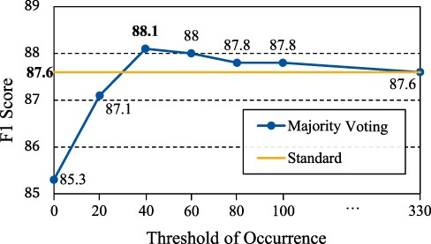
Figure 3. Performance of majority voting with different thresholds of occurrence τ on the validation set. Standard: a ...
Notes:
Figure 3. Performance of majority voting with different thresholds of occurrence τ on the validation set. Standard: a single Bio-LM-large model.
Unless provided in the caption above, the following copyright applies to the content of this slide: © The Author(s) 2022. Published by Oxford University Press.This is an Open Access article distributed under the terms of the Creative Commons Attribution-NonCommercial License (https://creativecommons.org/licenses/by-nc/4.0/), which permits non-commercial re-use, distribution, and reproduction in any medium, provided the original work is properly cited. For commercial re-use, please contact journals.permissions@oup.com

Slide 4
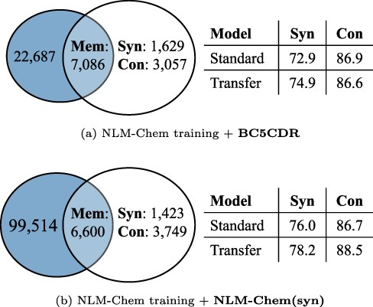
Figure 4. The number of mentions of Mem, Syn and Con and model performance on each split, when using BC5CDR and ...
Notes:
Figure 4. The number of mentions of Mem, Syn and Con and model performance on each split, when using BC5CDR and NLM-Chem(syn) as source data in transfer learning. The blue circles indicate the mentions in the validation set, and the others are the mentions in training sets ( i.e. $\mathbb{E}_\text{train}$). Standard and Transfer: Bio-LM-large without/with applying transfer learning, respectively.
Unless provided in the caption above, the following copyright applies to the content of this slide: © The Author(s) 2022. Published by Oxford University Press.This is an Open Access article distributed under the terms of the Creative Commons Attribution-NonCommercial License (https://creativecommons.org/licenses/by-nc/4.0/), which permits non-commercial re-use, distribution, and reproduction in any medium, provided the original work is properly cited. For commercial re-use, please contact journals.permissions@oup.com

