Slide 1
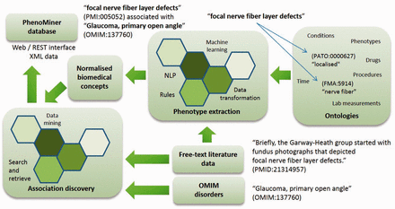
Figure 1. Overview of PhenoMiner illustrating the flow of data from the literature, to text mining, to association ...
Notes:
Figure 1. Overview of PhenoMiner illustrating the flow of data from the literature, to text mining, to association discovery and into an integrated semantic representation.
Unless provided in the caption above, the following copyright applies to the content of this slide: © The Author(s) 2015. Published by Oxford University Press. This is an Open Access article distributed under the terms of the Creative Commons Attribution License ( http://creativecommons.org/licenses/by/4.0/ ), which permits unrestricted reuse, distribution, and reproduction in any medium, provided the original work is properly cited.

Slide 2
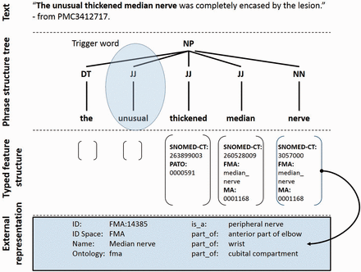
Figure 2. Semantic representation of a text fragment in the PhenoMiner system. Keyword search identifies the potential ...
Notes:
Figure 2. Semantic representation of a text fragment in the PhenoMiner system. Keyword search identifies the potential trigger word unusual causing the sentence to be selected for grammatical parsing. The adjectives thickened and median along with the common noun nerve are identified and their corresponding ontology terms are mapped as shown. A semantically typed regular expression then guides the system to select the phrase as a phenotype candidate.
Unless provided in the caption above, the following copyright applies to the content of this slide: © The Author(s) 2015. Published by Oxford University Press. This is an Open Access article distributed under the terms of the Creative Commons Attribution License ( http://creativecommons.org/licenses/by/4.0/ ), which permits unrestricted reuse, distribution, and reproduction in any medium, provided the original work is properly cited.

Slide 3
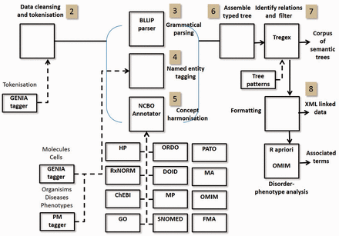
Figure 3. Text/data mining pipeline showing processes and resources. Highlighted indexes correspond to steps in ...
Notes:
Figure 3. Text/data mining pipeline showing processes and resources. Highlighted indexes correspond to steps in Text/Data Mining section.
Unless provided in the caption above, the following copyright applies to the content of this slide: © The Author(s) 2015. Published by Oxford University Press. This is an Open Access article distributed under the terms of the Creative Commons Attribution License ( http://creativecommons.org/licenses/by/4.0/ ), which permits unrestricted reuse, distribution, and reproduction in any medium, provided the original work is properly cited.

Slide 4
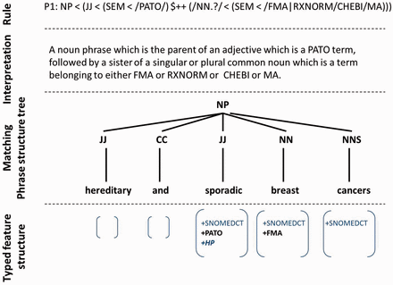
Figure 4. Example of semantic tree matching with a Tregex rule.
Notes:
Figure 4. Example of semantic tree matching with a Tregex rule.
Unless provided in the caption above, the following copyright applies to the content of this slide: © The Author(s) 2015. Published by Oxford University Press. This is an Open Access article distributed under the terms of the Creative Commons Attribution License ( http://creativecommons.org/licenses/by/4.0/ ), which permits unrestricted reuse, distribution, and reproduction in any medium, provided the original work is properly cited.

Slide 5
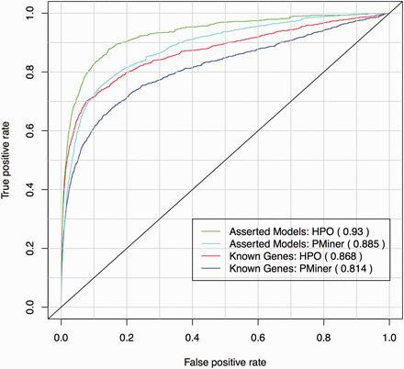
Figure 5. ROC curve for known gene-disease associations from OMIM’s MorbidMap using HP and PhenoMiner annotations. For ...
Notes:
Figure 5. ROC curve for known gene-disease associations from OMIM’s MorbidMap using HP and PhenoMiner annotations. For each disease the true- and false-positive rate is calculated from the list of mouse genes in MGD ordered by phenotypic similarity and the known associated gene in OMIM.
Unless provided in the caption above, the following copyright applies to the content of this slide: © The Author(s) 2015. Published by Oxford University Press. This is an Open Access article distributed under the terms of the Creative Commons Attribution License ( http://creativecommons.org/licenses/by/4.0/ ), which permits unrestricted reuse, distribution, and reproduction in any medium, provided the original work is properly cited.

