Slide 1
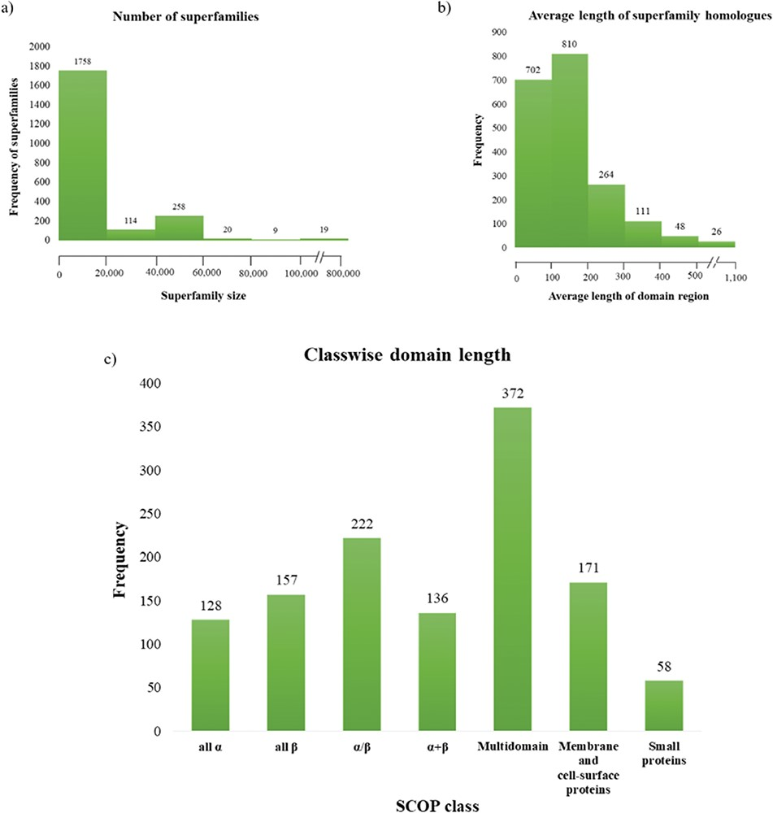
Figure 3 Superfamily statistics in GenDiS+. (a) The distribution of homologues across superfamilies. A majority of the ...
Notes:
Figure 3 Superfamily statistics in GenDiS+. (a) The distribution of homologues across superfamilies. A majority of the superfamilies (89.65%) have up to 20 000 homologues with only 19 (~1%) superfamilies having over 100 000 members. (b) Distribution of domain length across superfamilies. (c) Most of the superfamily homologues have an average length up to 200 residues, with only homologues of multi-domain superfamily class having a domain length above 500 residues.
Unless provided in the caption above, the following copyright applies to the content of this slide: © The Author(s) 2019. Published by Oxford University Press.This is an Open Access article distributed under the terms of the Creative Commons Attribution License (http://creativecommons.org/licenses/by/4.0/), which permits unrestricted reuse, distribution, and reproduction in any medium, provided the original work is properly cited.

