Slide 1
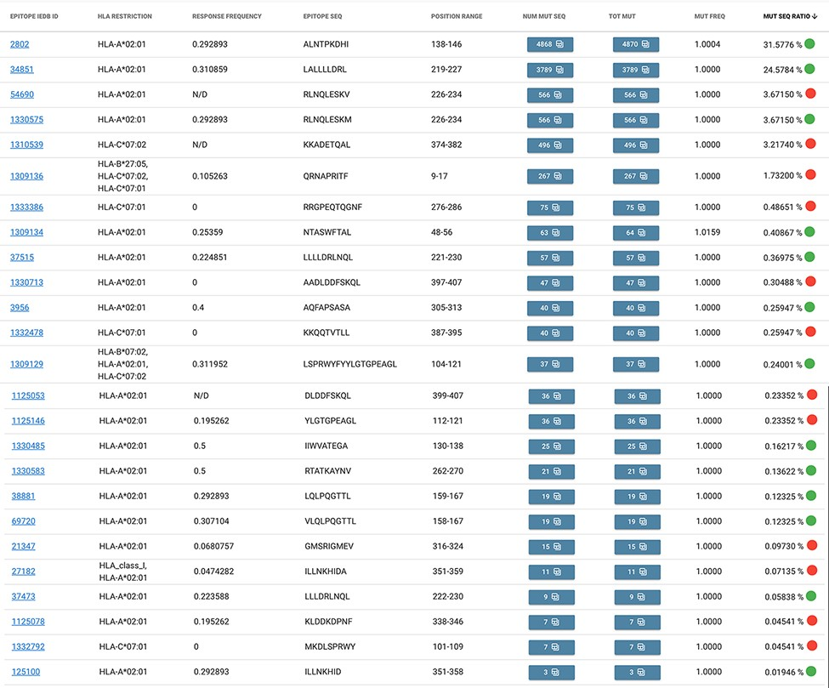
Figure 4. Result table of the query performed in Example 2: list of epitopes with their statistics descriptive of the ...
Notes:
Figure 4. Result table of the query performed in Example 2: list of epitopes with their statistics descriptive of the mutation rate over the selected population (Campania, Italy). Color codes are used to discriminate between epitopes with a response frequency > 0.2 (green) or < 0.2 (red).
Unless provided in the caption above, the following copyright applies to the content of this slide: © The Author(s) 2021. Published by Oxford University Press.This is an Open Access article distributed under the terms of the Creative Commons Attribution License (https://creativecommons.org/licenses/by/4.0/), which permits unrestricted reuse, distribution, and reproduction in any medium, provided the original work is properly cited.

