Slide 1
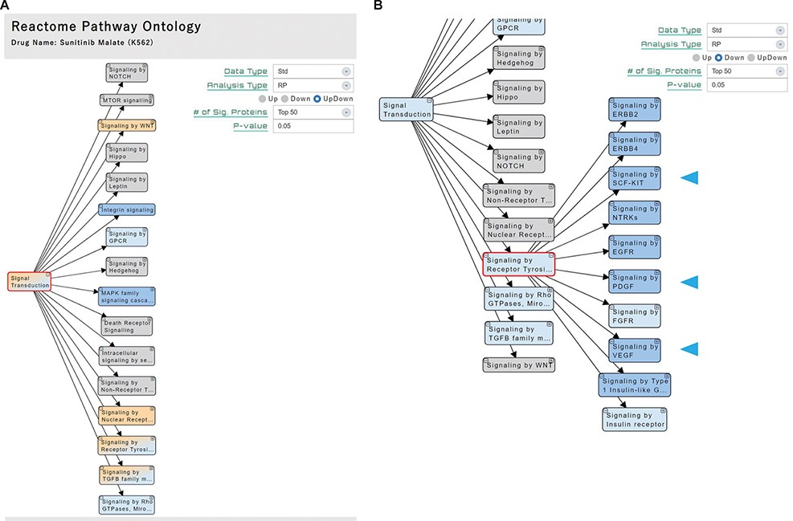
Figure 3. ‘Pathway’ section. (A) Significant pathways with Up, Down or both (UpDown) signatures are displayed in the ...
Notes:
Figure 3. ‘Pathway’ section. (A) Significant pathways with Up, Down or both (UpDown) signatures are displayed in the tree form, according to the pathway ontology classification of Reactome. The number of signature proteins for pathway analysis can be selected (top 50/100/150/200 or P-value < 0.05). (B) The multi-targeted RTK inhibitor sunitinib malate downregulates the ‘Signaling by Receptor Tyrosine Kinases’ pathways, including the drug target-related pathways (arrowhead).
Unless provided in the caption above, the following copyright applies to the content of this slide: © The Author(s) 2022. Published by Oxford University Press.This is an Open Access article distributed under the terms of the Creative Commons Attribution-NonCommercial License (https://creativecommons.org/licenses/by-nc/4.0/), which permits non-commercial re-use, distribution, and reproduction in any medium, provided the original work is properly cited. For commercial re-use, please contact journals.permissions@oup.com

