Slide 1
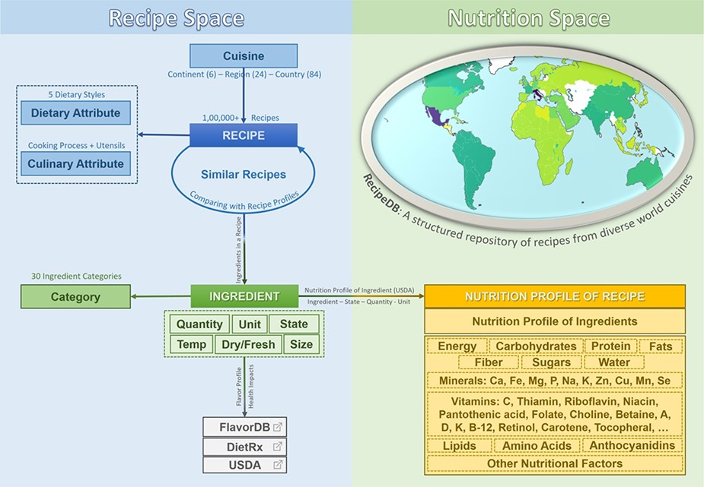
Figure 1. RecipeDB integrates the elements and attributes (Recipe Space) with the USDA nutritional profiles (Nutrition ...
Notes:
Figure 1. RecipeDB integrates the elements and attributes (Recipe Space) with the USDA nutritional profiles (Nutrition Space) and also links them to flavor and health attributes. The resource provides comprehensive coverage of worldwide recipes from across 26 world regions and 74 countries.
Unless provided in the caption above, the following copyright applies to the content of this slide: © The Author(s) 2020. Published by Oxford University Press.This is an Open Access article distributed under the terms of the Creative Commons Attribution License (http://creativecommons.org/licenses/by/4.0/), which permits unrestricted reuse, distribution, and reproduction in any medium, provided the original work is properly cited.

Slide 2
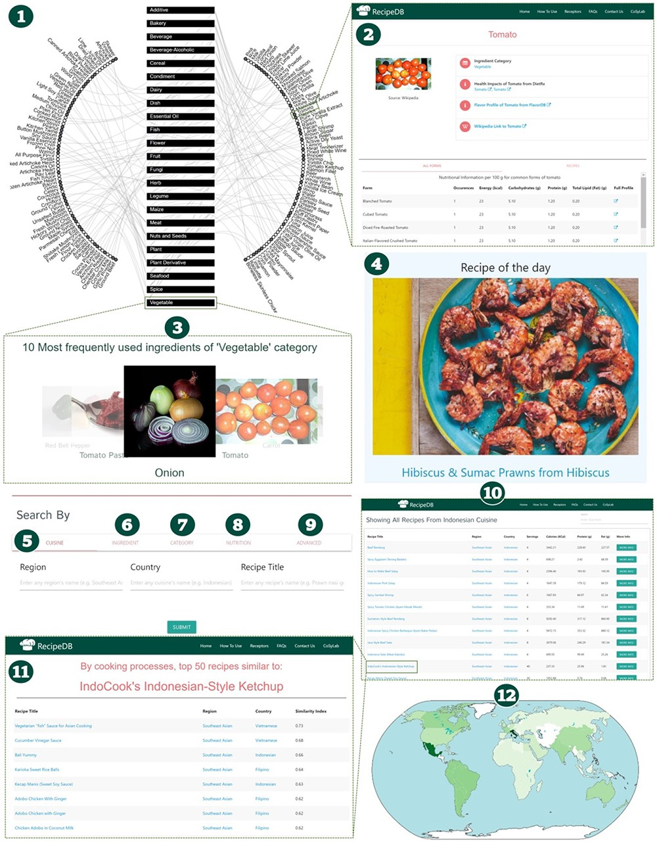
Figure 2. Schematic of RecipeDB user interface highlighting features for searching and navigation of data (1). Recipe ...
Notes:
Figure 2. Schematic of RecipeDB user interface highlighting features for searching and navigation of data (1). Recipe Network (2), Ingredient Profile (3), Category Profile (4), Ingredient of the day, (5)–(9) Search by Cuisine, Ingredient, Category, Nutrition and Advanced Search, (10) Results page for recipes search, (11) Similar recipes page and (12) RecipeDB Statistics (Recipes, Categories, Ingredients, Nutrition, Processes and Utensils).
Unless provided in the caption above, the following copyright applies to the content of this slide: © The Author(s) 2020. Published by Oxford University Press.This is an Open Access article distributed under the terms of the Creative Commons Attribution License (http://creativecommons.org/licenses/by/4.0/), which permits unrestricted reuse, distribution, and reproduction in any medium, provided the original work is properly cited.

