Slide 1
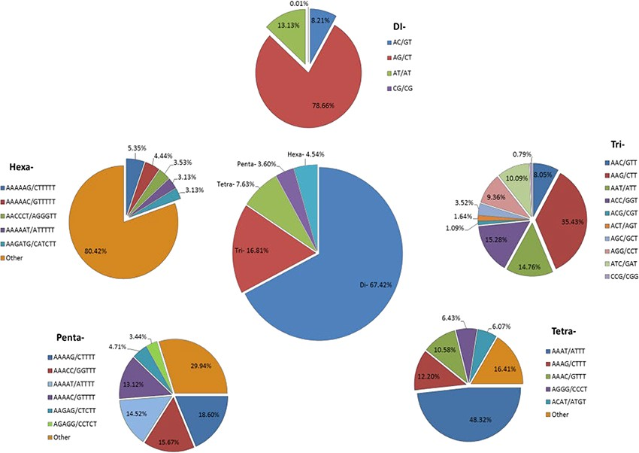
Figure 4 Identification of SSRs in the Transcriptome Shotgun Assembly of SRA data. Frequency of di- to hexa-nucleotide ...
Notes:
Figure 4 Identification of SSRs in the Transcriptome Shotgun Assembly of SRA data. Frequency of di- to hexa-nucleotide repeats in the central, large pie chart and small peripheral pie charts represent the motifs and their complementary sequences of identified di- to hexa-nucleotide repeats, respectively.
Unless provided in the caption above, the following copyright applies to the content of this slide: © The Author(s) 2020. Published by Oxford University Press.This is an Open Access article distributed under the terms of the Creative Commons Attribution License (http://creativecommons.org/licenses/by/4.0/), which permits unrestricted reuse, distribution, and reproduction in any medium, provided the original work is properly cited.

