Slide 1
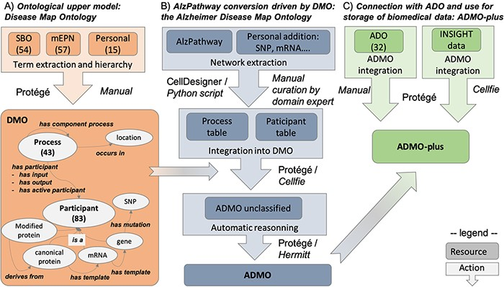
Figure 1. Summary of the workflow for AlzPathway conversion in OWL, from the DMO design to ADO instantiation and data ...
Notes:
Figure 1. Summary of the workflow for AlzPathway conversion in OWL, from the DMO design to ADO instantiation and data integration. (A) DMO design. (B) AlzPathway export into a structured table and its integration with DMO, resulting in ADMO. (C) Integration of ADO and biomedical experiment data resulting in ADMO-plus. This is not a pipeline, but a step-by-step process, in which manual and automatic steps are specified. Specifically, for each step, we indicate whether it was done manually (Manual) or mention which tool was used to do it automatically (Protégé, Cell designer, Python script, Cellfie, Hermitt).
Unless provided in the caption above, the following copyright applies to the content of this slide: © The Author(s) 2021. Published by Oxford University Press. All rights reserved. For permissions, please e-mail: journals.permissions@oup.comThis article is published and distributed under the terms of the Oxford University Press, Standard Journals Publication Model (https://academic.oup.com/journals/pages/open_access/funder_policies/chorus/standard_publication_model)

Slide 2
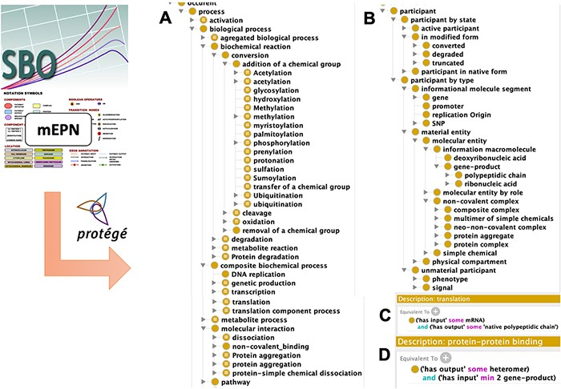
Figure 2. Disease Map Ontology (DMO) model design. Term of classes were extracted from the Systems Biology Ontology ...
Notes:
Figure 2. Disease Map Ontology (DMO) model design. Term of classes were extracted from the Systems Biology Ontology (SBO) and the modified Edinburg Pathway Notation format (mEPN) into Protégé. Classes were hierarchized as subclasses of process (A) or participant (B). Using property terms from the Relation Ontology (RO), classes were formally defined in description logic, as illustrated in the case of transcription (C) and protein complex formation (D) processes.
Unless provided in the caption above, the following copyright applies to the content of this slide: © The Author(s) 2021. Published by Oxford University Press. All rights reserved. For permissions, please e-mail: journals.permissions@oup.comThis article is published and distributed under the terms of the Oxford University Press, Standard Journals Publication Model (https://academic.oup.com/journals/pages/open_access/funder_policies/chorus/standard_publication_model)

Slide 3
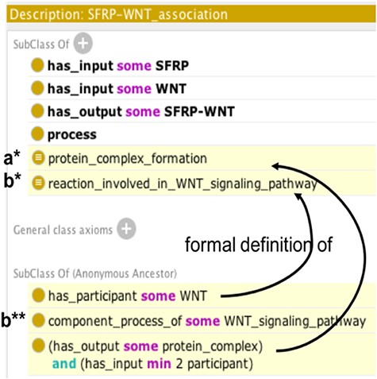
Figure 3. Example of automatic reasoning with Protégé. Asserted axioms are shown in uncolored lines and inferred axioms ...
Notes:
Figure 3. Example of automatic reasoning with Protégé. Asserted axioms are shown in uncolored lines and inferred axioms are highlighted in yellow. Following automatic reasoning, SFRP-WNT heterodimer association is classified as subclass of the ‘protein complex formation’ (a*) and ‘reaction involved in WNT signaling pathway’ classes (b*), thus it inherits the component_process_of ‘WNT_signaling pathway’ property (b**).
Unless provided in the caption above, the following copyright applies to the content of this slide: © The Author(s) 2021. Published by Oxford University Press. All rights reserved. For permissions, please e-mail: journals.permissions@oup.comThis article is published and distributed under the terms of the Oxford University Press, Standard Journals Publication Model (https://academic.oup.com/journals/pages/open_access/funder_policies/chorus/standard_publication_model)

Slide 4
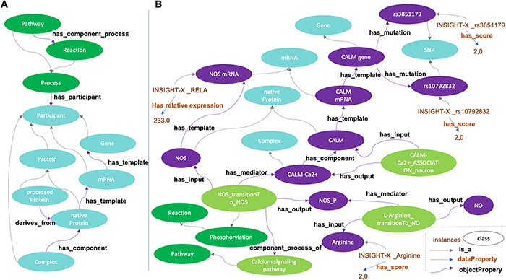
Figure 4. Disease Map Ontology (DMO) pattern (A) and application to Alzheimer Disease Map Ontology (ADMO) (B). ...
Notes:
Figure 4. Disease Map Ontology (DMO) pattern (A) and application to Alzheimer Disease Map Ontology (ADMO) (B). AlzPathway derived-classes (B; illustrated for the Nitric Oxide Synthase phosphorylation and NO production) are now subclasses of DMO classes (A). Each class of ADMO may be instantiated by the corresponding entities as individuals. As illustrated in B, for a subject, scores for SNP rs3851179, RELA mRNA expression and Arginine measurement are linked by biochemical reactions.
Unless provided in the caption above, the following copyright applies to the content of this slide: © The Author(s) 2021. Published by Oxford University Press. All rights reserved. For permissions, please e-mail: journals.permissions@oup.comThis article is published and distributed under the terms of the Oxford University Press, Standard Journals Publication Model (https://academic.oup.com/journals/pages/open_access/funder_policies/chorus/standard_publication_model)

