Slide 1
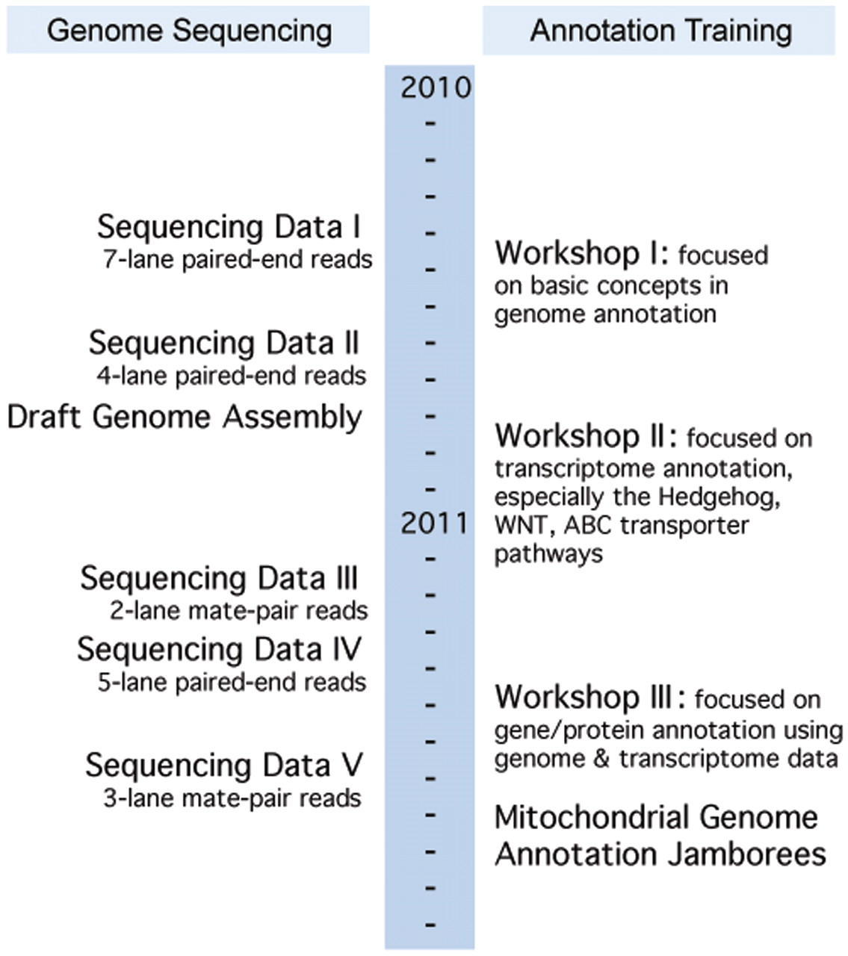
Figure 2. Little Skate Genome Project's timeline indicating the simultaneous annotation training and genome ...
Notes:
Figure 2. Little Skate Genome Project's timeline indicating the simultaneous annotation training and genome development. Sequencing Data Sets I: seven lanes of paired-end reads; II: four lanes of paired-end reads; III: two lanes of mate-pair reads; IV: five lanes of paired-end reads; V: three lanes of mate-pair reads. There are a total of 2 931 925 134 reads.
Unless provided in the caption above, the following copyright applies to the content of this slide: © The Author(s) 2012. Published by Oxford University Press.This is an Open Access article distributed under the terms of the Creative Commons Attribution Non-Commercial License (http://creativecommons.org/licenses/by-nc/3.0), which permits unrestricted non-commercial use, distribution, and reproduction in any medium, provided the original work is properly cited.

