Slide 1
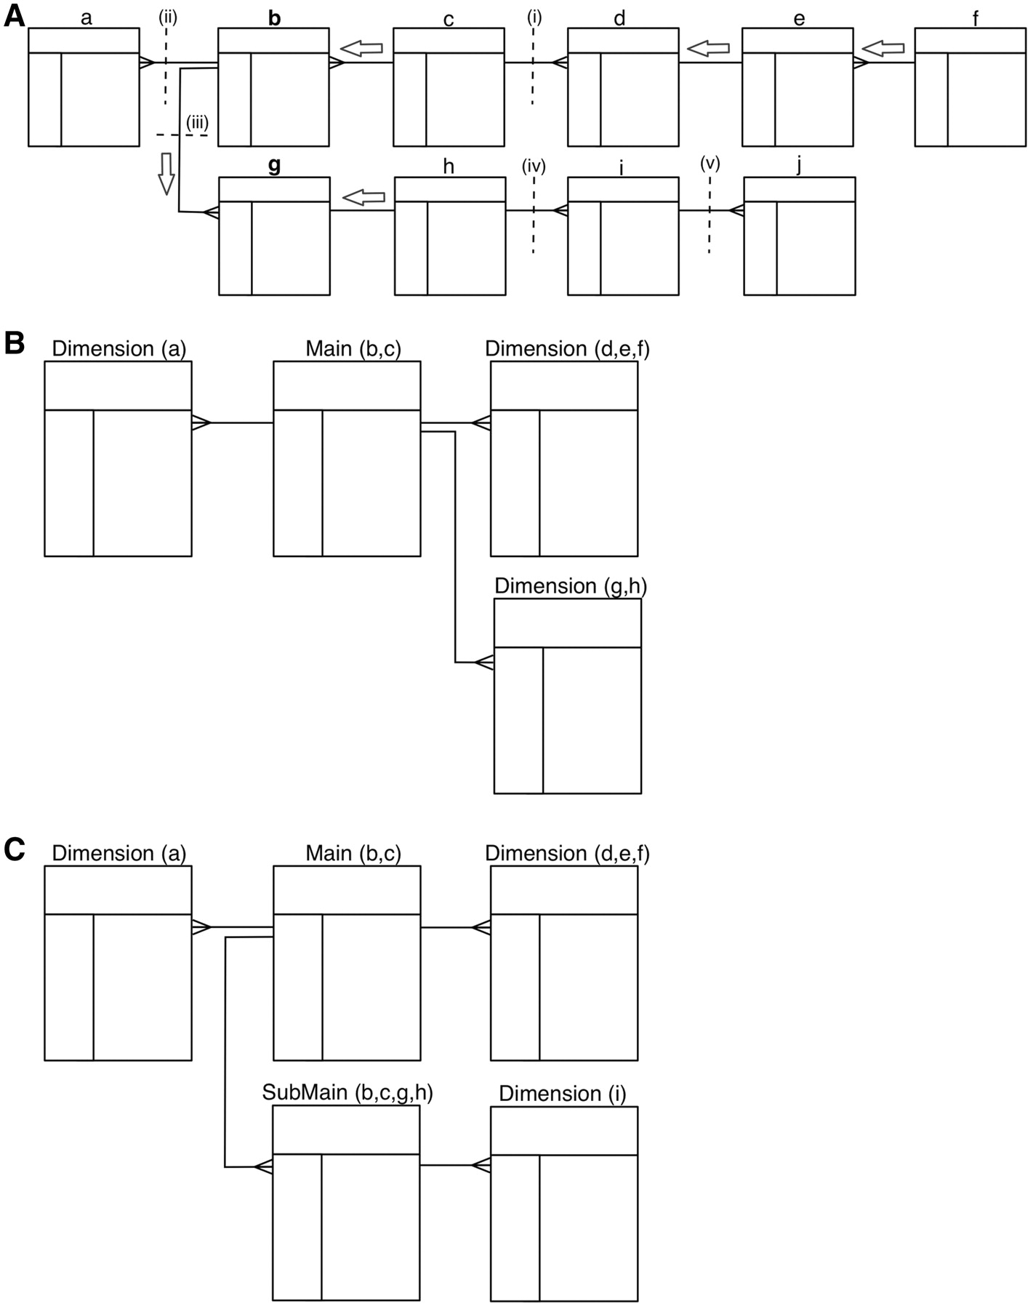
Figure 4. Transformation algorithm. A schematic showing how a 3NF schema is transformed into a reverse star schema. (A) ...
Notes:
Figure 4. Transformation algorithm. A schematic showing how a 3NF schema is transformed into a reverse star schema. (A) Shows the 3NF schema with 10 tables, with relations between tables indicated by connectors. To build a main table, the algorithm starts from the candidate table and walks outwards along all possible paths of related tables until a one-to-many relation is encountered. Such a one-to-many relation is called a break point. When starting from table b, there are three break points: i–iii; when starting from table g, the break points are: i, ii and iv. Tables traversed before reaching the break point will be merged via an SQL join to create the main table. Tables b and c are merged when table b is chosen as the candidate main; tables b, c, g and h are merged to build the main table when table g is chosen as the candidate. The same traversing and merging rule is applied for building dimension tables. (B) Shows the resulting reverse star schema when table b is chosen as the candidate main table. The transformed schema includes one main table (the original tables b and c merged) and three dimension tables: the original table a becomes the first dimension table, tables d, e and f are merged to form the second dimension table and tables g and h are merged to create the third dimension table. (C) Shows the resulting reverse star schema when both tables b and g are chosen as candidate main tables. In addition to one main table and two dimension tables that are the same as in B, there is one new submain table that is built by merging tables b, c, g and h. The original table i becomes a dimension table to the submain table. Note that, the submain table and main table have a many-to-one relation, and the submain table contains all the contents of the main table.
Unless provided in the caption above, the following copyright applies to the content of this slide: © The Author(s) 2011. Published by Oxford University Press.This is Open Access article distributed under the terms of the Creative Commons Attribution Non-Commercial License (http://creativecommons.org/licenses/by-nc/2.5), which permits unrestricted non-commercial use, distribution, and reproduction in any medium, provided the original work is properly cited.

