Slide 1
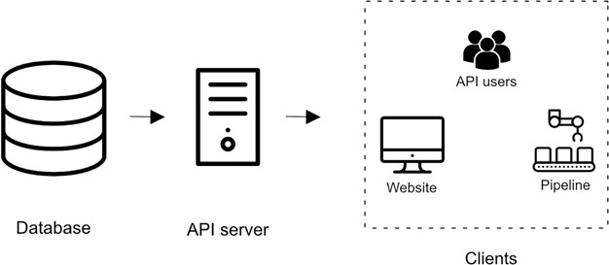
Figure 1 Overview of iPTMnet Architecture. The overall iPTMnet architecture has three distinct layers. The database ...
Notes:
Figure 1 Overview of iPTMnet Architecture. The overall iPTMnet architecture has three distinct layers. The database layer is built using Oracle or Postgres and holds the iPTMnet data. The API server layer is the actual API server software that encapsulates the logic to interpret requests and return a response in an appropriate format. The client layer consists of various frontends like the iPTMnet website or the Python and R packages.
Unless provided in the caption above, the following copyright applies to the content of this slide: © The Author(s) 2020. Published by Oxford University Press.This is an Open Access article distributed under the terms of the Creative Commons Attribution License (http://creativecommons.org/licenses/by/4.0/), which permits unrestricted reuse, distribution, and reproduction in any medium, provided the original work is properly cited.

