Slide 1
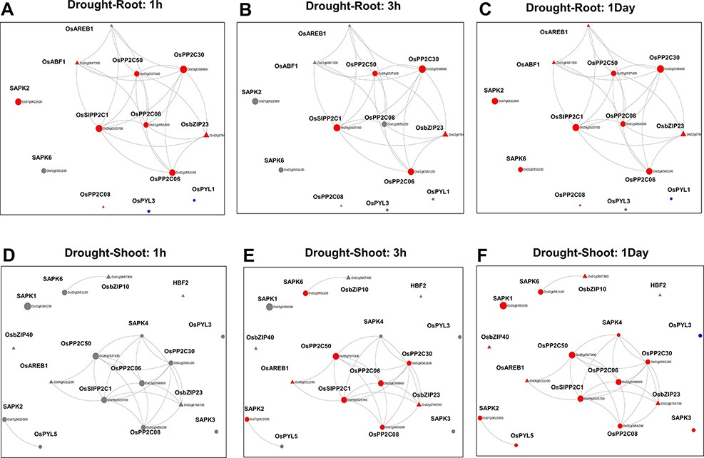
Figure 5. Time point–specific views from the Network Viewer for root tissue at (A) 1h, (B) 3h, (C) 1day and shoot ...
Notes:
Figure 5. Time point–specific views from the Network Viewer for root tissue at (A) 1h, (B) 3h, (C) 1day and shoot tissue at (D) 1h, (E) 3h and (F) 6h. The figure provides a comparative view of the transcriptional changes for the different time points along with tissue-specific gene connectivities.
Unless provided in the caption above, the following copyright applies to the content of this slide: © The Author(s) 2022. Published by Oxford University Press on behalf of the Center for Excellence in Molecular Cell Science, Chinese Academy of Sciences.This is an Open Access article distributed under the terms of the Creative Commons Attribution-NonCommercial License (https://creativecommons.org/licenses/by-nc/4.0/), which permits non-commercial re-use, distribution, and reproduction in any medium, provided the original work is properly cited. For commercial re-use, please contact journals.permissions@oup.com

