Slide 1
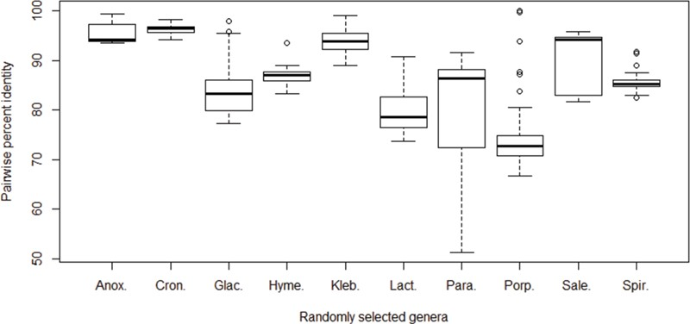
Figure 4 Pairwise percent identities of the cpn60 gene among species. The cpn60 sequences of species from 10 randomly ...
Notes:
Figure 4 Pairwise percent identities of the cpn60 gene among species. The cpn60 sequences of species from 10 randomly selected bacterial genera with at least 6 unique species records were aligned to calculate pairwise identities. Genera from left to right: Anoxybacillus (6 species), Cronobacter (6 species), Glaciecola (10 species), Hymenobacter (6 species), Klebsiella (9 species), Lactococcus (7 species), Paracoccus (9 species), Porphyromonas (17 species), Salegentibacter (6 species) and Spirosoma (7 species).
Unless provided in the caption above, the following copyright applies to the content of this slide: © The Author(s) 2019. Published by Oxford University Press.This is an Open Access article distributed under the terms of the Creative Commons Attribution License (http://creativecommons.org/licenses/by/4.0/), which permits unrestricted reuse, distribution, and reproduction in any medium, provided the original work is properly cited.

