Slide 1
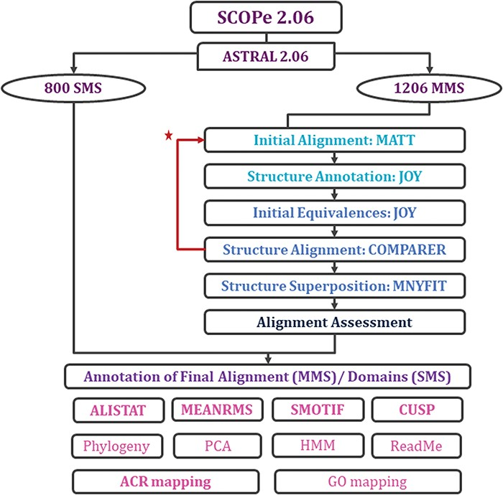
Figure 2 Workflow for rigorous structure-based sequence alignment of protein domains with less than 40% sequence ...
Notes:
Figure 2 Workflow for rigorous structure-based sequence alignment of protein domains with less than 40% sequence identity belonging to SCOPe superfamilies. The initial alignment, final alignment and alignment assessment phases are coloured in cyan, blue and indigo. Features that were generated for the alignments (for MMS) and domains (for SMS) are listed, with in-house features in bold. Extreme structural outliers were removed from superfamilies if required and the remaining members were realigned (marked by red star).
Unless provided in the caption above, the following copyright applies to the content of this slide: © The Author(s) 2019. Published by Oxford University Press.This is an Open Access article distributed under the terms of the Creative Commons Attribution License (http://creativecommons.org/licenses/by/4.0/), which permits unrestricted reuse, distribution, and reproduction in any medium, provided the original work is properly cited.

