Slide 1
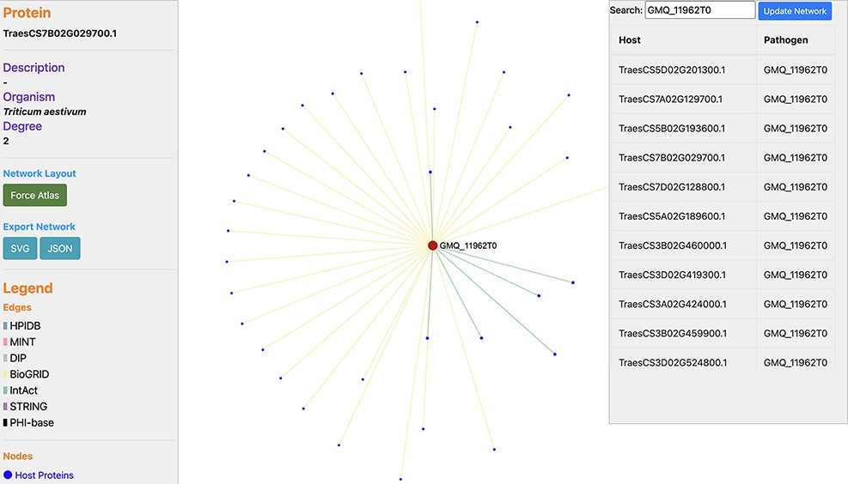
Figure 6. Network visualization of an Ug99 effector protein, GMQ_11962T0, interacting with 34 T. aestivum proteins as ...
Notes:
Figure 6. Network visualization of an Ug99 effector protein, GMQ_11962T0, interacting with 34 T. aestivum proteins as predicted by TRustDB (Supplementary Material, Sheet 4). GMQ_11962T0 has been shown to be involved in hydrolase activity (GO:0016817) and spliceosome (ko03040), which plays a role in the colonization and pathogenicity of the fungal pathogens.
Unless provided in the caption above, the following copyright applies to the content of this slide: © The Author(s) 2022. Published by Oxford University Press.This is an Open Access article distributed under the terms of the Creative Commons Attribution License (https://creativecommons.org/licenses/by/4.0/), which permits unrestricted reuse, distribution, and reproduction in any medium, provided the original work is properly cited.

