Slide 1
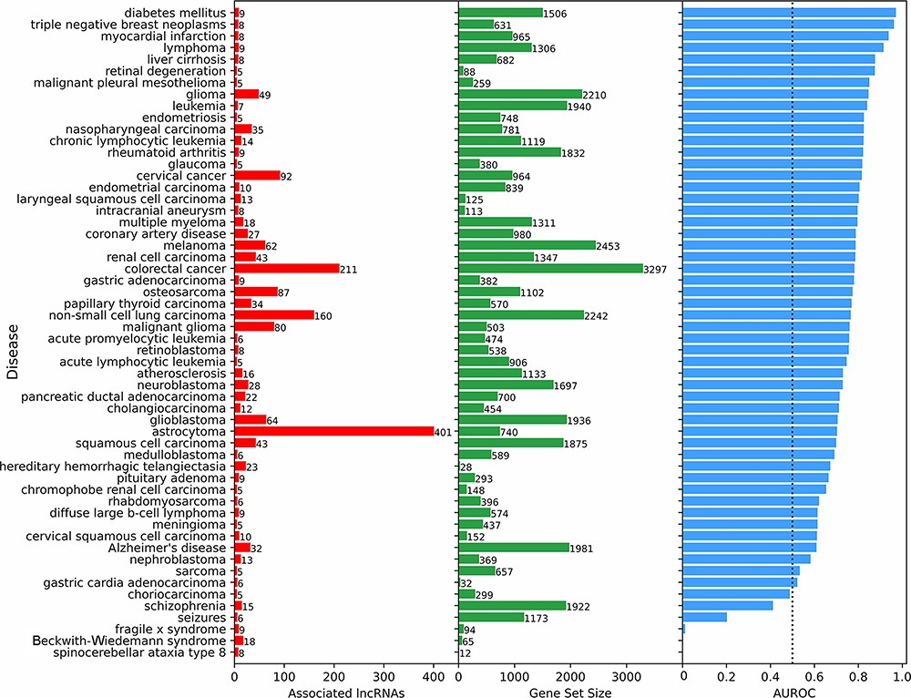
Figure 4. Predicting and evaluating the predictions of lncRNA–disease associations using gene–gene co-expression ...
Notes:
Figure 4. Predicting and evaluating the predictions of lncRNA–disease associations using gene–gene co-expression correlations. For each disease term from the DisGeNET gene-set library downloaded from Enrichr, the 18 705 human lncRNAs were ranked by their negative mean PCC with the corresponding gene set (bars at the center). The AUROC was calculated (bars at the right side of the plot) using the ranks of lncRNAs known to be associated with the same disease based on experimentally validated lncRNA–disease associations from LncRNADisease v2.0 (bars at the left side of the plot).
Unless provided in the caption above, the following copyright applies to the content of this slide: © The Author(s) 2023. Published by Oxford University Press.This is an Open Access article distributed under the terms of the Creative Commons Attribution License (https://creativecommons.org/licenses/by/4.0/), which permits unrestricted reuse, distribution, and reproduction in any medium, provided the original work is properly cited.

