Slide 1
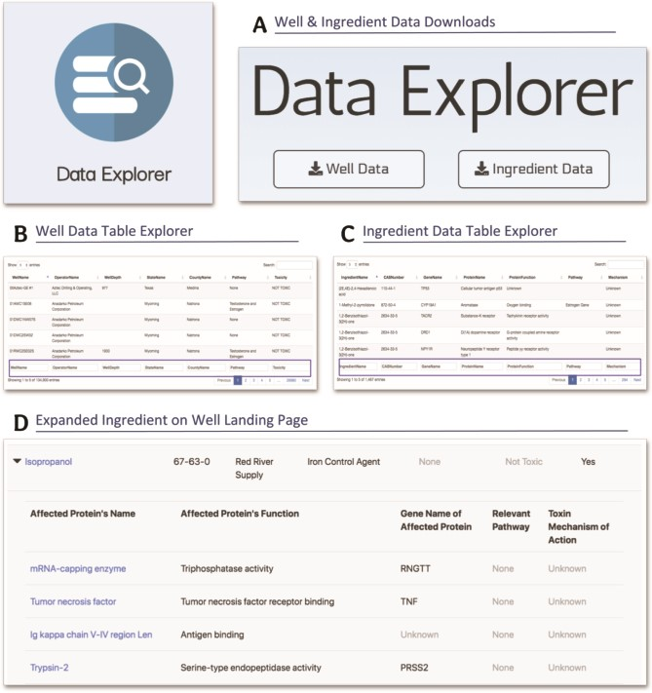
Figure 5 Screenshots from the Data Explorer and well landing pages detailing the download capabilities, data tables ...
Notes:
Figure 5 Screenshots from the Data Explorer and well landing pages detailing the download capabilities, data tables and specific, in-depth information available on these pages. (A) The data download buttons for the well and ingredient data. (B) The well data table explorer with search and sort functionality. (C) The ingredient data table explorer with search and sort functionality. (D) The expanded isopropanol ingredient on the well landing page, displaying the genes, proteins and biological pathways affected by this ingredient. We created the Data Explorer page and the expanded ingredients feature of the well landing page with a more research-purposed and knowledgeable audience in mind.
Unless provided in the caption above, the following copyright applies to the content of this slide: © The Author(s) 2020. Published by Oxford University Press.This is an Open Access article distributed under the terms of the Creative Commons Attribution License (http://creativecommons.org/licenses/by/4.0/), which permits unrestricted reuse, distribution, and reproduction in any medium, provided the original work is properly cited.

