Slide 1
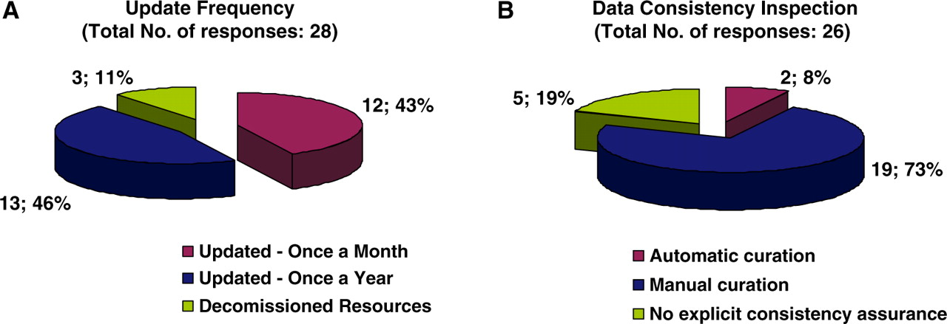
Figure 4. Pie charts representing the curatorial information for each biological database and resource. Forty-three ...
Notes:
Figure 4. Pie charts representing the curatorial information for each biological database and resource. Forty-three percent of resources are updated on a monthly basis, 46% annually and the remaining 11% corresponds to resources that have become decommissioned (A). Seventy-three percent of resources are curated manually, 8% use an automatic curation system, and 19% of resources have no explicit way of assuring data consistency with regard to the displayed information (B).
Unless provided in the caption above, the following copyright applies to the content of this slide: © The Author(s) 2010. Published by Oxford University Press.This is Open Access article distributed under the terms of the Creative Commons Attribution Non-Commercial License (http://creativecommons.org/licenses/by-nc/2.5), which permits unrestricted non-commercial use, distribution, and reproduction in any medium, provided the original work is properly cited.

