Slide 1
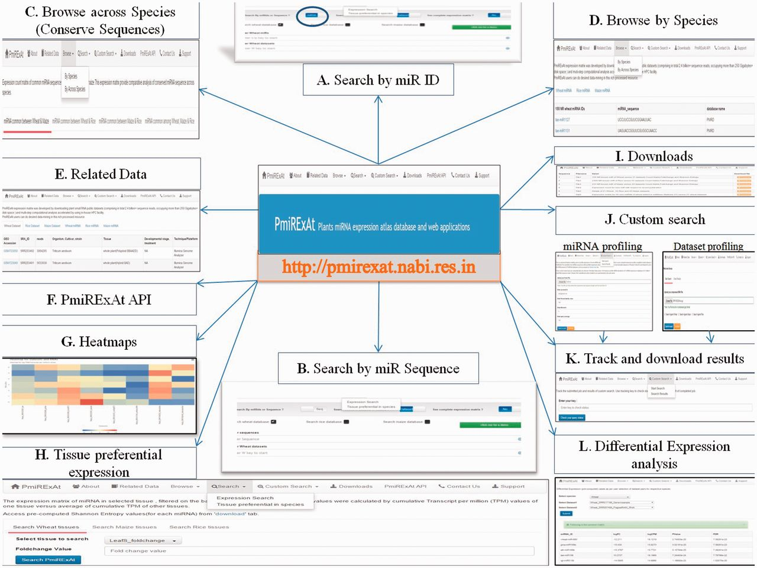
Figure 4. PmiRExAt features (web screen shots). (A) Search by miR ID: meant to search a miR expression by providing the ...
Notes:
Figure 4. PmiRExAt features (web screen shots). (A) Search by miR ID: meant to search a miR expression by providing the miRNA Id. (B) Search by miRNA sequence: meant to search a miR expression by providing the miRNA sequence as available in miRBase (release 20, 21), PMRD, PNRD or as given in added publications. (C) Browse expression of conserved miRNA: sequences across wheat, rice and maize. (D) Browse expression of individual miRNA: in all datasets of particular species. (E) Related data: information of datasets and the miRNA sequences can be explored hereby using hyperlinks of miRNA and datasets. (F) PmiRExAt API: to use PmiRExAt API, user need to create a web service client in respective platform/language in which user want to use PmiRExAt API. (G) Heatmap: expression visualization is supported by heatmaps which is based on log TPM values. (H) Tissue preferential expression: the expression matrix of miRNA in selected tissue, filtered on the basis of fold change. (I) Download section: the pre-computed matrixes of all data and information of datasets can be downloaded here. (J) Custom search: this is a advanced feature enabling users to profile expression of novel miRNA against available 117 datasets or profile 73 plant species miRNA in user uploaded new dataset. (K) Job tracking: as user submit the job, system generates a key which is useful in tracking the job status and downloading the results. (L) DE analysis: search DE of miRNA by choosing dataset pair or browse DE between pair of control verses condition libraries.
Unless provided in the caption above, the following copyright applies to the content of this slide: © The Author(s) 2016. Published by Oxford University Press.This is an Open Access article distributed under the terms of the Creative Commons Attribution License (http://creativecommons.org/licenses/by/4.0/), which permits unrestricted reuse, distribution, and reproduction in any medium, provided the original work is properly cited.

