Slide 1
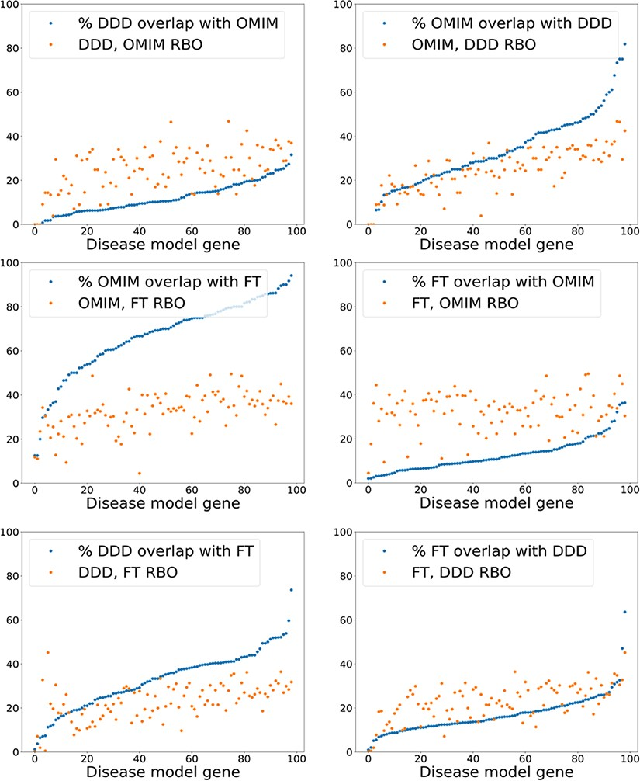
Figure 6. Exact model term overlap against RBO. For each pair of comparison models—A & B—the percentage of exact match ...
Notes:
Figure 6. Exact model term overlap against RBO. For each pair of comparison models—A & B—the percentage of exact match terms (A in B/A) is shown. The corresponding RBO similarity score for A & B is also plotted. RBO scores multiplied by 100 to normalize to percentage range. FT—full-text-derived.
Unless provided in the caption above, the following copyright applies to the content of this slide: © The Author(s) 2022. Published by Oxford University Press.This is an Open Access article distributed under the terms of the Creative Commons Attribution-NonCommercial License (https://creativecommons.org/licenses/by-nc/4.0/), which permits non-commercial re-use, distribution, and reproduction in any medium, provided the original work is properly cited. For commercial re-use, please contact journals.permissions@oup.com

