Slide 1
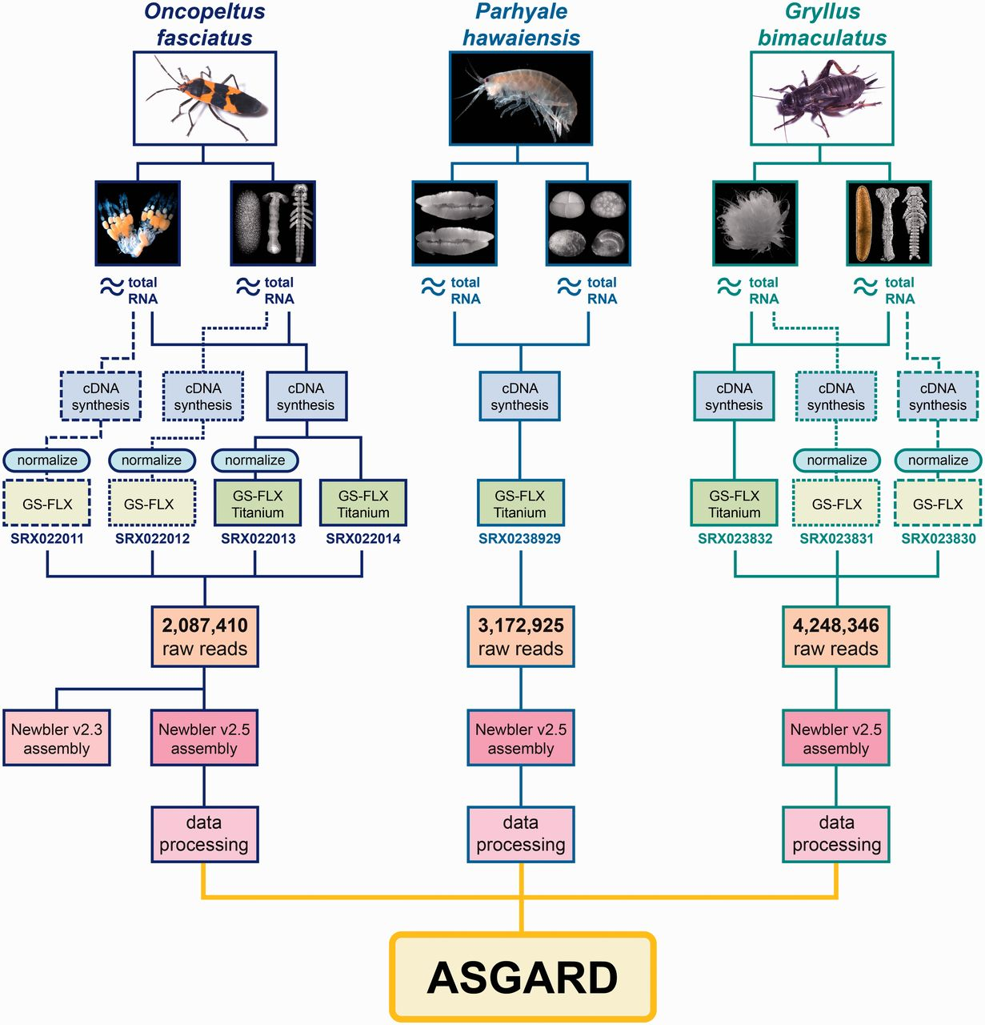
Figure 1 Origin and processing of data contained in ASGARD. Flowchart showing adult specimens and tissue types ...
Notes:
Figure 1 Origin and processing of data contained in ASGARD. Flowchart showing adult specimens and tissue types obtained for ASGARD v1.0 organisms O. fasciatus, P. hawaiensis and G. bimaculatus. Total RNA was prepared separately from ovaries and mixed-stage embryos and used for cDNA synthesis. For insect samples, some libraries were normalized in pilot experiments and sequenced using GS-FLX 454 pyrosequencing. The majority of reads used in the de novo assemblies were obtained using GS-FLX Titanium 454 pyrosequencing. SRA accession numbers are shown for each sequenced sample. Reads from each organism were pooled, assembled with Newbler v2.5 and annotated using the data processing pipeline described in the main text. The resulting data are searchable via the ASGARD web interface.
Unless provided in the caption above, the following copyright applies to the content of this slide: © The Author(s) 2012. Published by Oxford University Press.This is an Open Access article distributed under the terms of the Creative Commons Attribution License (http://creativecommons.org/licenses/by-nc/3.0/), which permits non-commercial reuse, distribution, and reproduction in any medium, provided the original work is properly cited. For commercial re-use, please contact journals.permissions@oup.com.

Slide 2
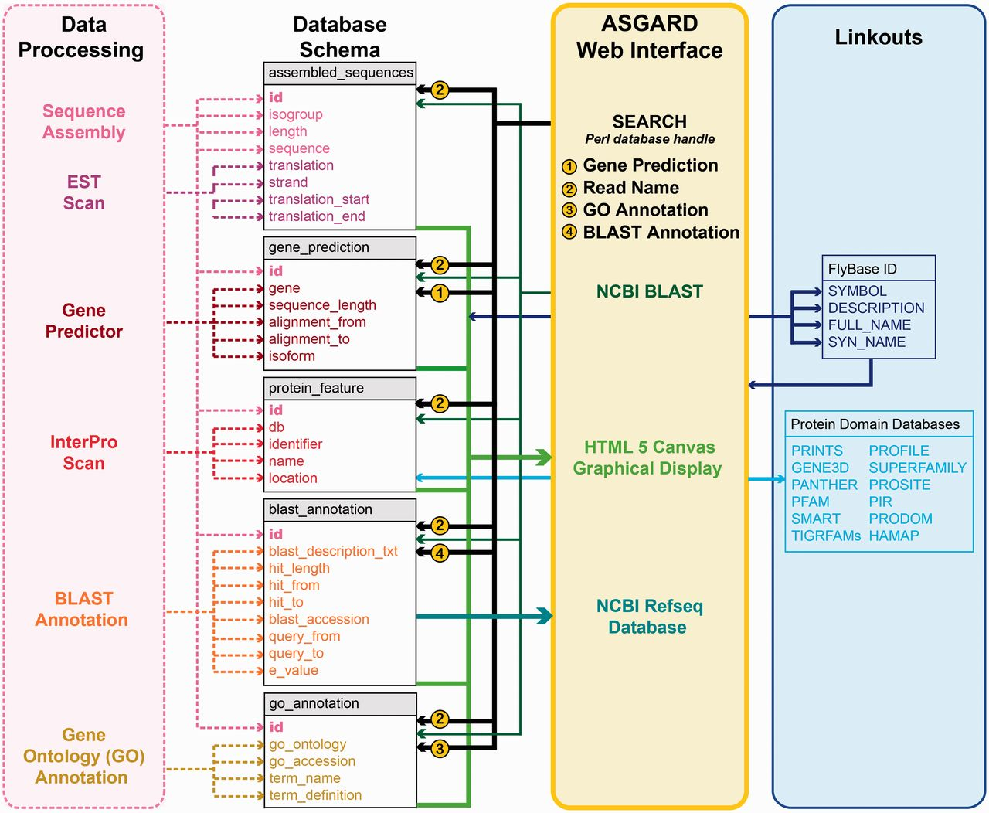
Figure 2 ASGARD database schema. Schematic of database implementation showing destination tables (gray/white) for each ...
Notes:
Figure 2 ASGARD database schema. Schematic of database implementation showing destination tables (gray/white) for each data type created by the data processing pipeline (pink), how users may access those data via the ASGARD web interface (yellow) and sources of linkout data provided by the ASGARD search results displays (blue). See main text for details.
Unless provided in the caption above, the following copyright applies to the content of this slide: © The Author(s) 2012. Published by Oxford University Press.This is an Open Access article distributed under the terms of the Creative Commons Attribution License (http://creativecommons.org/licenses/by-nc/3.0/), which permits non-commercial reuse, distribution, and reproduction in any medium, provided the original work is properly cited. For commercial re-use, please contact journals.permissions@oup.com.

Slide 3
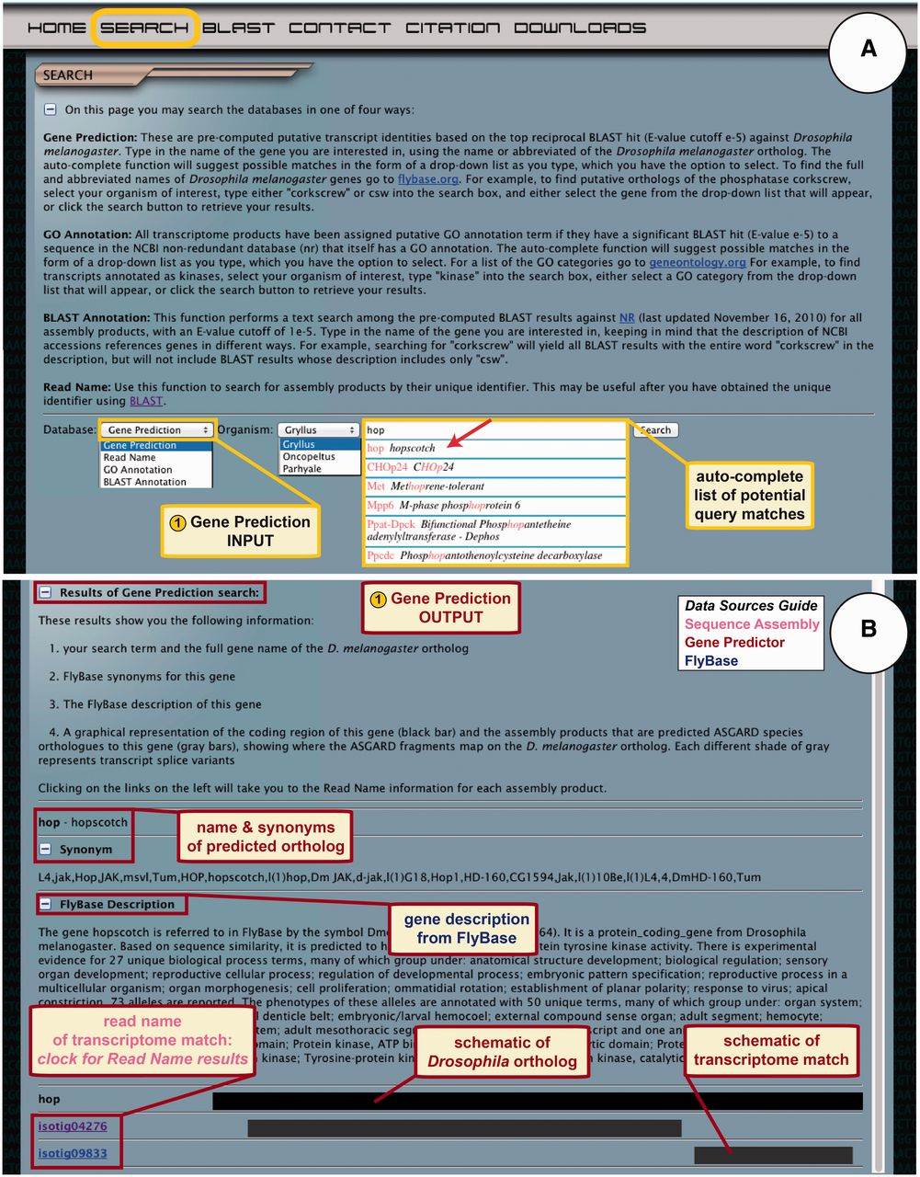
Figure 3 ASGARD Gene Prediction search. The search page gives users access to the Gene Prediction, Read Name, GO ...
Notes:
Figure 3 ASGARD Gene Prediction search. The search page gives users access to the Gene Prediction, Read Name, GO Annotation and BLAST Annotation search functions. (A) The input user interface allows users to choose an organism of interest and enter query terms based on D. melanogaster gene names. While entering the search term, users are assisted by an auto-completed list of suggested matching gene names. In this example, a user searching for G. bimaculatus orthologs of Janus kinase (JAK) has begun to enter the name of the D. melanogaster JAK ortholog ‘hopscotch’, which obtained an exact match in the auto-completion list (arrow). (B) The output of the gene prediction search shows predicted ortholog matches, a description of the D. melanogaster gene, schematic representations of and links to matching assembly products.
Unless provided in the caption above, the following copyright applies to the content of this slide: © The Author(s) 2012. Published by Oxford University Press.This is an Open Access article distributed under the terms of the Creative Commons Attribution License (http://creativecommons.org/licenses/by-nc/3.0/), which permits non-commercial reuse, distribution, and reproduction in any medium, provided the original work is properly cited. For commercial re-use, please contact journals.permissions@oup.com.

Slide 4
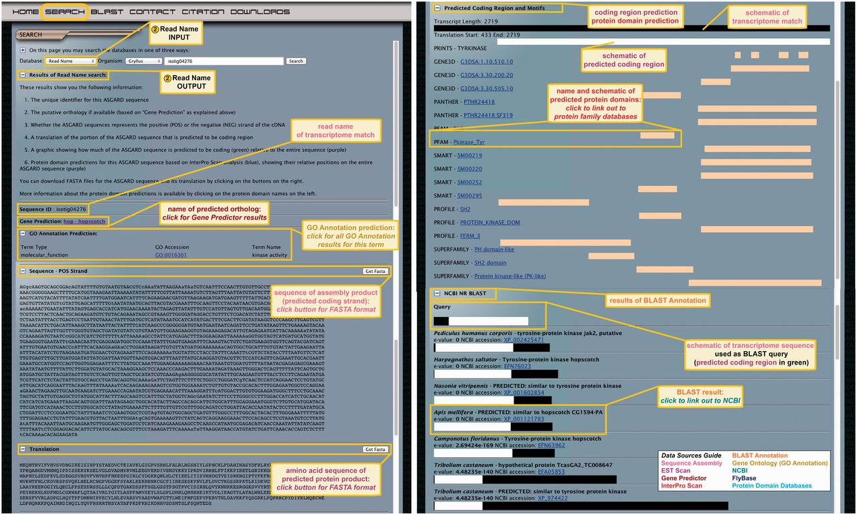
Figure 4 ASGARD Read Name search. The input user interface allows users to enter an assembly product (isotig or ...
Notes:
Figure 4 ASGARD Read Name search. The input user interface allows users to enter an assembly product (isotig or singleton) unique identifier (read name) obtained with any of the other search methods (Figures 3 and 5–7). In this example, read name isotig04276 was obtained in a Gene Prediction search (Figure 3) as a putative G. bimaculatus JAK ortholog. The output of read name searches provides all annotation data for the selected assembly product.
Unless provided in the caption above, the following copyright applies to the content of this slide: © The Author(s) 2012. Published by Oxford University Press.This is an Open Access article distributed under the terms of the Creative Commons Attribution License (http://creativecommons.org/licenses/by-nc/3.0/), which permits non-commercial reuse, distribution, and reproduction in any medium, provided the original work is properly cited. For commercial re-use, please contact journals.permissions@oup.com.

Slide 5
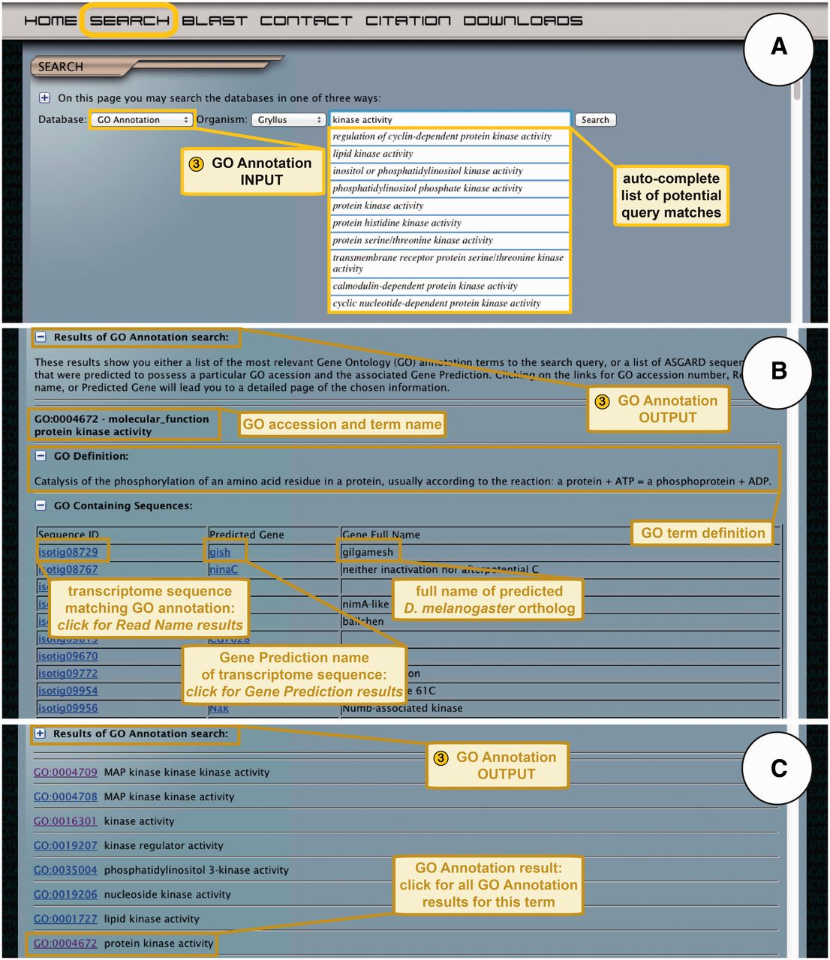
Figure 5 ASGARD GO Annotation search. (A) The input user interface allows users to choose an organism of interest and ...
Notes:
Figure 5 ASGARD GO Annotation search. (A) The input user interface allows users to choose an organism of interest and enter GO term queries, where they are assisted by an auto-completed list of suggested matching GO terms. In this example, a user searching for G. bimaculatus protein kinases enters the query ‘kinase activity’ into the search box. (B) The output of GO annotation searches based on user-defined queries yields a list of transcriptome sequences that map to the chosen GO term, with links to the read name searches for each sequence. This example shows results obtained by using ‘kinase activity’ as a query. (C) The output of GO annotation searches based on selection of auto-completion menu items yields a list of matching GO terms assigned to transcriptome sequences from the chosen organism, with links to all transcriptome sequences assigned to a given GO term. The example shows results obtained by selecting the GO term ‘protein kinase activity’ from the drop-down auto-completion suggestions shown in (A).
Unless provided in the caption above, the following copyright applies to the content of this slide: © The Author(s) 2012. Published by Oxford University Press.This is an Open Access article distributed under the terms of the Creative Commons Attribution License (http://creativecommons.org/licenses/by-nc/3.0/), which permits non-commercial reuse, distribution, and reproduction in any medium, provided the original work is properly cited. For commercial re-use, please contact journals.permissions@oup.com.

Slide 6
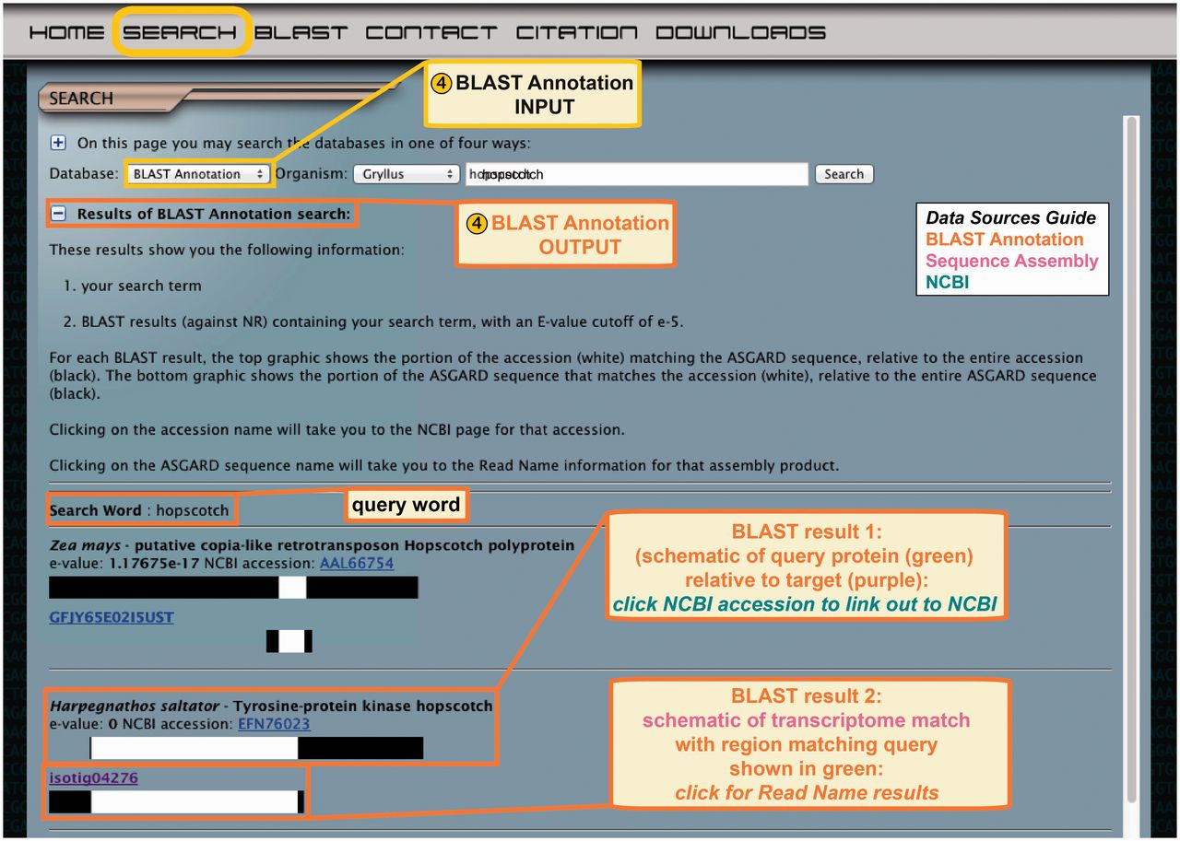
Figure 6 ASGARD BLAST Annotation search. Top: the input user interface allows users to select an organism of interest ...
Notes:
Figure 6 ASGARD BLAST Annotation search. Top: the input user interface allows users to select an organism of interest and enter queries based on gene names from any organism. This example shows what a user might enter to search for G. bimaculatus transcripts similar to JAK orthologs from any organism in nr. Bottom: the output of this search lists BLAST hits against nr whose text descriptions contain the search term, with links to the NCBI accession for each hit, schematic representations of matching transcriptome sequences and links to read name data.
Unless provided in the caption above, the following copyright applies to the content of this slide: © The Author(s) 2012. Published by Oxford University Press.This is an Open Access article distributed under the terms of the Creative Commons Attribution License (http://creativecommons.org/licenses/by-nc/3.0/), which permits non-commercial reuse, distribution, and reproduction in any medium, provided the original work is properly cited. For commercial re-use, please contact journals.permissions@oup.com.

Slide 7
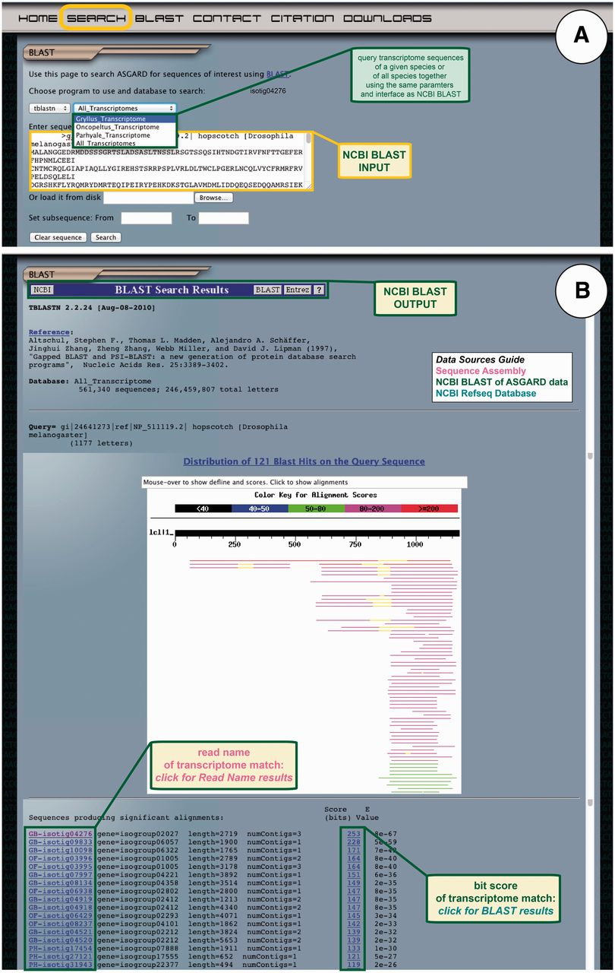
Figure 7 ASGARD NCBI BLAST search. The BLAST page gives users access to the embedded NCBI BLAST function to query ...
Notes:
Figure 7 ASGARD NCBI BLAST search. The BLAST page gives users access to the embedded NCBI BLAST function to query transcriptome sequences with a nucleotide or protein sequence of interest. (A) The input user interface allows users to compare the sequence of any gene of interest to the transcriptome sequences from one or all ASGARD organisms using BLAST. In this example, a user chooses the tBLASTn algorithm to search for G. bimaculatus sequences similar to the D. melanogaster JAK ortholog ‘hopscotch’ by using NCBI accession NP_511119 as a query. (B) The output of this search is transcriptome sequences formatted as for the NCBI BLAST algorithm (97). For each match, the unique identifier links to read name data and the bit score links to the BLAST alignment result. Read names in this output are assigned a prefix identifying the species from which the assembly product derives: GB = Gryllus bimaculatus, OF = Oncopeltus fasciatus, PH = Parhyale hawaiensis. This example shows results of the search for JAK-like G. bimaculatus sequences described in (A).
Unless provided in the caption above, the following copyright applies to the content of this slide: © The Author(s) 2012. Published by Oxford University Press.This is an Open Access article distributed under the terms of the Creative Commons Attribution License (http://creativecommons.org/licenses/by-nc/3.0/), which permits non-commercial reuse, distribution, and reproduction in any medium, provided the original work is properly cited. For commercial re-use, please contact journals.permissions@oup.com.

