Slide 1
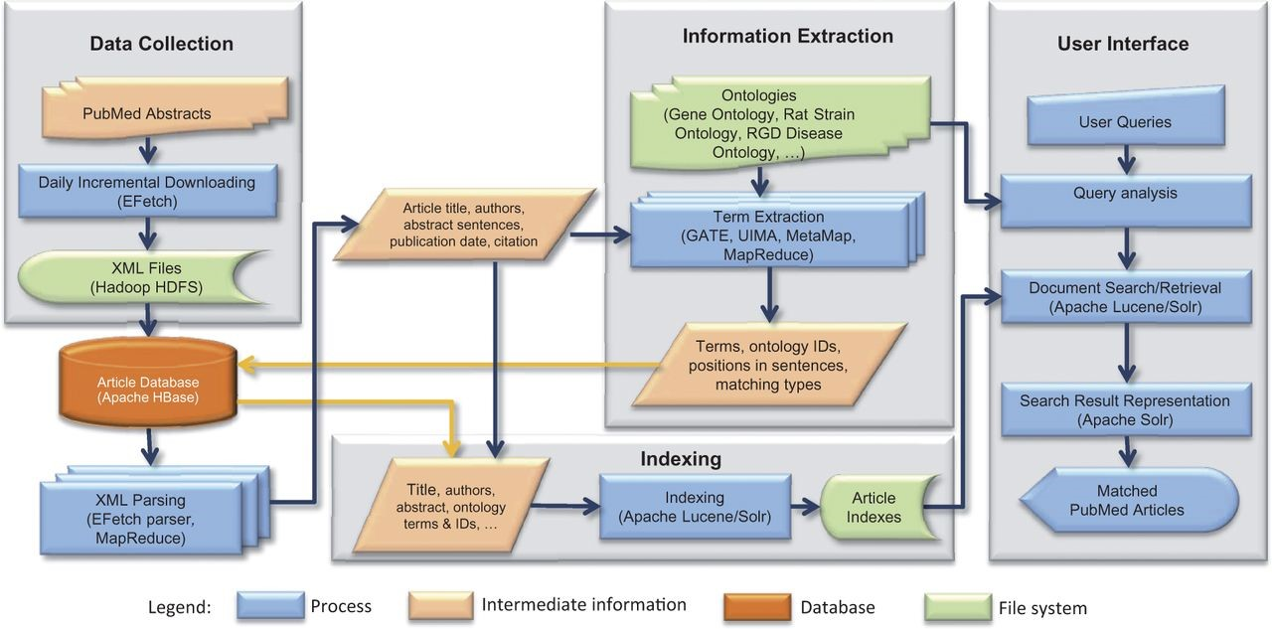
Figure 1. OntoMate system architecture. The basic system consists of data collection, article database, information ...
Notes:
Figure 1. OntoMate system architecture. The basic system consists of data collection, article database, information extraction and information retrieval (indexing and user interface). User interface can be adapted for different applications.
Unless provided in the caption above, the following copyright applies to the content of this slide: © The Author(s) 2015. Published by Oxford University Press.This is an Open Access article distributed under the terms of the Creative Commons Attribution License (http://creativecommons.org/licenses/by/4.0/), which permits unrestricted reuse, distribution, and reproduction in any medium, provided the original work is properly cited.

Slide 2
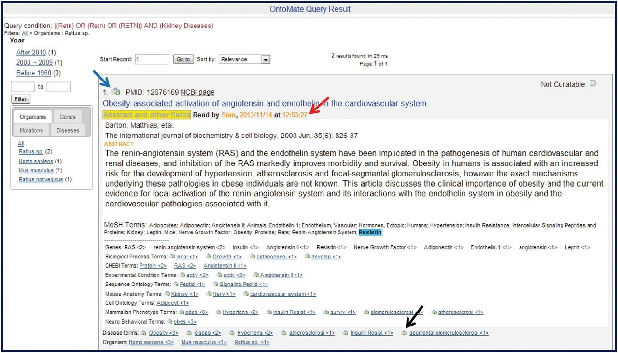
Figure 4. Sample OntoMate abstract entry. The abstract has been opened by clicking on the ‘Abstract and other fields’ ...
Notes:
Figure 4. Sample OntoMate abstract entry. The abstract has been opened by clicking on the ‘Abstract and other fields’ button underneath the title. A ‘Read by’ (red arrow) note shows that the abstract has been accessed by another user sometime before. The abstract can be entered into the main RGD database and into the curation tool interface by clicking on the bucket icon (blue arrow) above the title. Any of the hyperlinked terms can be placed in the curation tool term bucket by clicking the bucket icon (example at black arrow) to the left of the appropriate term. Terms may also be displayed in the term browser in the curation tool interface by clicking the hyperlinked term. Corresponding terms in the abstract are highlighted if the user ‘mouses over’ any of the terms listed below the abstract.
Unless provided in the caption above, the following copyright applies to the content of this slide: © The Author(s) 2015. Published by Oxford University Press.This is an Open Access article distributed under the terms of the Creative Commons Attribution License (http://creativecommons.org/licenses/by/4.0/), which permits unrestricted reuse, distribution, and reproduction in any medium, provided the original work is properly cited.

Slide 3
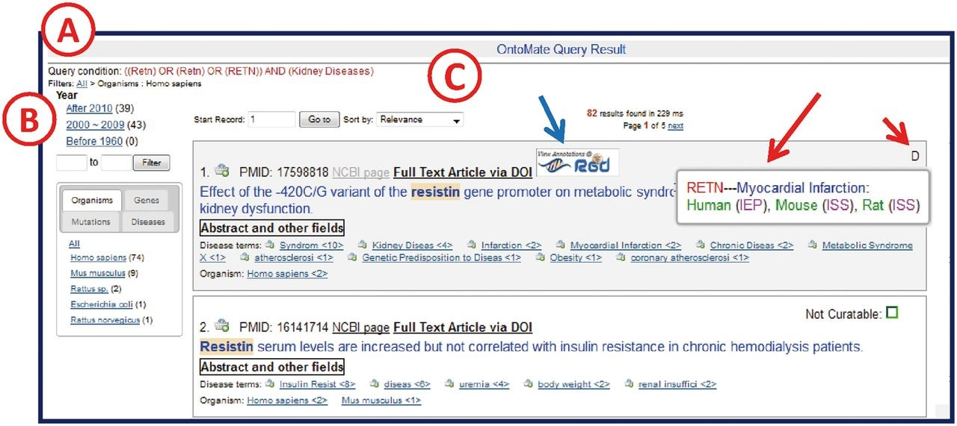
Figure 3. OntoMate query results page. ( A ) ‘Query Condition’ displays the string of objects and terms used in the ...
Notes:
Figure 3. OntoMate query results page. ( A ) ‘Query Condition’ displays the string of objects and terms used in the query. ( B ) The filter section allows users to adjust the results according to publication chronology or object/term refinements. The tabs display hyperlinked subsets of result categories. Any link may be selected to restrict or expand the selected results. A ‘filter path’ appears below the Query Condition to show the user what filters have been applied. ( C ) The search results are sorted by relevance by default, but can also be sorted by publication date or PMID. If the reference is in RGD already, an RGD logo appears (blue arrow) above the title. If there are any GO or disease vocabulary annotations from this reference, an aspect initial appears in the upper right corner of the reference entry (short red arrow, D = disease). By ‘mousing over’ the aspect letter, a pop-up appears to show what annotation(s) has been made (long red arrow).
Unless provided in the caption above, the following copyright applies to the content of this slide: © The Author(s) 2015. Published by Oxford University Press.This is an Open Access article distributed under the terms of the Creative Commons Attribution License (http://creativecommons.org/licenses/by/4.0/), which permits unrestricted reuse, distribution, and reproduction in any medium, provided the original work is properly cited.

Slide 4
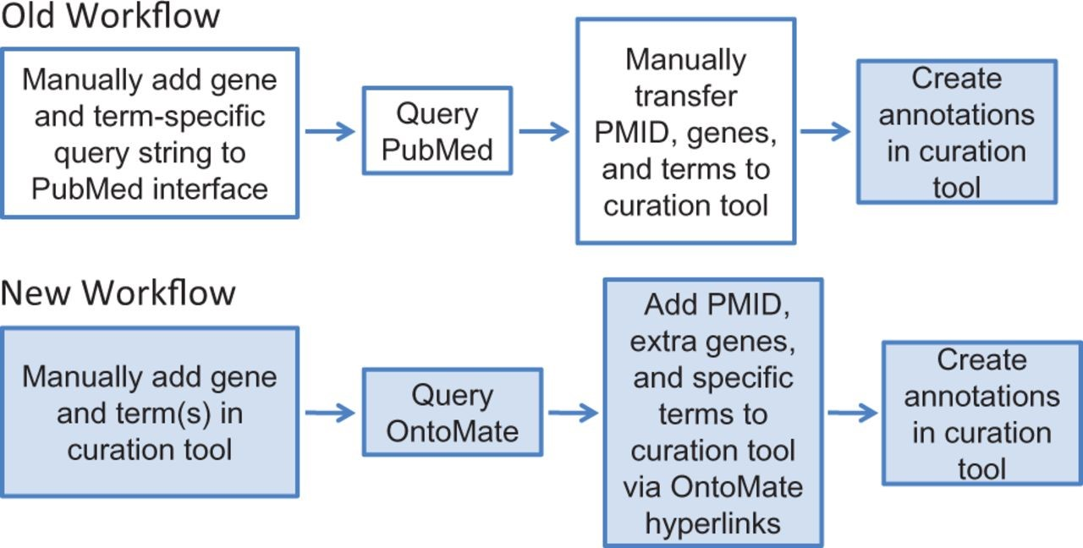
Figure 2. RGD’s old and new workflows for manual gene curation. White boxes represent tasks involving the PubMed ...
Notes:
Figure 2. RGD’s old and new workflows for manual gene curation. White boxes represent tasks involving the PubMed interface and colored boxes represent processes done in the RGD curation tool interface. The new workflow has reduced the processes of the old workflow from two interfaces to one interface.
Unless provided in the caption above, the following copyright applies to the content of this slide: © The Author(s) 2015. Published by Oxford University Press.This is an Open Access article distributed under the terms of the Creative Commons Attribution License (http://creativecommons.org/licenses/by/4.0/), which permits unrestricted reuse, distribution, and reproduction in any medium, provided the original work is properly cited.

