Slide 1
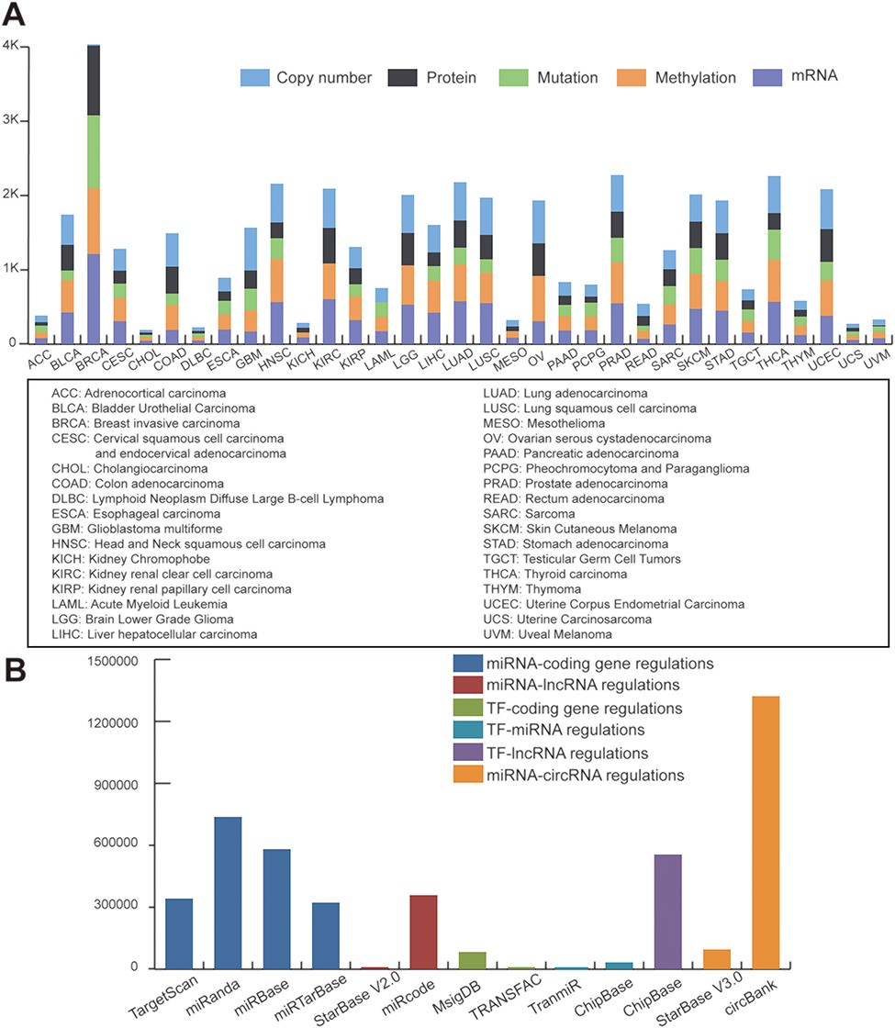
Figure 1 Statistics of data sources. (A) Statistics of TCGA multi-omic datasets across pan-cancer. (B) Statistics of ...
Notes:
Figure 1 Statistics of data sources. (A) Statistics of TCGA multi-omic datasets across pan-cancer. (B) Statistics of regulatory patterns derived from databases.
Unless provided in the caption above, the following copyright applies to the content of this slide: © The Author(s) 2019. Published by Oxford University Press.This is an Open Access article distributed under the terms of the Creative Commons Attribution License (http://creativecommons.org/licenses/by/4.0/), which permits unrestricted reuse, distribution, and reproduction in any medium, provided the original work is properly cited.

Slide 2
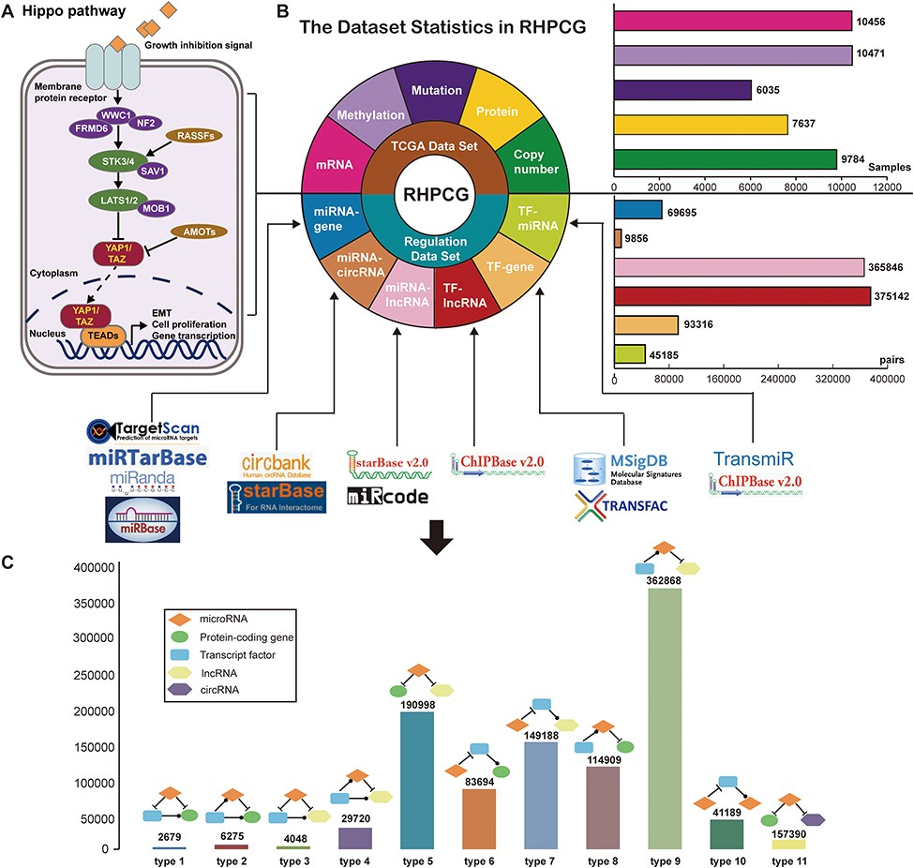
Figure 2 Flow chart of the RHPCG database. (A) Core genes in the Hippo signaling pathway. (B) Dataset statistics in ...
Notes:
Figure 2 Flow chart of the RHPCG database. (A) Core genes in the Hippo signaling pathway. (B) Dataset statistics in RHPCG. (C) Statistics of regulatory motifs in RHPCG.
Unless provided in the caption above, the following copyright applies to the content of this slide: © The Author(s) 2019. Published by Oxford University Press.This is an Open Access article distributed under the terms of the Creative Commons Attribution License (http://creativecommons.org/licenses/by/4.0/), which permits unrestricted reuse, distribution, and reproduction in any medium, provided the original work is properly cited.

Slide 3
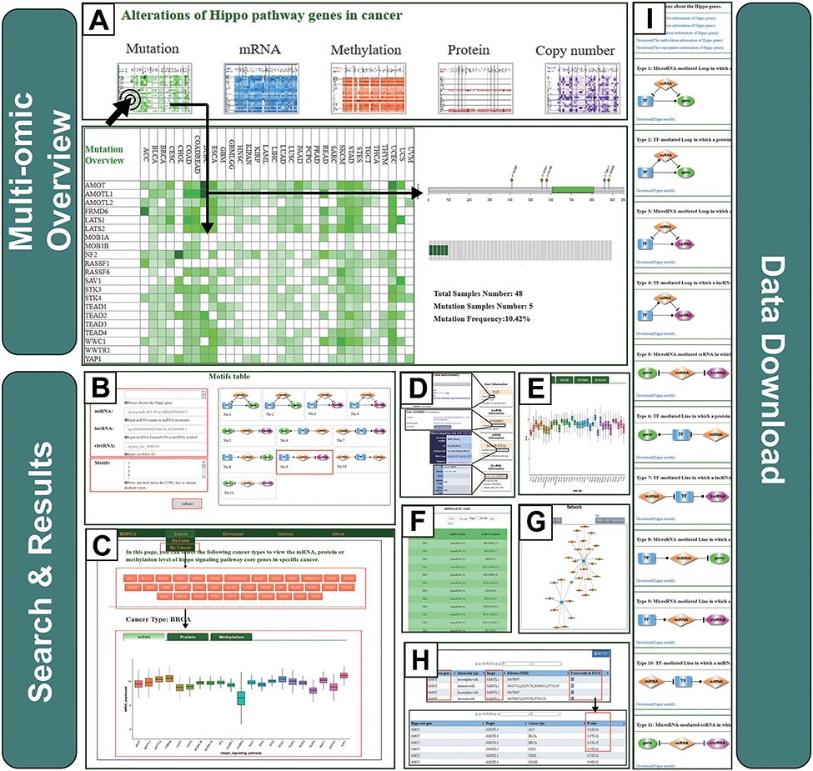
Figure 3 Operating instructions of the RHPCG database. (A) Overview of the multi-omics interface of RHPCG. (B) Search ...
Notes:
Figure 3 Operating instructions of the RHPCG database. (A) Overview of the multi-omics interface of RHPCG. (B) Search by gene section. (C) Search by cancer section. (D) Information box. (E) Multi-omics visualization section. (F) Table of motif results. (G) Network of motifs. (H) Potential targets of the Hippo signaling pathway. (I) Download page of RHPCG.
Unless provided in the caption above, the following copyright applies to the content of this slide: © The Author(s) 2019. Published by Oxford University Press.This is an Open Access article distributed under the terms of the Creative Commons Attribution License (http://creativecommons.org/licenses/by/4.0/), which permits unrestricted reuse, distribution, and reproduction in any medium, provided the original work is properly cited.

Slide 4
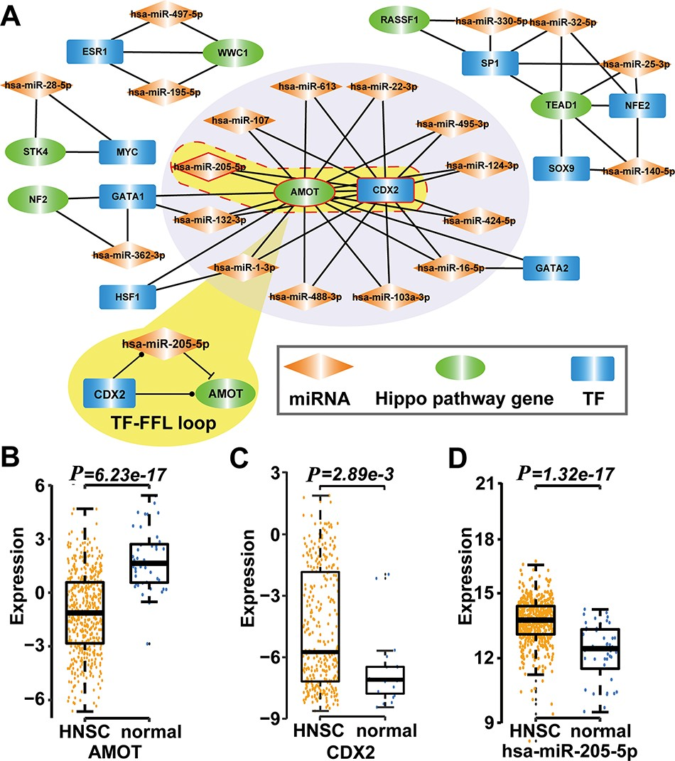
Figure 4 Type 2 motif (FFLs) subnetworks predicted by RHPCG. (A) Both AMOT and CDX2 are hubs in the type 2 motif ...
Notes:
Figure 4 Type 2 motif (FFLs) subnetworks predicted by RHPCG. (A) Both AMOT and CDX2 are hubs in the type 2 motif (FFLs) subnetworks. (B–D) Box plot of expression of molecules in healthy and patients with HNSC.
Unless provided in the caption above, the following copyright applies to the content of this slide: © The Author(s) 2019. Published by Oxford University Press.This is an Open Access article distributed under the terms of the Creative Commons Attribution License (http://creativecommons.org/licenses/by/4.0/), which permits unrestricted reuse, distribution, and reproduction in any medium, provided the original work is properly cited.

