Slide 1
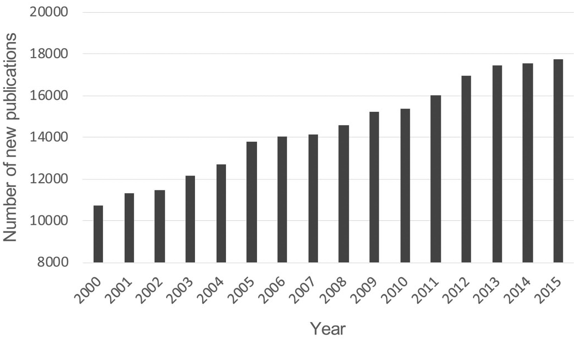
Figure 1. Number of new publications for immunosuppression from 2000 to 2015. The retrieval was performed using the ...
Notes:
Figure 1. Number of new publications for immunosuppression from 2000 to 2015. The retrieval was performed using the keyword of ‘immunosuppression’ or ‘immunosuppressive’ in PubMed (https://www.ncbi.nlm.nih.gov/pubmed/).
Unless provided in the caption above, the following copyright applies to the content of this slide: © The Author(s) 2017. Published by Oxford University Press.This is an Open Access article distributed under the terms of the Creative Commons Attribution License (http://creativecommons.org/licenses/by/4.0/), which permits unrestricted reuse, distribution, and reproduction in any medium, provided the original work is properly cited.

