Slide 1
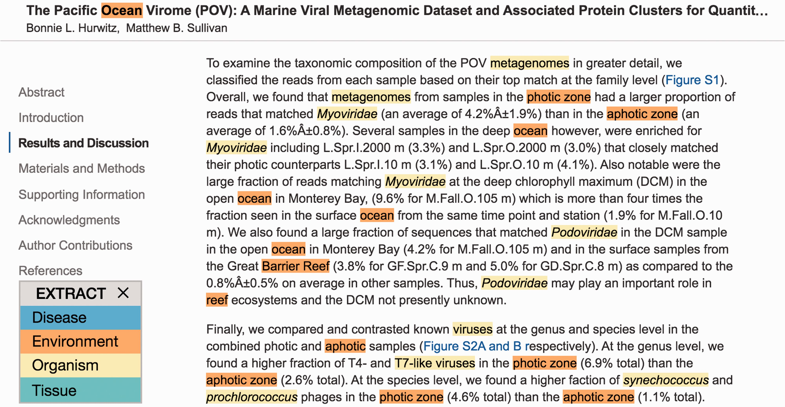
Figure 2. EXTRACT highlighting of terms. To quickly identify metadata-relevant pieces of text in a larger document, ...
Notes:
Figure 2. EXTRACT highlighting of terms. To quickly identify metadata-relevant pieces of text in a larger document, users may perform a full page tagging. The highlighted entities can indicate candidate segments for subsequent inspection and term extraction. As shown, identified organisms mentions are highlighted in yellow and environment descriptors in orange. The example shows an excerpt of reference ( 21 ).
Unless provided in the caption above, the following copyright applies to the content of this slide: © The Author(s) 2016. Published by Oxford University Press. This is an Open Access article distributed under the terms of the Creative Commons Attribution License ( http://creativecommons.org/licenses/by/4.0/ ), which permits unrestricted reuse, distribution, and reproduction in any medium, provided the original work is properly cited.

