Slide 1
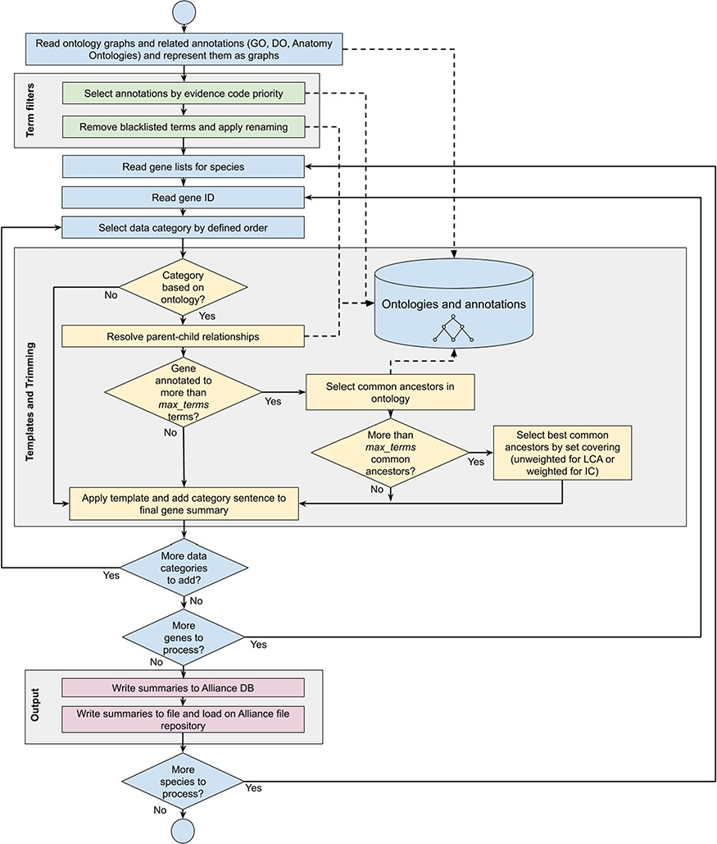
Figure 1 Workflow diagram of the gene summary generation process at the Alliance of Genome Resources. Solid arrows ...
Notes:
Figure 1 Workflow diagram of the gene summary generation process at the Alliance of Genome Resources. Solid arrows represent sequential steps followed by the software to generate the summaries, whereas dashed arrows represent data flow from/to the algorithm to data stores. Ontologies and annotations are loaded and represented as graphs. Then, term filters and renaming are applied to the annotations and to the ontology graphs. For each gene, basic information such as gene ID, name and additional information such as orthology data are fetched. The list of terms associated with the gene is extracted from the Alliance database and sentences are generated according to the templates defined for each data category. If the list of terms exceeds the defined maximum number, the trimming algorithm reduces the length of the sentence by traversing the related ontology graph and by selecting the common ancestors that best group the initial set of terms. Ontology graphs are also used to resolve parent–child relationships to avoid including both parent and child terms in the final summaries. The final summaries are generated by concatenating the data category specific sentences and are written to the Alliance database and to the download files available on the Alliance website.
Unless provided in the caption above, the following copyright applies to the content of this slide: © The Author(s) 2020. Published by Oxford University Press.This is an Open Access article distributed under the terms of the Creative Commons Attribution License (http://creativecommons.org/licenses/by/4.0/), which permits unrestricted reuse, distribution, and reproduction in any medium, provided the original work is properly cited.

Slide 2
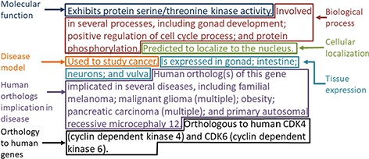
Figure 2 Example of the gene summary for the C. elegans gene cdk-4 with the different data categories highlighted in ...
Notes:
Figure 2 Example of the gene summary for the C. elegans gene cdk-4 with the different data categories highlighted in different boxes.
Unless provided in the caption above, the following copyright applies to the content of this slide: © The Author(s) 2020. Published by Oxford University Press.This is an Open Access article distributed under the terms of the Creative Commons Attribution License (http://creativecommons.org/licenses/by/4.0/), which permits unrestricted reuse, distribution, and reproduction in any medium, provided the original work is properly cited.

Slide 3
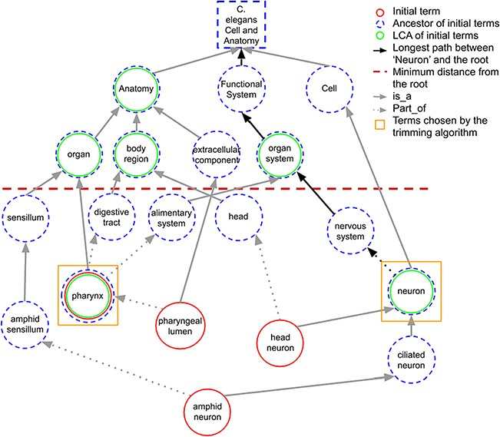
Figure 3 A portion of the C. elegans anatomy ontology graph (generated with the WB SObA tool; 33). Terms circled in ...
Notes:
Figure 3 A portion of the C. elegans anatomy ontology graph (generated with the WB SObA tool; 33). Terms circled in red (single solid circle) represent the initial set of annotated terms for the C. elegans gene abf-1. Dashed blue circles are the ancestors of the initial terms and green circles (double circle) are their respective LCAs in the ontology (excluding the root node). The terms pharynx and neuron (marked by yellow squares) are chosen by the trimming algorithm as they are the only LCAs at the predefined minimum distance from the root (depicted as a dashed horizontal line), which in this example is set to 3. Note that the distance of a term from the root is the length of the longest path between them, which is highlighted in the figure as an example for the term neuron.
Unless provided in the caption above, the following copyright applies to the content of this slide: © The Author(s) 2020. Published by Oxford University Press.This is an Open Access article distributed under the terms of the Creative Commons Attribution License (http://creativecommons.org/licenses/by/4.0/), which permits unrestricted reuse, distribution, and reproduction in any medium, provided the original work is properly cited.

Slide 4
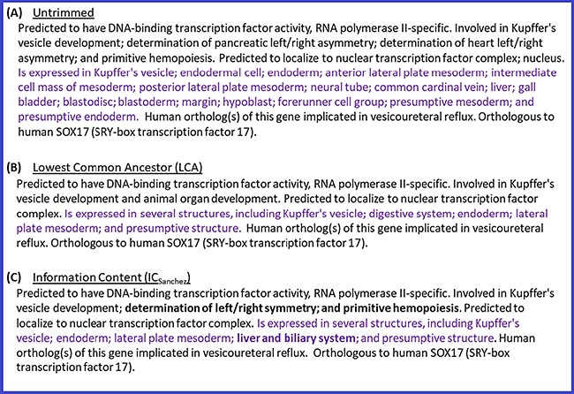
Figure 4 Untrimmed and trimmed summaries for the zebrafish gene sox17. (A) Untrimmed summary that shows all the 25 ...
Notes:
Figure 4 Untrimmed and trimmed summaries for the zebrafish gene sox17. (A) Untrimmed summary that shows all the 25 terms annotated to the gene. (B) The summary trimmed with the LCA-based algorithm. (C) The summary trimmed with the algorithm based on ICSanchez. Text highlighted in purple indicates the tissue expression data category, which has 17 terms in the untrimmed summary. Text in bold shows the difference between (B) and (C).
Unless provided in the caption above, the following copyright applies to the content of this slide: © The Author(s) 2020. Published by Oxford University Press.This is an Open Access article distributed under the terms of the Creative Commons Attribution License (http://creativecommons.org/licenses/by/4.0/), which permits unrestricted reuse, distribution, and reproduction in any medium, provided the original work is properly cited.

